Slide 1

Incremental-Composite Sampling (ICS) and XRF: Tools for Improved Soil Data
Deana Crumbling
USEPA Office of Superfund Remediation and Technology Innovation
Technology and Field Services Division
crumbling.deana@epa.gov 703-603-0643

Slide 2
Take-Away Points
The Problem: Soil data can mislead decision-makers about risk and cleanup!
Why? Common practice generates a concentration result from a few grams of soil and then assumes that tons of soil in the field have that same concentration.
This presentation will show:
“Representativeness” for soil samples is only meaningful in terms of a sample, or a set of samples, that provide an average over some defined soil mass.
“Sample representativeness” does not exist until the RPM defines for a specific sampling event what field soil volume and particle size a soil sample is supposed to represent.
A defined field soil volume/mass is called a Decision Unit (DU), and DUs must be described in the QAPP/FSP.
Notes:
Using incremental and/or composite sampling vastly improves the representativeness of soil or sediment data. Why can I make that claim?

Slide 3
Soil Sampling Is NOT Simple
Effect of short-scale, between-sample heterogeneity
A grab field sample does not represent the field concentration
Misleading data possible if decision based on 1 grab sample
Remedy: In the field, use large discrete data sets or many-increment composites, use QC checks on sampling design
Effect of micro-scale, within-sample heterogeneity
A grab analytical subsample does not represent the sample
Misleading data possible if decision is based on 1 grab subsample
Remedy: In the laboratory, isolate target soil particle size, avoid sample segregation errors, match subsample mass to sample particle size, form subsample from many increments
Notes:
Using incremental and/or composite sampling vastly improves the representativeness of soil or sediment data. Why can I make that claim?

Slide 4
Tools for Reliable Soil Data Are Available
Incremental-composite sampling (ICS) addresses:
Short-scale heterogeneity by collecting many field increments
Micro-scale heterogeneity by specialized sample processing and subsampling procedures
X-ray fluorescence (XRF) instruments
ICS + real-time XRF data = powerful, efficient sampling designs
XRF can guide real-time, in-field choice of increment number, set DU boundaries & evaluate sample processing
Proper XRF application requires sufficient QC and documentation
XRF & ICP comparisons usually done incorrectly
Notes:
Using incremental and/or composite sampling vastly improves the representativeness of soil or sediment data. Why can I make that claim?

Slide 5
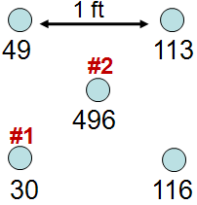
Short-Scale Heterogeneity
Differences in concentration at the scale of collocated field QC samples (inches to a few feet)
Collocated samples are considered equivalent, but very different results are common
If decision is based on a single grab sample, chance (“the luck of the grab”) may determine outcome
Decisions that are based on single samples:
“Hot spot” presence/absence
Drawing concentration contour lines
Set of collocated samples for uranium (mg/kg)
1 ft apart over 4 ft
As 129 221 61 39 14
Arsenic in a residential yard transect (mg/kg)
Notes:
5
The same principles apply to short-scale sampling error. Recall that this refers to extrapolating a single data point to a large field area without taking heterogeneity into account. Taking the whole targeted soil volume as a single sample for analysis would provide THE concentration for that volume without any sampling error. Of course, that’s not possible. That’s why we take samples. The trick is to have enough samples to capture field heterogeneity without breaking the bank. This can be done by taking increments of soil from many locations and pooling them together for a single analysis. This both increases sampling density of the area AND increases the sample support of the field sample—both of which help control sampling error. When increments are pooled for this purpose, it’s called incremental sampling.

Slide 6


Very Short Short-Scale Heterogeneity
Figure: 21 separate ~½-1-gram samples (~16 g total) within a 4-inch diameter circle with ½-in depth (analyzed by ICP)
Assumed mean for the 160 g in the 6.5-cu.in. volume = 1994 ppm
560
1010, 1125
305
343
295
11,900
8690
9575
2”
900, 995 ,1800
~½-1-gram soil samples
1 cm apart
367
305
360
540, 650, 390
510, 720, 589
Could be an issue for XRF!
Notes:
Joanna Becker, Perdue Univ. PhD thesis, 2005, Centimeter scale analysis of soil heterogeneities within a long-term, heavy metal contaminated site.
Becker, Joanna M., T. Parkin, C.H. Nakatsu, J.D. Wilbur and A. Konopka (2006) Bacterial Activity, Community Structure, and Centimeter-Scale Spatial Heterogeneity in Contaminated Soil. Microbial Ecology Vol. 51, 220-231.
Mass of soil in 4-inch circle (to ½-inch depth) = 160 g (assuming soil density of 1.5 g/cubic cm)

Slide 7
A Grab Sample is “Representative” of …?
…its own mass.
Do you make decisions at the scale of 100 grams?
Is there evidence that a jar represents a larger field volume?
“Sampling uncertainty”: Unmanaged heterogeneity raises the question of whether the sample’s concentration is the same as (i.e., represents) the concentration of a larger mass.
Think about the typical dimensions for the soil you make decisions about…
…the concentration for that mass is what you need to know.

Slide 8
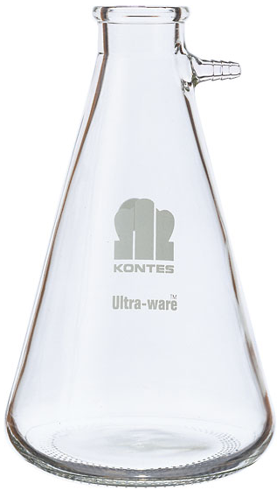
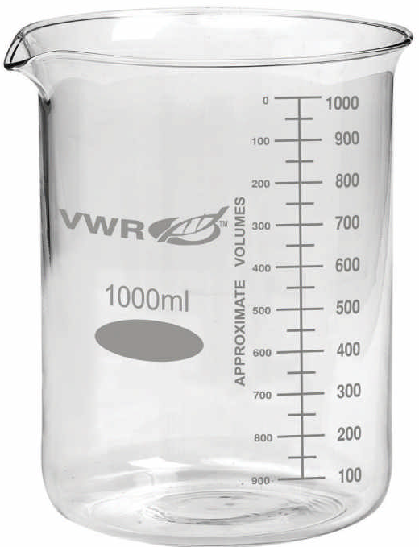
A Thought Experiment
A unit of soil for which a decision needs
to be made (a decision unit, DU)
30 sq. yd. area x 1 in. deep
~1 cu. yd. volume
~1 ton of soil
GIANT digestion vessel
Provides 1 analytical result that represents the true conc of the 1 ton of soil
(There is no sampling uncertainty)
GIANT flask of digestion acid
Notes:
If the entire DU could be analyzed in a single giant analysis, there would be no uncertainty about the true Pb concentration. Note that this process would produce a result that represents a giant composite of all soil particles in the DU.

Slide 9
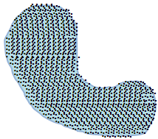
Alternative: Divvy the Whole Mass into Analytical Samples
Analyze entire 1-ton mass as 1-gram analytical samples ( )
n = 1.4 x 10⁶ samples & analyses = the statistical “population”
.
Take the 1.4 million data results & calculate their average = true conc for the 1-ton soil mass.
(Since the entire population of 1-gram samples is analyzed, there is no sampling uncertainty)
Notes:
Assume no analytical error.

Slide 10
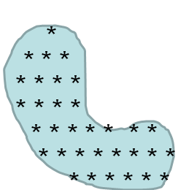
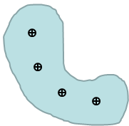
Real World: Only a Fraction of the Population Can be Analyzed, so Sampling is Required
“Representative”: the sample result, or the average of multiple samples, is close enough to the true concentration so that decisions are correct
A
B
*
= increment (n = 33) for 1 incremental sample (1 analysis)
(Is sampling uncertainty present?)
= discrete sample (4 samples for 4 analyses) Is there sampling uncertainty?
C
= discrete sample (1 sample for 1 analysis) Is there sampling uncertainty?
Notes:
For this thought experiment, again assume that there is no analytical error.
Since a single DU cannot be analyzed in a single analysis, we must take samples, analyze them, and then draw conclusions about the DU concentration from the concentration of the samples.
In scenario A, we take more samples (n = 33), but it is expensive to analyze them all. So we perform a physical averaging by combining all the samples (now called increments) together to form a single composite called an incremental sample, which is analyzed. This is equivalent to taking 33 samples and analyzing all individually, then mathematically averaging all 33 results. Because this is not an analysis of the entire volume, there is uncertainty about how close the sample average is to the true concentration. With only 1 analysis, it is not possible to determine how much uncertainty is present in the result. However, if we take multiple independent incremental samples, we can determine uncertainty.
In scenario B, we take 4 discrete (grab) samples. Because we want to use those samples to determine the actual concentration for the entire DU, we take the average of the 4 data points. Since we are using 4 small samples taken from a heterogeneous medium (soil), there is uncertainty in whether the average of the 4 data points accurately represents the concentration for the DU. We can calculate an estimate of the uncertainty from the variability between the 4 results.
In scenario C, we take 1 discrete sample. There is sampling uncertainty present, but we have no way to estimate how large that uncertainty is.
Which design looks like it would be more representative of the true concentration of the DU?

Slide 11
Incremental Sampling Methodology
(Field ISM)
Single incremental sample (IS) covers a decision unit (DU)
ISM definitive guidance is the ITRC ISM Tech Reg web document
DU
www.itrcweb.org/ISM-1
Starting pt chosen at random along edge of DU
DU-IS
This example: 30 increments (having a plug shape) are combined into a single incremental sample (IS) that represents the DU

Slide 12
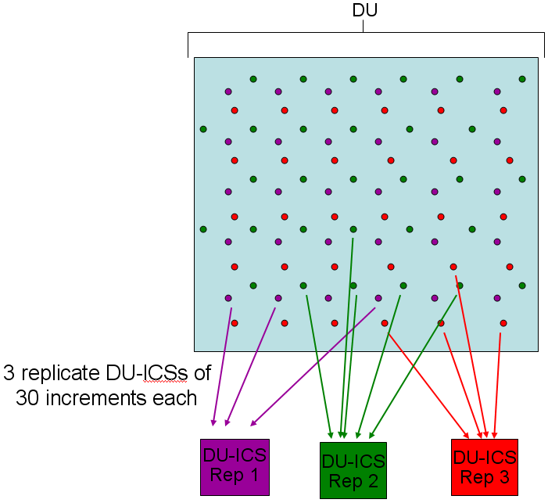
Need at least 3 independent replicate ICSs if want to calculate UCL or measure data uncertainty
Replicate ICSs per DU
Each replicate ICS result represents an estimate of the DU mean.
Example: 3 replicate ICSs of 30 increments each = 90 increments total in DU

Slide 13
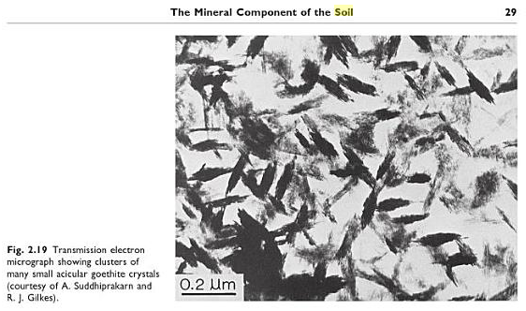
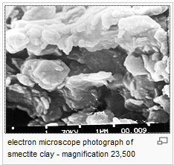
Sample Processing & Correct Subsampling Critical for Reliable Data
Micro-scale, within-sample heterogeneity caused by differences in particle size & composition
Tiny particles are often composed of minerals that readily adsorb contaminants
Iron oxides
Clay minerals
“Contamination is in the fines”

Slide 14
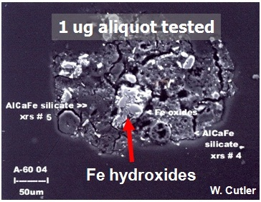
“Nuggets”: Particles with High Loadings
Dark background: pyroxene-like minerals that do not bind arsenic
White particles: particles of iron oxide coated by arsenic
The largest iron oxide particle (arrow) would pass through a 200-mesh (74 micron, µm) sieve
Photo courtesy of Roger Brewer, HDOH
Notes:
Speaker Notes
Particulate iron minerals, such as oxides, are very good at binding contaminants.
One researcher stated that the Fe in a cubic yard of soil can adsorb ½ to 5 lbs of soluble metals or organics.
The photomicrograph shows microscopic iron hydroxide grains coated with arsenic. The arsenic appears as a light-colored deposit covering Fe-OH grains (see red arrow).
Silicate minerals make up most of the soil mass in the photo. Arsenic does not adsorb to those minerals, so they are dark gray.
Photo provided by Roger Brewer with the Hawaii Dept. of Health
Supplemental Information
See ISM-1 Section 2.2 hyperlinks
--------------------------------------------------------
Quote from the journal article: “Given the average concentration in soil, the iron in a cubic yard of soil is capable of adsorbing from 0.5 to 5 pounds of soluble metals as cations, anionic complexes, or a similar amount of organic[s].” (Vance, 1994). [Reference = David B. Vance. “Iron – The Environmental Impact of a Universal Element,” National Environmental Journal, May/June. 1994 Vol.4 No. 3 page 24-25. see also URL = http://2the4.net/iron.htm]

Slide 15
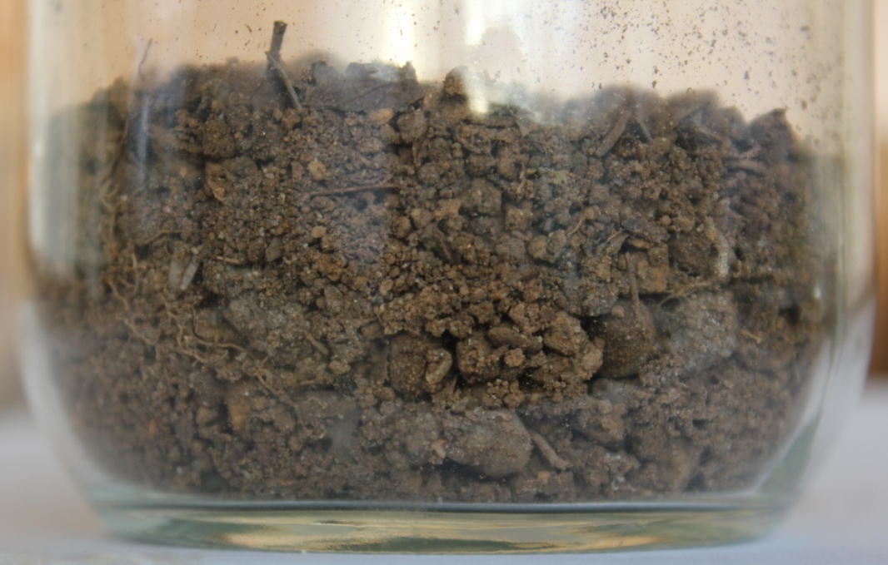
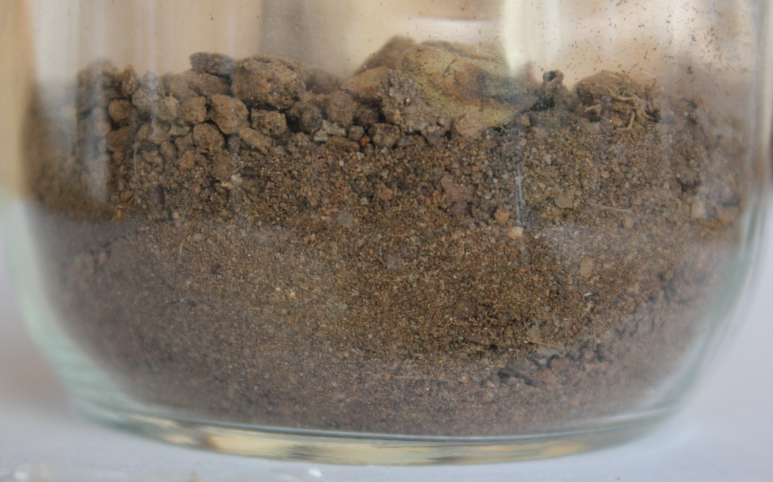
Particle Size vs. Routine Lab Subsampling
Freshly collected soil sample – Particles of many sizes & composition
Photo credits: Deana Crumbling
Same sample jar after jostling to mimic transport to lab: particles segregate.
What if just scoop subsample off the top?
Notes:
Here’s what we mean by “particle segregation.”
These photos contrast non-segregated soil with segregated soil
With shaking or jiggling, larger particles migrate to the top while smaller particles settle downward
Stirring to “mix” is ineffectual to redistribute particles; often makes segregation worse
If subsampling involves scooping off the top, could predominately get larger particles; but this depends on another factor (see next slide)

Slide 16
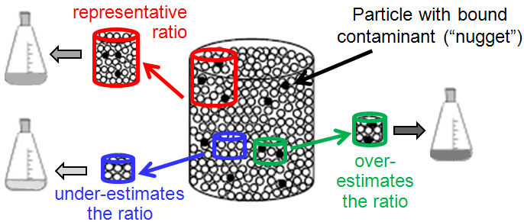
Micro-Scale, Within-Sample Heterogeneity
Same conc as sample
Higher conc than sample
Lower conc than sample
The red subsample has the same proportion of nuggets as the sample (the large container). The blue subsample has a lower proportion of nuggets, and the green subsample has a higher proportion.
Figure adapted from EPA 530-D-02-002 (2002)
Notes:
Speaker Notes
Another way sample support influences concentration results is whether the sample support is large enough to accurately capture the particle ratio of the population.
In this cartoon, the large container represents a field sample in a jar.
The cartoon illustrates how subsample support affects how well a lab subsample represents the field sample.
The lab subsample represents the field sample if the ratio of contaminant-laden particles to “cleaner” particles in the subsample mirrors the ratio in the field sample.
A sampling error occurs when a subsample does not have same ratio as the field sample.
Sampling error is more likely for smaller subsample supports, since they are more likely to under- or over-estimate the proportion of “hot nuggets” to less contaminated “cool” particles.
Larger supports are more likely to represent the actual ratio and give a concentration result that is representative of the mean of the jarred field sample.
Figure adapted from EPA 530-D-02-002, RCRA Waste Sampling Draft Technical Guidance, August 2002, page 92.
ISM addresses this problem by collecting many increments which results in a large mass representing the whole volume of the material being investigated.

Slide 17
Micro-Scale Heterogeneity & Sample Handling
Without direction to the contrary, labs assume the sample they get is ready for analysis “as is”
May stir to “mix”— actually makes particle segregation worse
Lab duplicates often don’t match
Reveals need for better sample processing & subsampling
Good sample processing may include drying, disaggregation, sieving, and perhaps grinding
Match subsample mass to soil particle size (see equation in EPA530-D-02-002, Aug 2002, App. D)
Subsampling is performed using an incremental technique or mechanical splitting
QC includes replicates to calculate subsampling precision

Slide 18
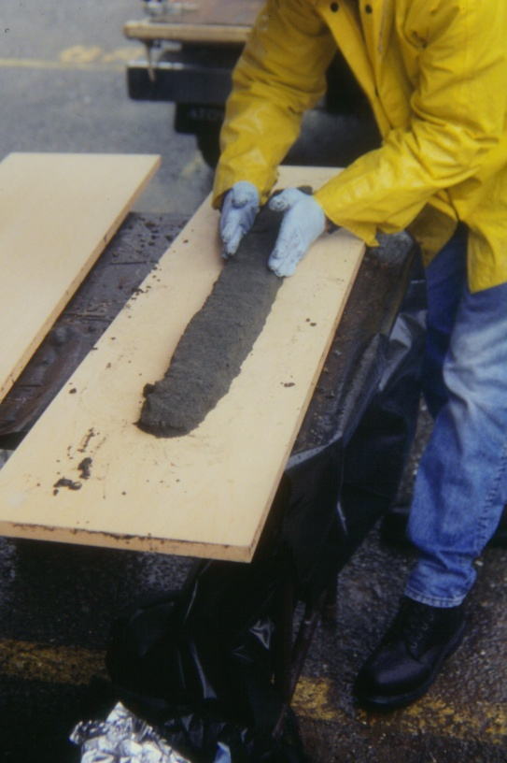

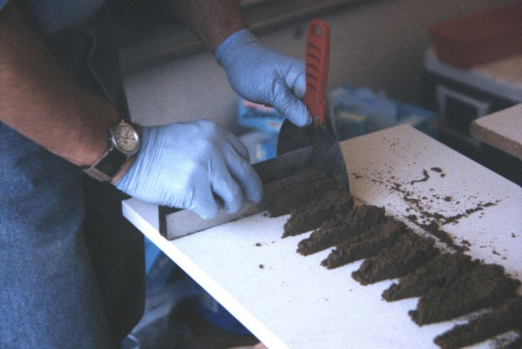
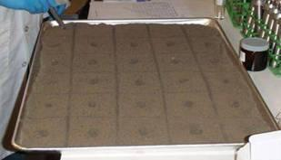
ICS Sample Splitting & Subsampling Options Manual Techniques
Collect through full thickness with properly shaped scoop
“1-Dimensional Slabcake”
“2-Dimensional Slabcake”
Notes:
Speaker bullets
2 D slabcake
Lower cost than sectorial splitter
Pretty good representativeness
Wet or dry sample
Systematic Random design
All increments combined = analytical subsample
Narrative
The 2 dimensional Japanese slabcake frequently provides acceptable subsample representativeness at a lower cost than the sectorial splitter. This process is a miniaturized version of what takes place in the systematic random field sample collection process. The wet or dry processed sample is spread evenly in rectangular slabcake and divided into grids as determined in project planning. The default is 30. The analyst removes a small increment from a random location in the first grid. Subsequent increments are collected from the same location in the other grids. All increments are combined to form the subsample for digestion or extraction so the size of the increment must be appropriate for the number of increments and the target subsample size.
2D slabcake subsampling can minimize bias and improve precision.
Supplemental information
See Section 6.2.2.7

Slide 19
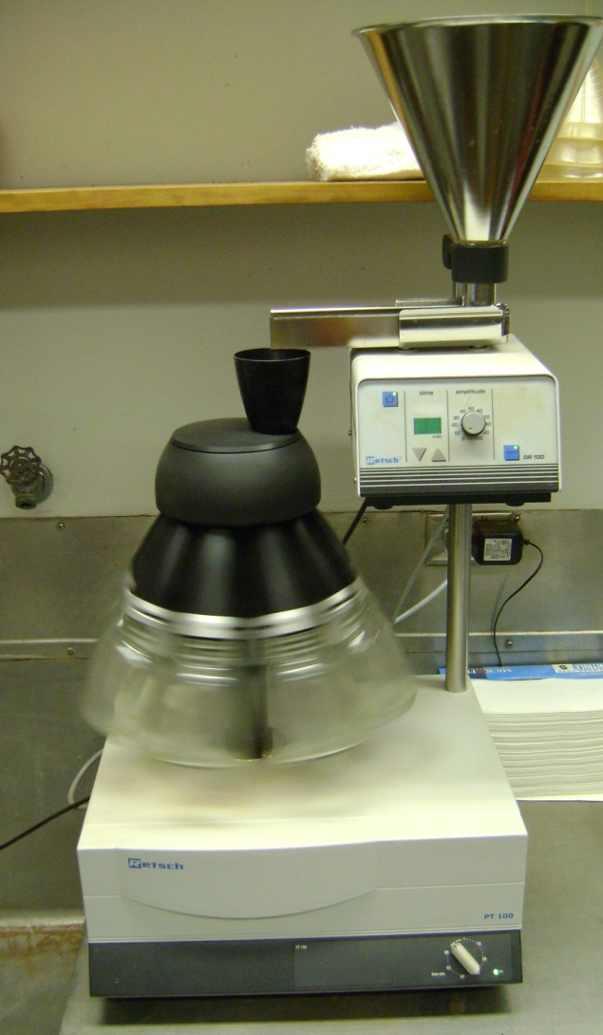
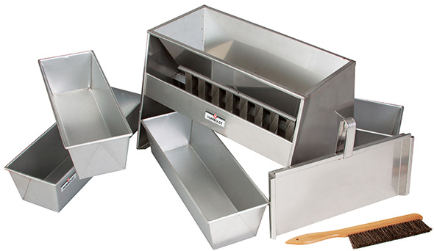
ICS Sample Splitting & Subsampling Options Mechanical Techniques
Rotary sectorial splitter
Best precision
More expensive
Riffle splitter
Performance depends on operator skill
Notes:
Riffle splitter picture from Humboldt Mfg. Co. website, http://www.humboldtmfg.com

Slide 20
ICS Quality Control Procedures
Replication in the field (3 DU-ICS replicates)
Indirect measure of within-DU concentration variability: if field replicates too variable (and all other variability sources low), indicates the # of increments is too low in relation to field heterogeneity in that DU.
If all sample processing done in lab, 3 analytical subsample replicates on 1 of the field ICS replicates
Measures effectiveness of sample processing & subsampling procedures
If sample processing done in the field & sample splitting performed, 3 replicates from splitting procedure from 1 of the field ICS replicates.
Also, 3 analytical subsample replicates performed on 1 of the split replicates
From this info, can calculate relative contributions to sampling variability for each critical step.
Will be able to target corrective action if data are too imprecise.

Slide 21
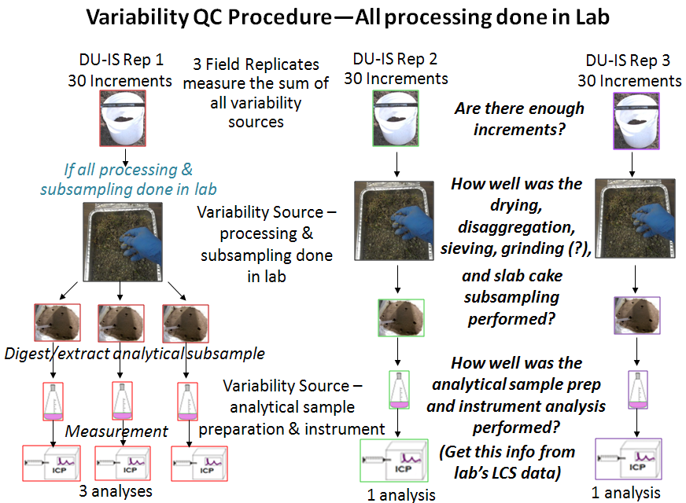

Slide 22
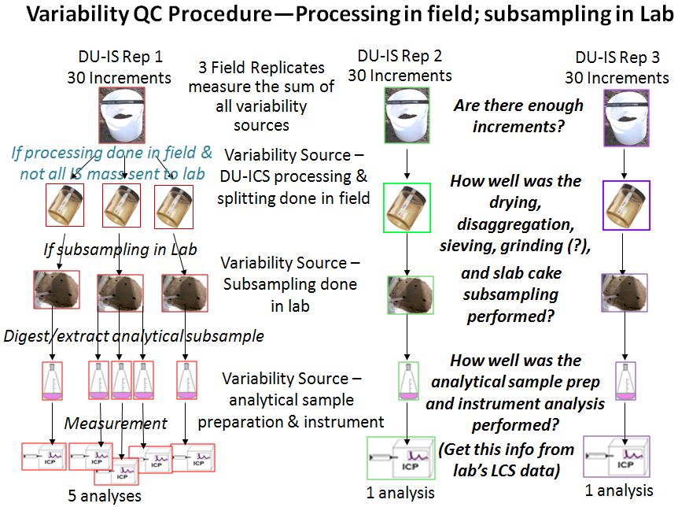

Slide 23
Data Variability Partitioning Equation
Partitioning equation:
SD_{Total}² = SD_{LCS-analytical}² + SD_{analytical subsampling}²
+ SD_{IS processing}² + SD_{IS field heterogeneity}²
Remember! Must square the SDs (to get variances) before adding & subtracting, then take square root of final value to convert back to SD.
In actual projects, probably will not get all the info needed to partition variability to 4 sources; the SD for subsampling and the SD for sample processing will probably be merged together.
Should get field variability (from field IS triplicates) and sample processing/analysis (from triplicate subsampling) and analytical (from lab’s LCS data).
Actual data example to illustrate follows:

Slide 24
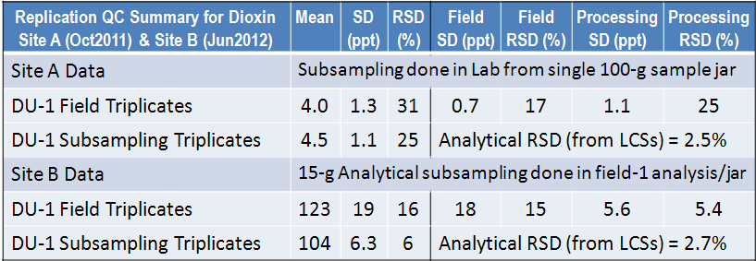
Partitioning Variability & Selecting Corrective Action for a Dioxin Site
Problem: Site A data had a higher RSD for sample processing (25%) than for field variability (17%), and overall results were not sufficiently precise. Corrective action:
For Site B’s work, subsampling was taken out of lab’s hands and done in the field.
Great improvement: the processing RSD (5.4%) is only twice the analytical RSD (2.7%) and much less field RSD (15%). Overall precision was acceptable.

Slide 25
Most Helpful As Part of Pilot Study
A pilot study can provide many benefits
Assess sources of data variability
If necessary, select corrective actions to reduce largest source
Use opportunity to fill CSM gaps or test critical assumptions underlying the sampling design
Determine optimal number of increments and/or number of IS field replicates
Use as readiness review for field & lab staff

Slide 26
Potential Corrective Actions (1)
For reduction of error (variability) from short-scale heterogeneity
Increase mass of increments
Increase number of increments
Improve sample handling/homogenization prior to splitting sample or subsampling
Break up clods better (coffee mill, mortar & pestle)
More careful sieving so particle sizes more uniform
Milling
More “correct” sample volume reduction [e.g., “correct” tool with 1-D slabcake or a sectorial splitter; see EPA 600/R-03/027, 2003 (Subsampling Guidance)]

Slide 27
Potential Corrective Actions (2)
For reducing error in analytical subsampling
Increase number of increments in subsample
Increase mass of increments and mass of the analytical subsample
Improve rigor of analytical subsampling
Use more “correct” (per Gy) sampling tool
Exercise more care when preparing 2-D slabcake (need to avoid segregation of particles)
Perform replicate analytical subsampling & average them for a single analytical result

Slide 28
Advantages and Limitations of Incremental Sampling
Advantages | Effect
Improved spatial coverage (increments x replicates) | Sample includes high and low concentrations in same proportions as present within decision unit (DU)
Higher field sample mass | Sample is more representative of field conditions; statistical distribution of replicate results is normalized
Optimized processing | Reduces subsampling errors so analytical sample is more representative of field sample
Fewer non-detects | Simplifies statistical analysis
More consistent data | More confident decisions; more regulator & RP agreement on data interpretation
Limitations | Effect
Small number of replicates | Limits UCL calculation methods (t-UCL & Chebyshev-UCL)
No spatial resolution within Decision Unit | Limits remediation options within the DU unless a more complex ICS design is used or have a 2nd remobilization
Assessing Acute Toxicity | Decision Unit has to be very small
Notes:
_____
ISM has both advantages and disadvantages from a sampling design perspective.
Can’t directly compare discrete and ISM samples because each measure different properties of the population.
Under disadvantages, discrete sampling allows for calculations of ratios of two variables – allows for correlations among constituents, or estimates of bioaccumulation factors (update from abiotic media to organisms) that you cannot get from ISM.
When assessing acute toxicity issues, the decision unit would have to be very small for incremental sampling. ISM may not be practical.

Slide 29
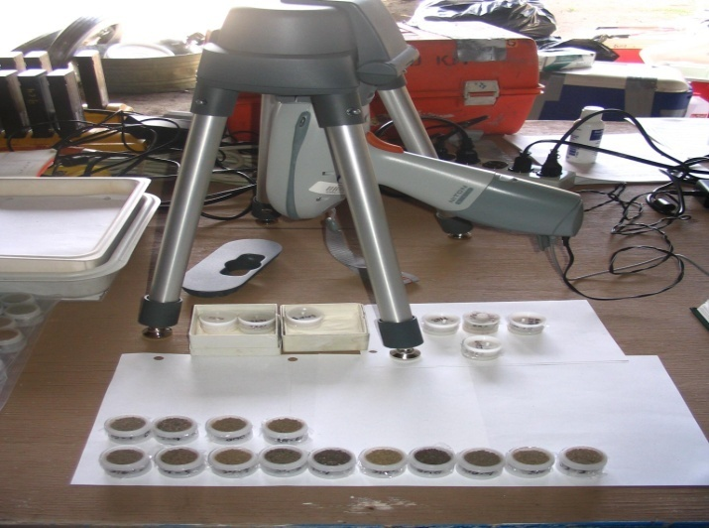
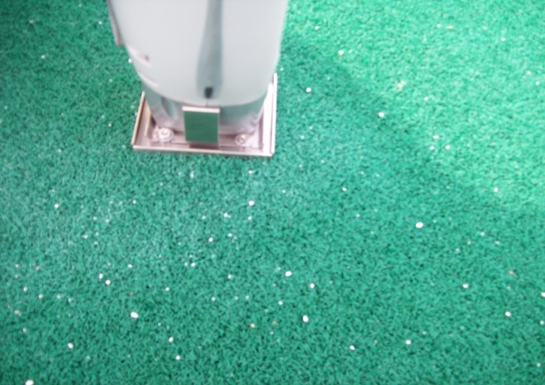

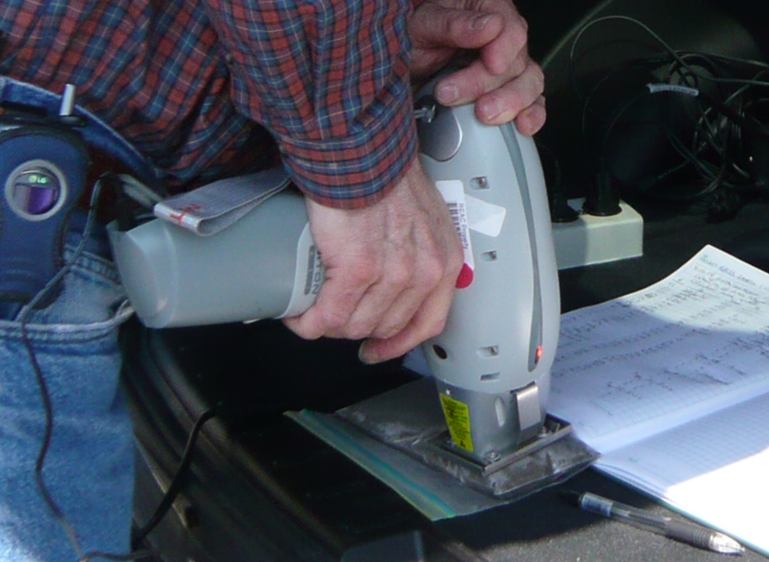
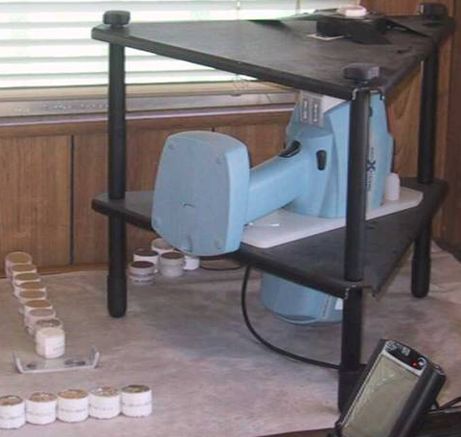
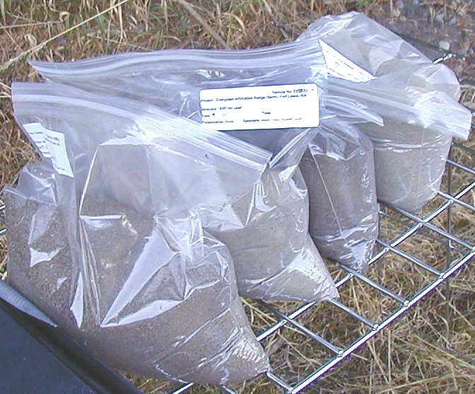
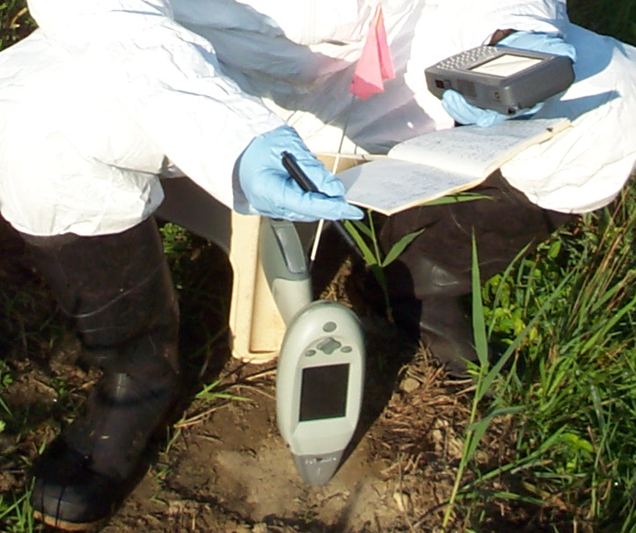
XRF: Great Partner with Incremental Sampling for Metals Analysis in Soil
Notes:
29

Slide 30
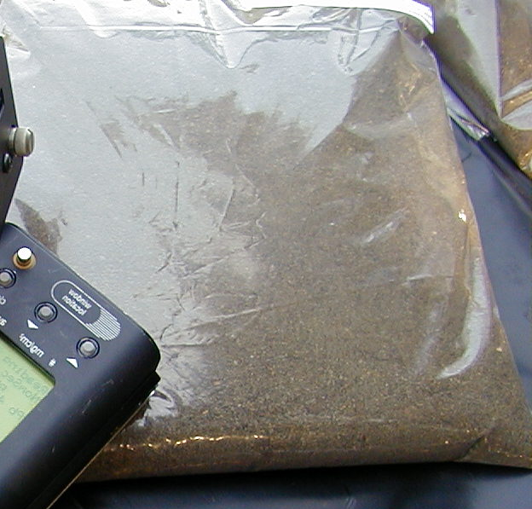
Managing XRF’s Micro-Scale Heterogeneity
Take replicate readings to understand the degree of short-scale (for in situ readings) and micro-scale within-bag heterogeneities
Replicate readings can substitute for, or complement, sample processing
Use reps’ arithmetic average as the “result”
Have QC procedures that quantify sampling error & ID corrective actions when needed
How many XRF replicates? Depends on data variability & closeness to decision threshold; can be decided adaptively in real-time.
How many seconds of read time? Depends on desired quant limit
Program the calculations into spreadsheet for fast decision-making
Can estimate concentration & sampling variability fast & “cheap”
Replicate readings do not add any consumables cost (only labor)

Slide 31
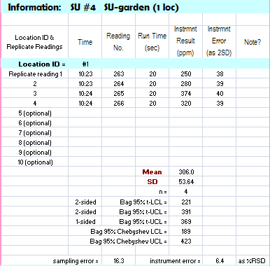
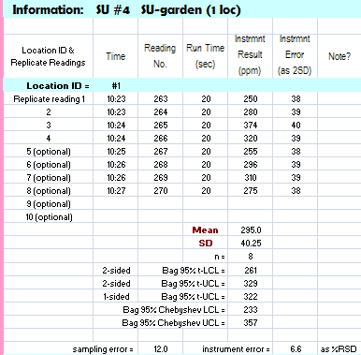
Programmed Spreadsheet
After the initial 4 readings per bag, can take additional readings until decision (Is the mean conc < 350 ppm?) is without statistical uncertainty, i.e., the 95% upper confidence limit (UCL) is < 350 ppm.
Statistical decision uncertainty present, need more data to resolve
Notes:
For more information, or to obtain a copy of the spreadsheet, contact Deana Crumbling, USEPA, crumbling.deana@epa.gov

Slide 32
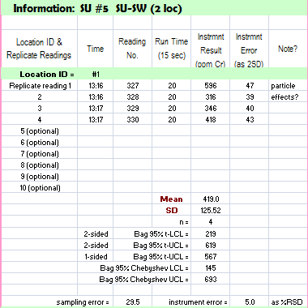
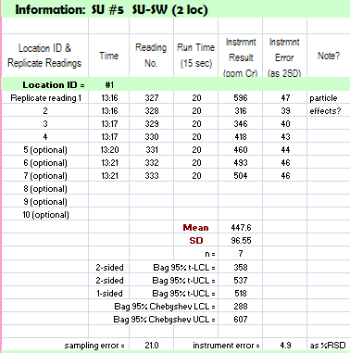
Programmed Spreadsheet (cont’d)
On the other hand, is a sample really “dirty”? (Is the mean conc > 350 ppm?) Additional readings can provide statistical certainty [95% lower confidence limit (LCL) > 350 ppm].
Red circle indicates dirty
Green circle indicates clean
Notes:
For more information, or to obtain a copy of the spreadsheet, contact Deana Crumbling, USEPA, crumbling.deana@epa.gov

Slide 33
Warnings about XRF-ICP Data Comparability
“Comparability” usually refers to comparing XRF results to standard laboratory data (ICP or AA)
SAME samples must be analyzed by both XRF and lab (reduces, but may not eliminate, sampling error)
Regression analysis is the technique most commonly used to measure comparability; generates: y = mx + b
R² is the commonly used “goodness” metric, BUT IT SHOULD NOT BE!!
R² greatly influenced by sampling error & outliers: XRF data cannot match ICP data any better than ICP data can match itself!
m (slope) & b (intercept) are more important than R²:
Intercept measures “bias”, the difference between total metal (via XRF) & dissolvable/”available” metal (via 3050B digestion & ICP)
Slope should be close to 1.0
Regression line should be close to “line of perfect agreement”
Notes:
33

Slide 34
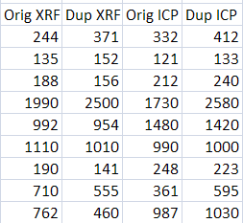
Common ICP vs XRF Regression Techniques Ignore the Effects of Sampling Variability
Falsely assumes the ICP data are without error; any differences “blamed” on XRF performance
line of perfect agreement

Slide 35
When Sampling Variability is Controlled, XRF-Lab Comparability Can be Excellent
XRF Total Uranium vs. Lab Total Uranium
Other factors that can degrade comparability:
Differences in moisture content
Plastic bags holding XRF samples not free of interferences (this is easily checked before the start of the project).
Interfering minerals and elements
700
600
y = 0.97x + 4.9
R² = 0.98
500
400
line of perfect agreement
XRF Total U (ppm)
300
200
100
0
0
100
200
300
400
500
600
700
Alpha Spectroscopy Total U (ppm)
Notes:
35

Slide 36
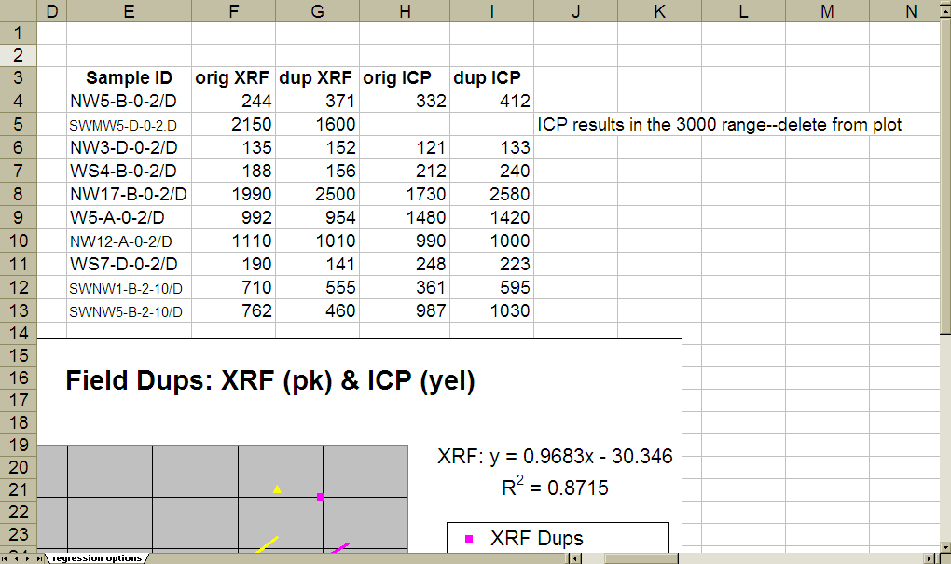
Comparability Done the Right Way
Each comparability sample is analyzed twice by both methods
1 XRF bag or cup
2 XRF readings
(orig & dup)
Send bag/cup to the Lab
2 separate ICP analyses
(orig & dup)
Analyte is Pb (ppm)
(because the single high value biases the regression)
For more info, contact Deana Crumbling, crumbling.deana@epa.gov
Measures: 1) how well XRF dups agree;
2) how well ICP dups agree; and
3) how well XRF & ICP agree
Notes:
For more information, contact Deana Crumbling, USEPA, crumbling.deana@epa.gov

Slide 37
95% confidence interval (dashed red lines) bound the ICP vs ICP-dup regression line (black)
An Unbiased Regression Technique for Comparability
The XRF-XRF dup regression line (blue) falls within ICP’s CI (red). This means the XRF data set is as comparable to the ICP data set as the ICP is to itself. Near the action level (400), there is good agreement.
line of perfect agreement
Comparability regression line of ICP to itself
Comparability regression line of XRF to itself
Dup ICP & XRF results
Note that the XRF line stays closer to the line of perfect agreement than the ICP line (black).
Orig ICP & XRF results
Notes:
For more information, contact Deana Crumbling, USEPA, crumbling.deana@epa.gov

Slide 38
Take-Away Comparability Points
Standard laboratory data can be “noisy” due to sampling error & cause poor regression relationship
Remember: XRF cannot match ICP better than ICP matches itself!
Choose samples with conc’s in decision-making range
On each comparability sample, run XRF and ICP twice
Regress ICP1 vs. ICP2 & XRF1 vs. XRF2…plot the 2 lines on 1 graph
Does XRF line lie within 95% confidence interval around the ICP line?
R² values are a poor measure of comparability
1 or 2 very high values can bias R²…it looks better than really is
Slope & intercept more important: provide more useful information that can indicate where any problems lie.
NDs
Real high
Notes:
38

Slide 39
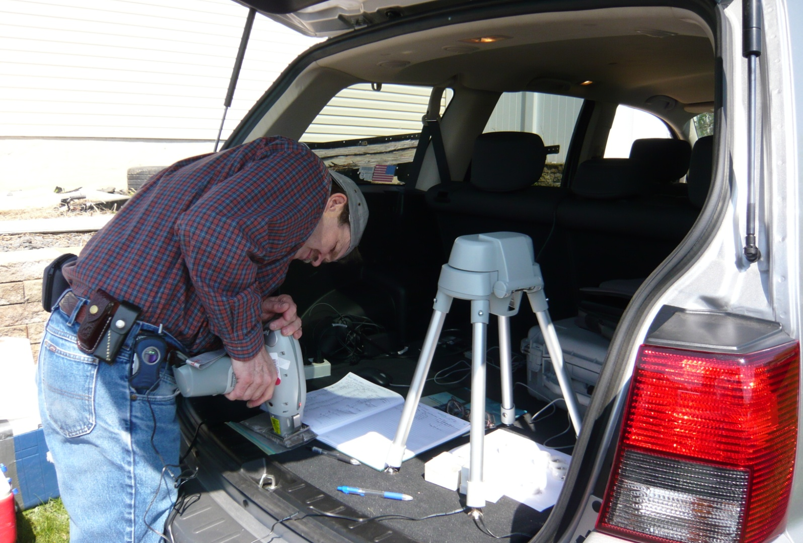
Using XRF to Guide Aspects of Incremental Sampling for Metals

Slide 40
XRF to Verify Adequate Sample Processing
XRF excellent for developing and verifying ICS sample processing procedures prior to lab metals analysis.
Especially useful if sample splitting will be done in the field (measure variability within- and between-bags after splitting)
To perform
Process samples & take at least 4 XRF readings thru bag (2 on each side). Enter data into programmed spreadsheet & calculate average.
Select samples with average conc in certain “bins” near action level
Take additional 5 to 10 shots over sample
Compare to pre-established std dev limit derived from limits on allowable decision error (can be done with a simple spreadsheet)

Slide 41
XRF to Verify Adequate Sample Processing (cont’d)
If limits on allowable variability after processing are exceeded, might…
Reprocess the sample & oversee to make sure technician is following correct procedures
Need to modify procedures or decision-making criteria
Have a difficult sample that will require extra processing (such as grinding)
Require mass of lab analytical subsamples to be increased
Can be part of pilot study &/or on-going QC for field & lab procedures

Slide 42
Adaptive Strategies for Tailoring Incremental Sampling with XRF
Help set DU boundaries if want to avoid mixing large “clean” and “dirty” areas into same DU (such as remedial-sized DUs and source delineation DUs).
Use XRF to approximate mean and SD across a DU. Use to statistically determine:
How many increments per incremental sample?
😐 Enlarge the XRF sample support to ~same mass as the increment sample support, or will over-estimate between-increment variability!
Use XRF to evaluate IS samples before leave the DU:
Do you have enough replicate ISs to meet statistical decision goals?
How much within-sample heterogeneity is present? Perhaps need to refine sample processing/subsampling?

Slide 43
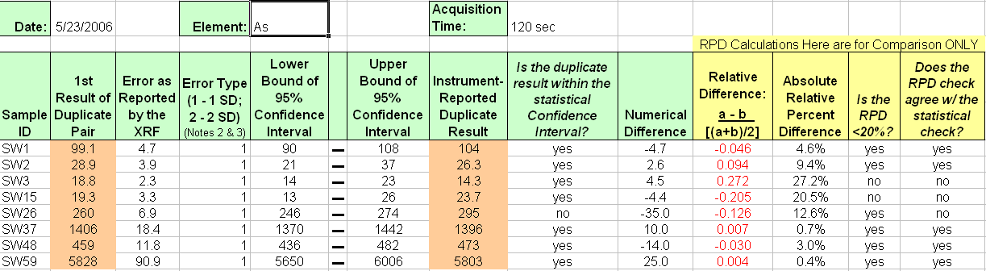
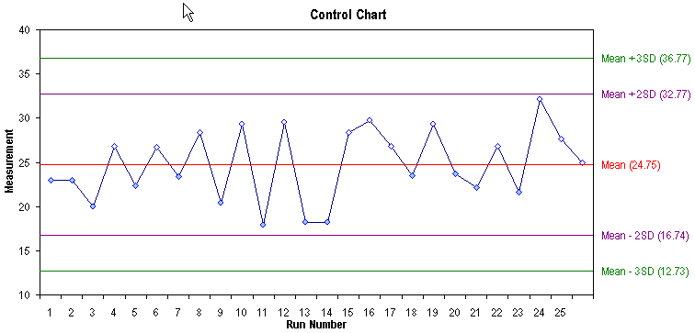
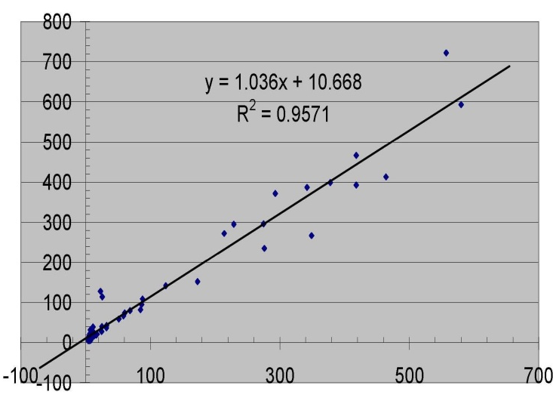
Ensure Sufficient & Appropriate XRF Quality Control
Notes:
43

Slide 44
What Can Go Wrong with an XRF?
Initial or continuing calibration problems
Instrument drift
Window contamination
Interference effects
Matrix effects
Unacceptable detection limits
Matrix heterogeneity effects
Operator errors
Weak battery
XRF has a very small sample support
Notes:
44

Slide 45
Field Portable XRF Daily Operation for Best Results– Soil Mode
Power up: Stabilize 10 – 30 minutes
Instrument detector calibration (using metal puck provided)
Application verification
SiO₂ or Sand Blank (or both)
SRMs 2709, 2710, 2711 (plot results for the target analytes on QC charts)
Other SRMs/certified standards as needed (plot results for the target analytes on QC charts)
Precision QC sample, e.g., LCS sample from ERA (~100-200 ppm most elements) or LCS prepared from site soil
to evaluate instrument precision, do not move XRF between shots;
to evaluate matrix variability, move XRF between shots
QC evaluation spreadsheet for precision samples available
Notes:
For more information, or to obtain a copy of the spreadsheet, contact Deana Crumbling, USEPA, crumbling.deana@epa.gov
45

Slide 46
Field Portable XRF Suggested Control Frequency – Soil Mode
Run Soil Samples
Analyze MDL sample (e.g., SRM 2709)
Analyze Precision/QC/LCS sample(s)
Analyze 10-15 samples; each sample may have multiple shots (sample results must be bounded by in-control QC samples)
Analyze MDL sample (e.g., SRM 2709)
Analyze Precision/QC/LCS sample(s)
Repeat steps 1-3 until all samples have been analyzed
Run QC at end of XRF use (like before a lunch break); when start back up after lunch; and at end of day
Notes:
46

