Slide 1
Tools and Technologies for Mining Site Remediation
Michele Mahoney
US Environmental Protection Agency
Office of Superfund Remediation and Technology Innovation
mahoney.michele@epa.gov
www.cluin.org/mining

Slide 2
Overview
Technology Assessment Branch
Mining Website
  www.cluin.org/mining
Mining Webinar Series
MIW Treatment Technologies

Slide 3
Technology Assessment Branch
Demonstrates and promotes the use of new and innovative treatment technologies for more cost effective cleanups
Assesses and communicates to site managers state-of-the-art remedy technology information
Provides site-specific support through five Technical Support Centers and staff consultation

Slide 4
Mining Website: CLU-IN Mining Sites Focus Area www.cluin.org/mining

Slide 5
CLU-IN Mining Sites Focus Area
Launched in 2012 (www.cluin.org/mining)
Maintained on CLU-IN: Contaminated Site Cleanup Information (www.cluin.org)
Goal: develop a source of information on site assessment, characterization, cleanup, and revitalization technologies & training opportunities
Initial focus: abandoned mine lands
Today: current and former (i.e., active, closed and abandoned) sites

Slide 6
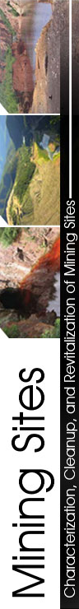
CLU-IN Mining Sites Focus Area
Target audience: site managers, regulatory agencies, consultants, general public
Spotlight, overview, and RSS feed
Case studies
Characterization
Revitalization and reuse
Resources and links
Conference proceedings and presentations
Training and events

Slide 7
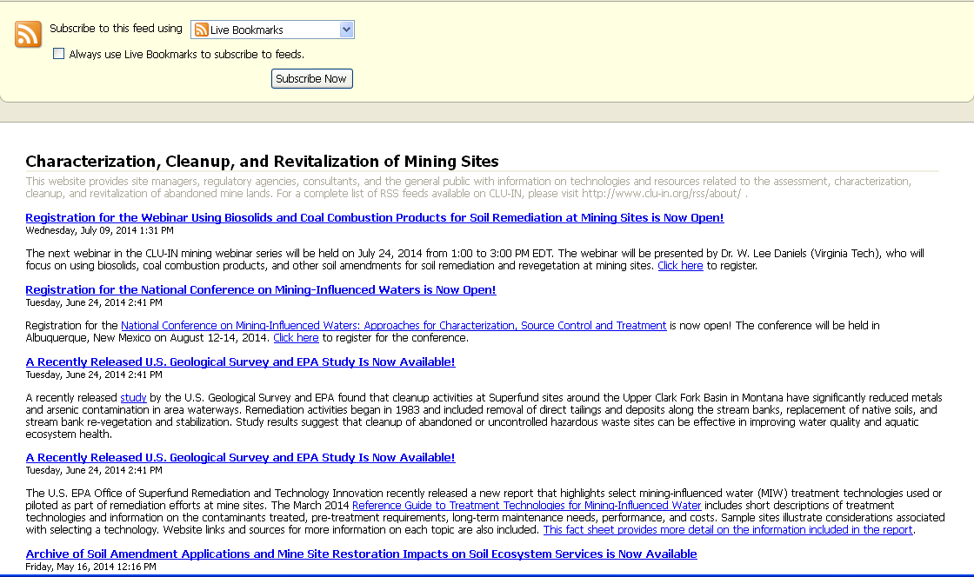
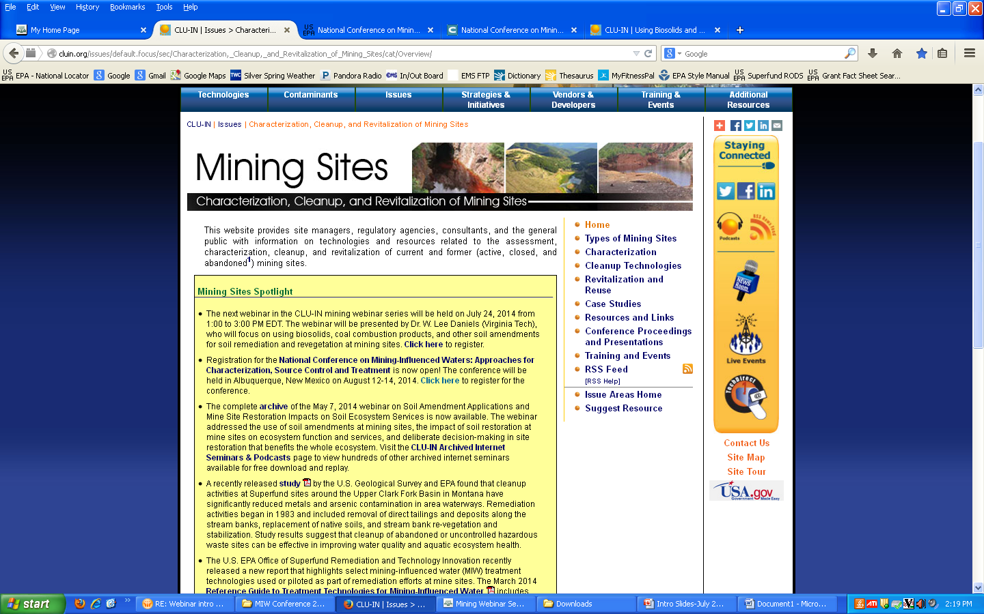
CLU-IN Mining Sites Focus Area
Spotlight and overview
RSS feed

Slide 8
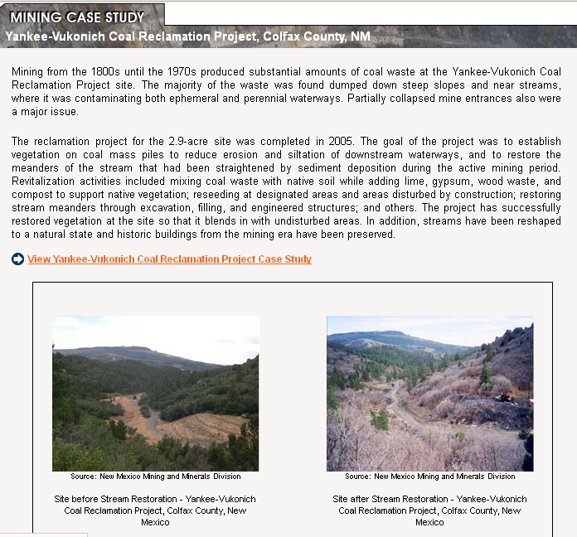
CLU-IN Mining Sites Focus Area
Case studies
  Successful remediation and revitalization efforts
  Grouped by mining site type
    Hardrock
    Coal
    Uranium

Slide 9
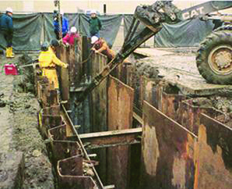
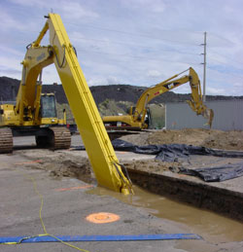
CLU-IN Mining Sites Focus Area
Characterization
Cleanup technologies (adapted from ITRC)
  Mining solid waste
  Mining-influenced water
  Both media
Revitalization and reuse

Slide 10
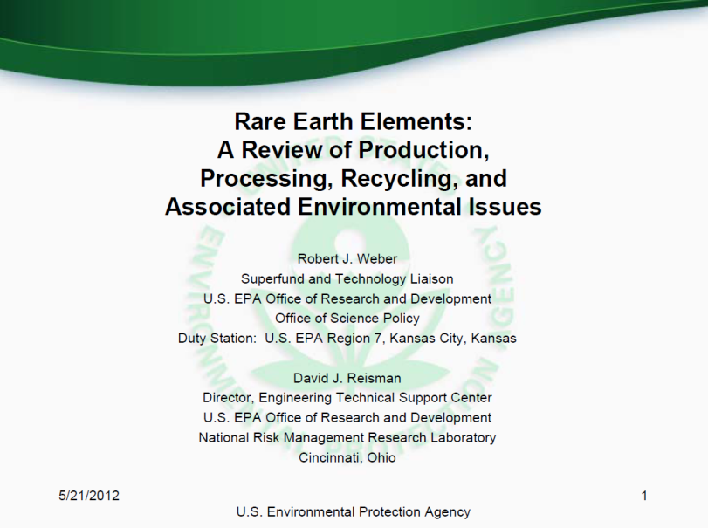
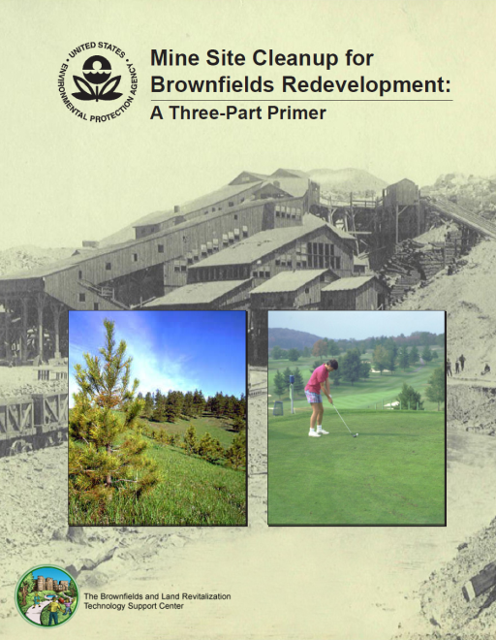
CLU-IN Mining Sites Focus Area
Resources & links
Conference proceedings and presentations
Training & events
www.cluin.org/mining/events

Slide 11
CLU-IN Mining
Webinar Series www.cluin.org/mining

Slide 12
CLU-IN Mining Webinar Series
Launched in June 2012
Complements CLU-IN Mining Sites Focus Area
Held quarterly
Goal: technology transfer resource and additional information source on innovative technologies and approaches for mine waste and MIW treatment

Slide 13
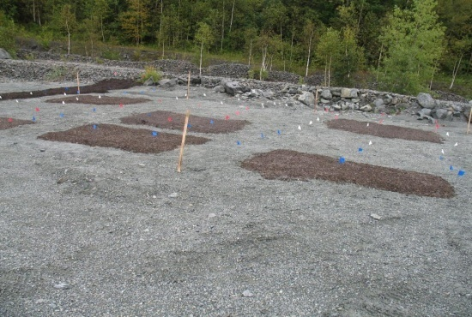
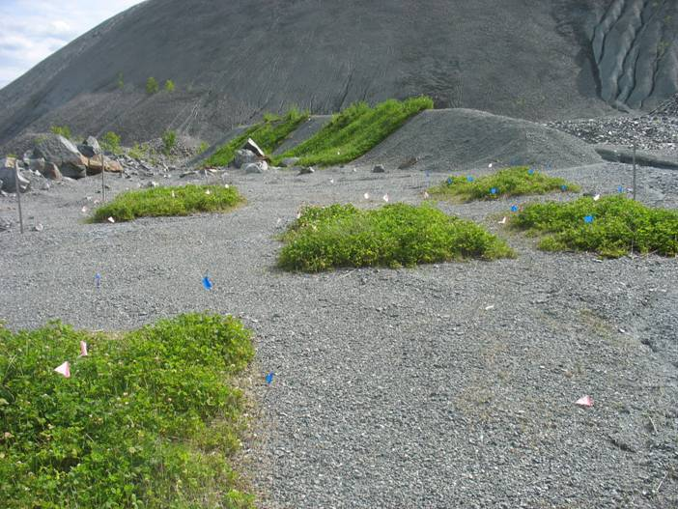
CLU-IN Mining Webinar Series
Six webinars held since the launch
Example topics:
  EPA resources and training opportunities
  Overview of the Global Acid Rock Drainage
  (GARD) Guide
  Impact of soil restoration at mine sites on
  ecosystem function and services
  Using biosolids and coal combustion
  products for soil remediation at mining sites

Slide 14
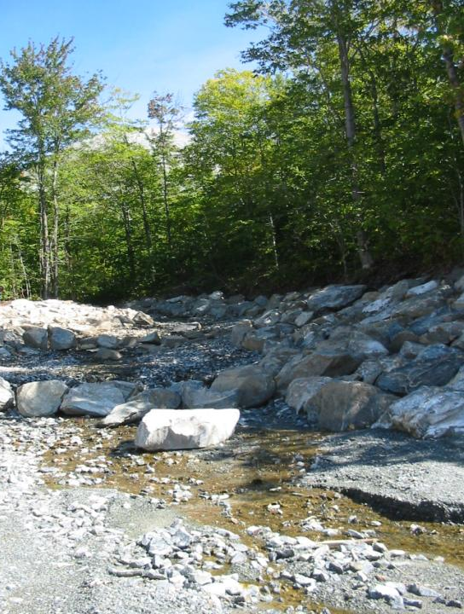
CLU-IN Mining Webinar Series
Case studies and field applications at different types of mining sites and mine waste/MIW
1050 attendees total (average 175 per webinar)
  Environmental, engineering, and mining professionals – government, consulting firms, academia, natural resource exploration industries

Slide 15
CLU-IN Mining Webinar Series
Next webinar: December 17, 2014
  http://www.clu-in.org/conf/tio/miwtt/
Updates and archived mining webinars: www.cluin.org/mining/events

Slide 16
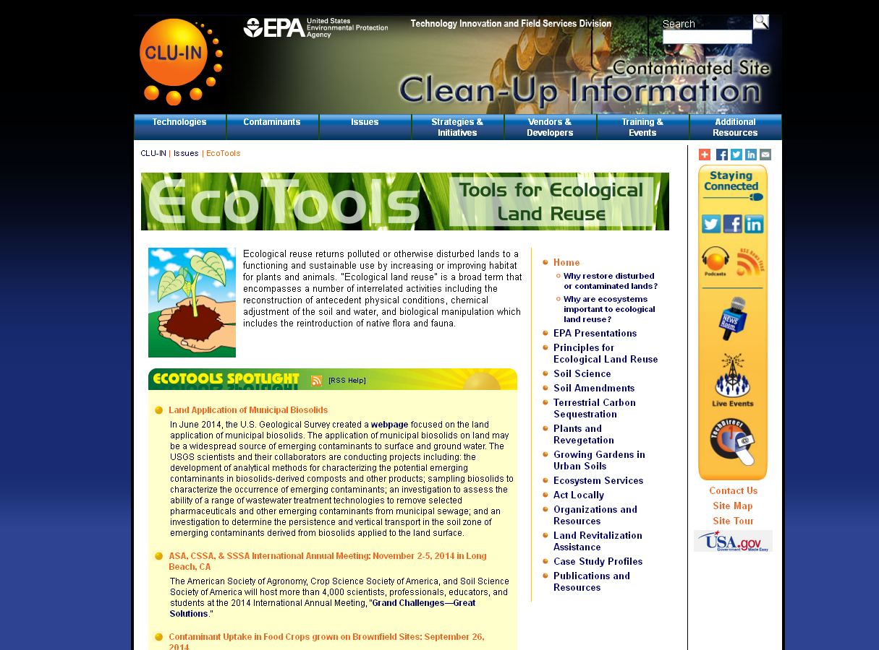

Slide 17
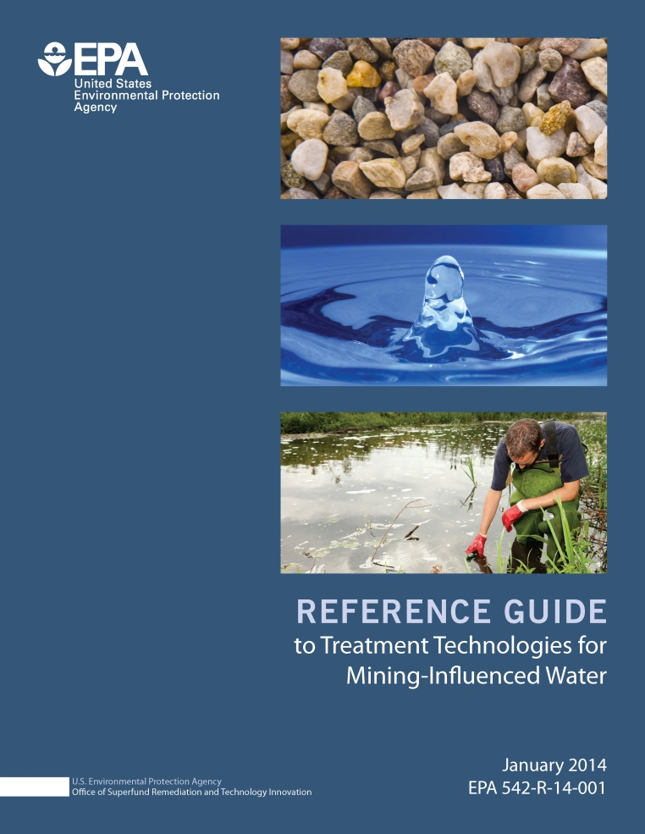
2014 EPA Reference Guide
Compilation of MIW treatment technologies
For regulators, site owners and operators, and other stakeholders

Slide 18
Document Development
EPA National Mining Team
External Stakeholders

Slide 19
Document Objectives
Identify and describe MIW treatment technologies
Support selection of appropriate and cost-effective treatment technologies
Inform decision makers on up to date and available treatment technologies

Slide 20
Long-term Goal
Support development of technologies
  Low energy needs
  Low costs
  Low maintenance

Slide 21
MIW
MIW: water whose composition has been affected by mining or mineral processing
Includes acid rock drainage, neutral and alkaline waters, mineral processing waters and residual waters
Affects over 10,000 miles of receiving waters in the United States

Slide 22
Treatment Considerations
Available land surface and its topography
System longevity
Maintenance needs
Flow rate and strength
Site accessibility and remoteness
Availability of power sources
Performance criteria
Design, capital and operation costs
Maintenance costs
Local climate impacts on system effectiveness

Slide 23
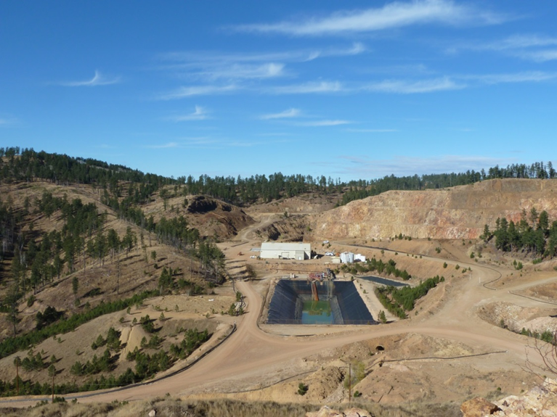
Reference Guide Content
16 Technology Narratives
  7 passive
  9 active
31 Technology Summaries

Slide 24
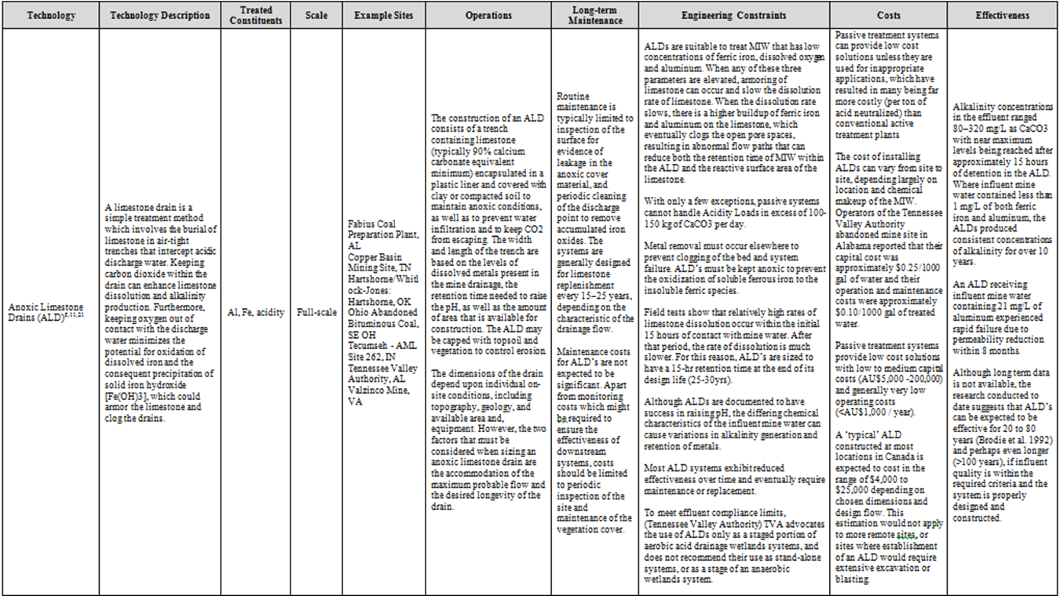
Summary Table Snapshot

Slide 25
Reference Guide Content
Treatment technologies
Contaminants treated
Pre-treatment requirements
Costs
Long-term maintenance needs
System performance

Slide 26
Reference Guide Content
System costs
Example sites
Data gaps and research needs
Resources for more information on each technology

Slide 27
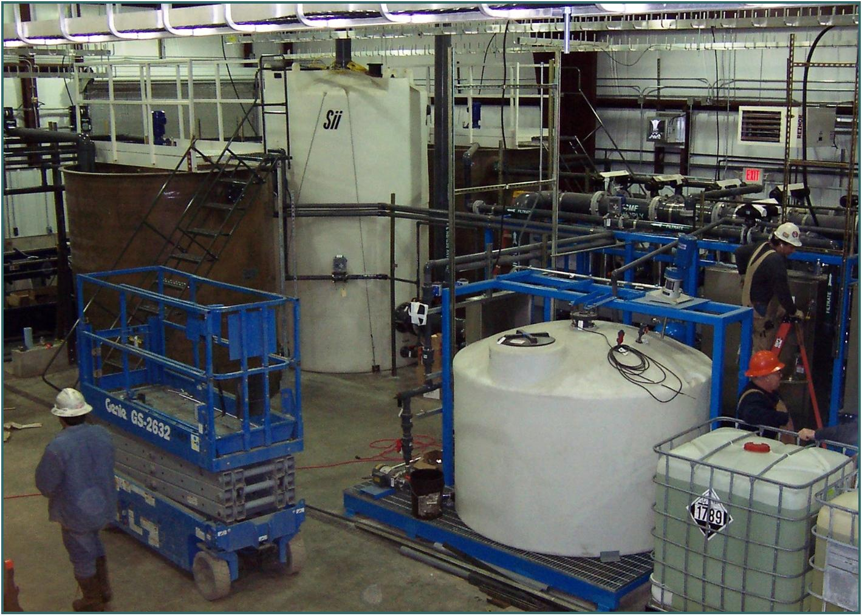
Technologies
Anoxic limestone drains
Successive alkalinity producing systems
Aluminator
Constructed wetlands
Biochemical reactors

Slide 28
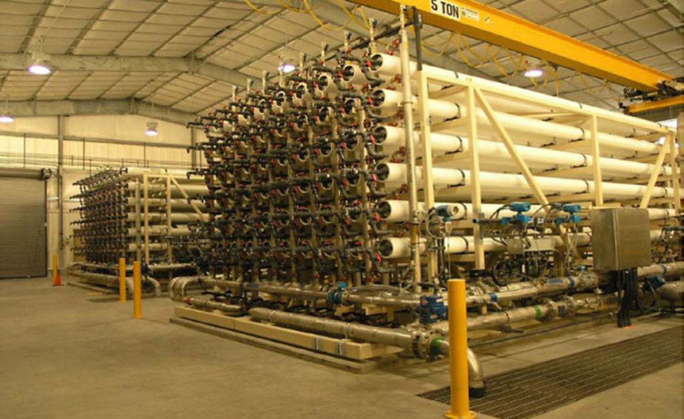
Technologies
Phytotechnologies ( http://cluin.org/products/phyto/ )
Permeable reactive barriers
Fluidized bed reactors
Reverse osmosis
Zero valent iron

Slide 29
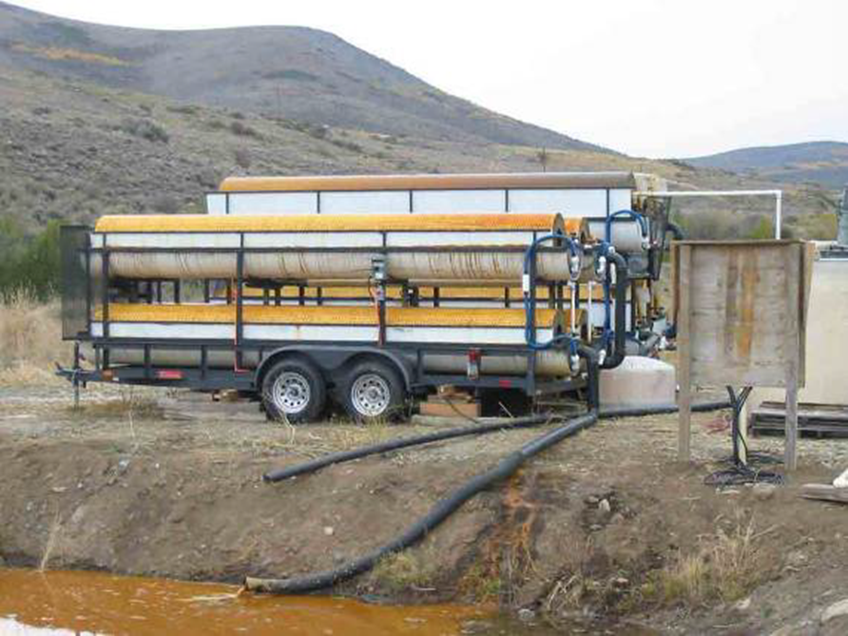
Technologies
Rotating cylinder treatment systems
Ferrihydrite adsorption
Electrocoagulation
Ion exchange
Biological reduction
Ceramic microfiltration

Slide 30
Anticipated Outcomes
Supplement and complement existing reference materials
Identify promising technologies and best practices
Determine data needs
Develop pilot projects
Present information publically

Slide 31
For More Information
Reference Guide: http://www.clu-in.org/download/issues/mining/Reference_ Guide_to_Treatment_Technologies_for_MIW.pdf
Characterization, Cleanup and Revitalization of Mining Sites: http://www.cluin.org/mining

Slide 32
Contact
www.cluin.org/mining
Michele Mahoney
  US EPA OSWER TIFSD TAB
  Mahoney.Michele@epa.gov
  703-603-9057

