Slide 1
Mined Materials Geochemical Characterization Primer
Prepared for:
Hardrock Mining Geochemistry and Hydrology Workshop 1: Evaluating Water Chemistry Predictions at Hardrock Mine Sites
Sponsored by: U.S. EPA Region 10, Office of Research and Development (ORD), and the Office of Superfund Remediation and Technology Innovation
Ann Maest, PhD
Stratus Consulting
Boulder, CO/Washington, DC
February 13, 2013

Slide 2
Linkages
Grasberg Open Pit, New York Times, 12/27/05
Geochemical characterization – modeling – mine management
Purpose of characterization and modeling is to guide management decisions
Which rock goes where in the field? Will water treatment be needed? Will mitigation work?
Results of some geochemical tests used for field decisions, others as inputs to block or geochemical models

Slide 3
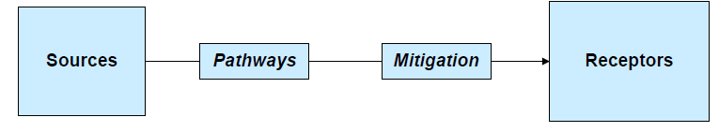
Geochemical Characterization of What?
Mined materials (sources)
Tailings, waste rock, walls of open pits and underground workings, ore (why?), heap and dump leach materials, smelter slag, blended wastes, cemented backfill…

Slide 4
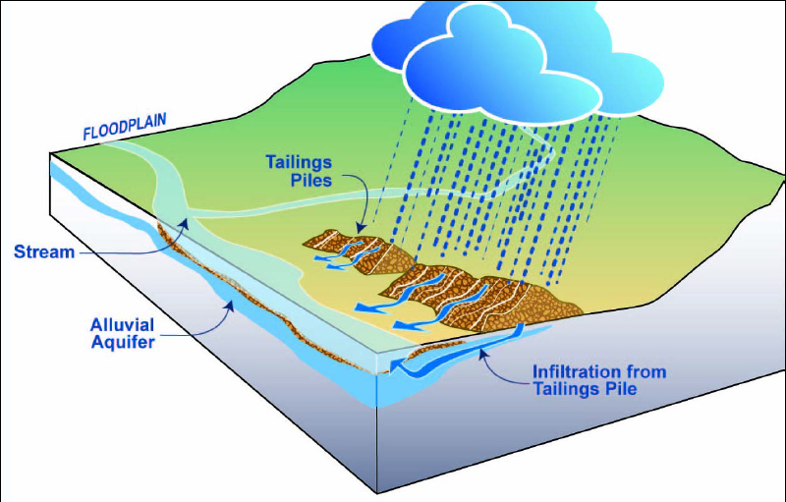
What Processes Are We Trying to Simulate?
Earth processes
Dissolution, precipitation, acid/base
Mining processes
Creation of tailings, waste rock, etc. – from crushed drill core
Blasting is rarely included – commonly missing contaminants of concern (NO₃/NO₂, NH₄)
Heap leaching (CN)

Slide 5
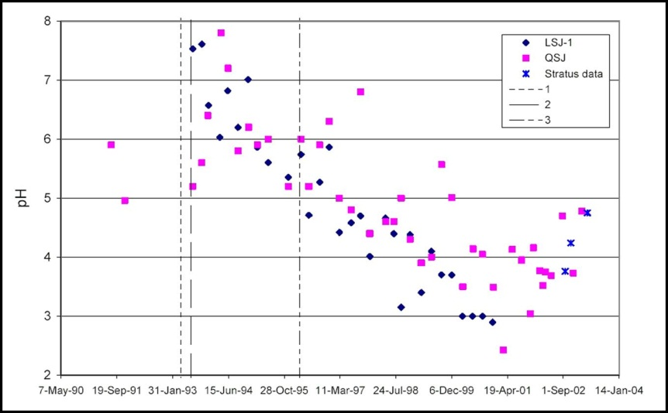
The Real World: Waste Rock Yanacocha Mine, Peru
Photo by A. Maest

Slide 6
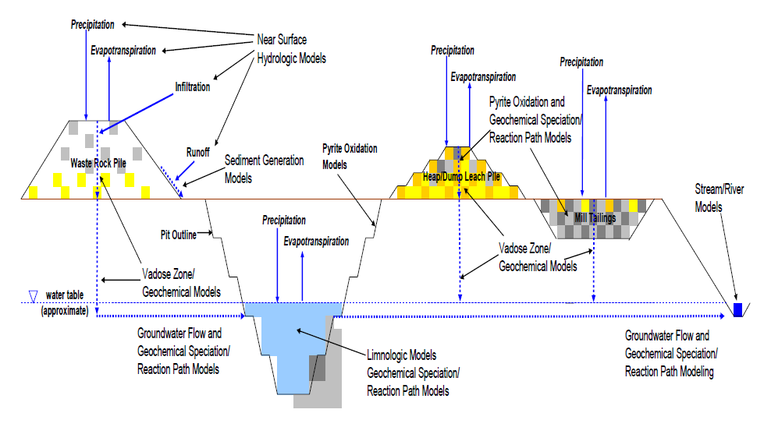
Sources, Pathways, Modeling
Kuipers and Maest, 2006

Slide 7
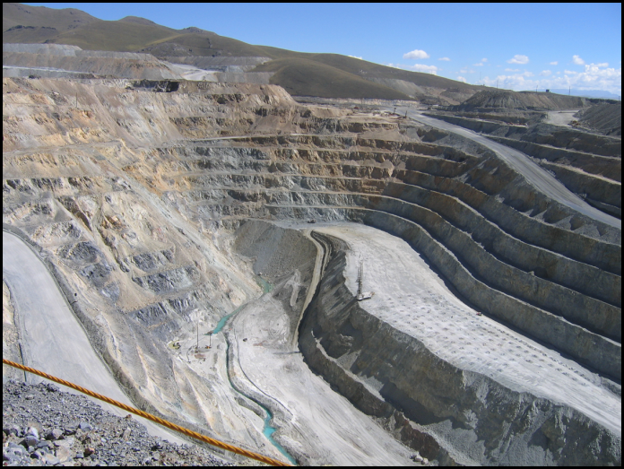
Characterization Overview
Focus on new and expanding mines
Basics: test units, # samples
What methods are used to characterize the geochemistry of mined materials?
What are the advantages, limitations, and uses of each method?
What kind of characterization should be done in each phase of mining?
Tintaya Cu Mine, Peru; photo by A. Maest

Slide 8
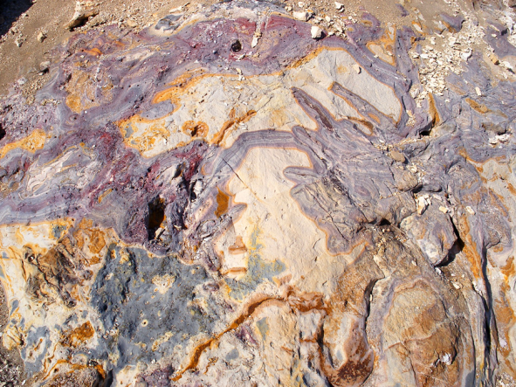
Geochemical Test Unit
Yellowstone: http://www.americansouthwest.net/ wyoming/photographs700/purple-rock.jpg
Most important phase of predictions is sample selection – capture variability
Rock types of distinctive lithology, mineralogy, and/or alteration, mineral availability (“liberation”)
Should be as homogeneous as possible
Could evolve during exploration/operation
Examples: propylitically altered rhyolite, granodiorite with quartz-sericite-pyrite alteration
Conduct full geochemical characterization on each unit

Slide 9
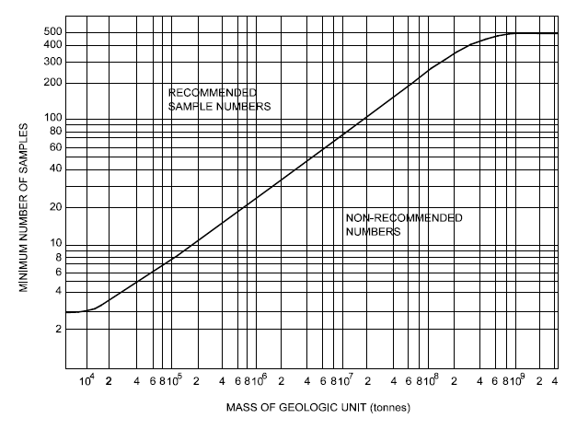
Sample Size
Suggested samples/ton for each geochemical testing unit
More homogeneous materials (tailings) require fewer samples
Sample entire unit; put geochemical characterization information in block model
Price and Errington, 1994.
US EPA, 2003 (BC AMD Task Force, 1989)
Notes:
How much is enough?
No magic #
Some statistical approaches
Of course don’t use this for # of HCTs, more geared toward ABAs and static testing

Slide 10
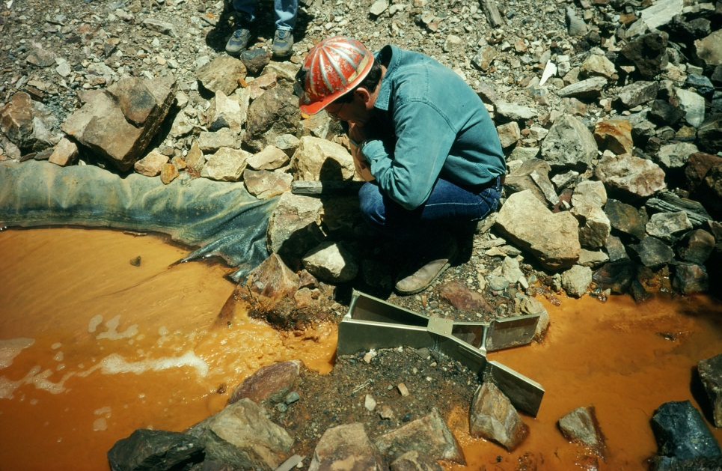
Geochemical Characterization Methods
Static testing
Lithology and alteration zones
Whole rock analysis
Mineralogy
ABA, NAG tests
Short-term leach tests
Kinetic testing
Humidity cell
Column tests
Field tests
Acid drainage at Eagle Mine, CO; photo by A. Maest

Slide 11
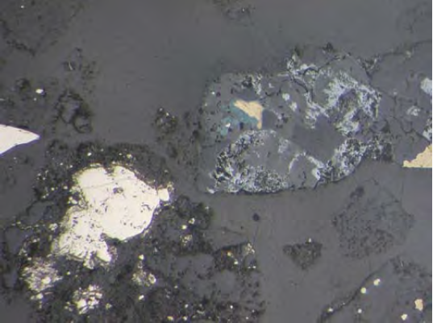
Lithology and Alteration Zones
Pebble deposit, Alaska; PLP, 2011, App. 11E; pyrite, chalcopyrite
What: Rock types and alteration overprints
How: Borehole logs, petrographic/mineralogic analysis, block model
Use: ID geochemical test units
Limitations: Sample representativeness

Slide 12
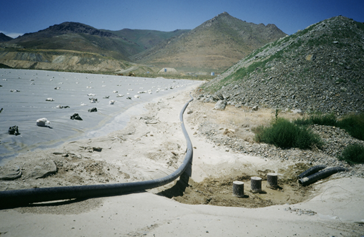
Whole Rock Analysis
Pinson Mine, NV, heap leach monitoring; photo by A. Maest
What: Total concentrations of metals, etc., in rock/waste
How: Grind sample, acid digestion, analyze for metal, etc., content by XRF, ICP, -AES, -MS…
Use: ID overall contaminant levels in rock types
Limitations: Detection limits, interferences; does not provide information on mineralogy

Slide 13
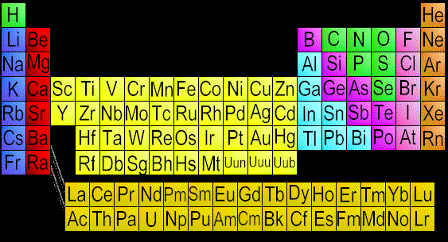
Constituents of Interest/ Concern
Start bigger, get smaller
Solids, liquids (charge balance if liquids)
Focus on potentially toxic constituents, AGP/ANP
General: pH, SC, alkalinity, acidity, TDS
Metals
Ag, Al, As, B, Ba, Be, Ca, Cd, Co, Cr, Cu, Fe, Hg, K, Mg, Mo, Mn, Na, Ni, Pb, Sb, Se, Tl, V, Zn…
Non-metals
Cl, CN, F, NH₄, NO₃/NO₃, S, Si, SO₄ …

Slide 14
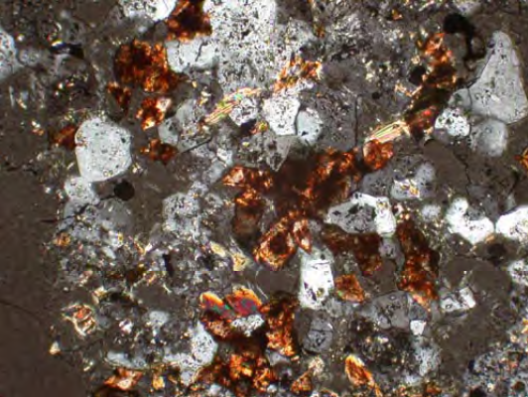
Mineralogy
Pebble deposit, Alaska; PLP, 2011, App. 11E; carbonate replaced by hematite
What: ID minerals and poorly crystalline substances present in rock/waste samples
How: Optical microscopy, XRD, electron microscopy (SEM, TEM, HR-TEM), sulfide oxidation index/Rietveld analysis, AVIRIS (remote spectral imaging)
Use: ID controls on solubility, identity source of AGP/ ANP, mineral availability (“liberation”)
Limitations: Need specific expertise to interpret results, not great for secondary minerals, representativeness

Slide 15
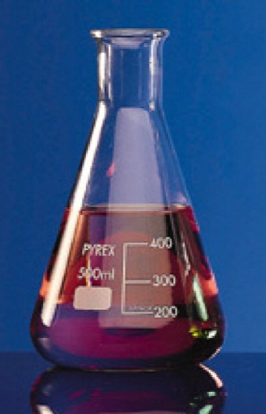
Acid-Base Accounting (ABA)
What: Total amount of acid-generating and acid-neutralizing material in a mined material
How: Pulverize sample; add acid or H₂O₂ (AP), backtitrate with NaOH (NP)
Use: Identify rock units with potential to generate acid; waste management
Advantages: Well established, fast/cheap, operational definition for field management
Limitations: Not for predicting long-term behavior
Notes:
Kinds of sulfur: total, pyritic, sulfide, organic, sulfate
Part of acid-base accounting (ABA) testing; distinguishes between forms with more (pyritic, sulfide) and less (organic, sulfate) acid generation potential (AGP)
Issues: which form to use in AP (over/under-estimate AGP), does not confirm identity of minerals that contain the sulfur

Slide 16
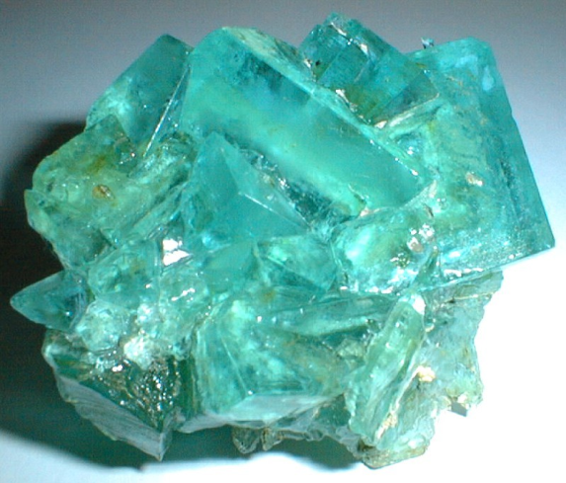
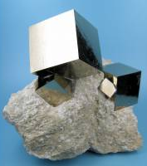
Primary Sources of AP and NP
Acidity
Pyrite, pyrrhotite, marcasite, chalcopyrite, arsenopyrite…
Certain Fe sulfate minerals
Siderite
Neutralization potential
Calcite, dolomite
Certain aluminosilicates (more likely at lower pH values)
Melanterite http://www.mindat.org/min-2633.html
Pyrite in limestone http://www.mindat.org/min-3314.html
Good summary: Plumlee, 1999.

Slide 17
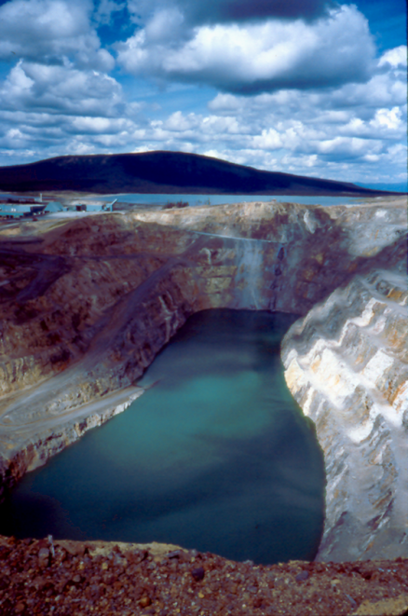
~ ABA Testing Methods
Modified Sobek (pH 7), Lapakko (pH 8.3), BCRI, BCRC, siderite correction
Most commonly used
NCV (Newmont): no titration, infrared for C and S
Only includes carbonate minerals in NP
Can overestimate NP if siderite present
NAG (Net Acid Generation): H₂O₂ + NaOH
Commonly used in Australia, screening only, fast
Does not distinguish between AP and NP
Equity Silver Mine, Canada; photo by A. Maest

Slide 18
ABA/Static Testing: Main Sources of Uncertainty
Cananea Cu Mine, Mexico; photo by A. Maest
Crushed sample – assumes all AP and NP available
Fracture surface vs. groundmass, encapsulation
Final pH < 6: overestimate NP (silicates)
Modified Sobek and Lapakko pH 6 most reliable and conservative (Sobek > modified Sobek > BC Research > Lapakko)
Mineralogy unknown – compare to “mineralogic” AP and NP
Especially important for low S, low NP wastes

Slide 19
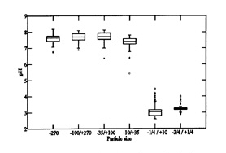
Grain Size and Mineral Availability
Smaller waste rock particles made neutral/ slightly basic drainage
Larger waste rock particles created acidic drainage
Lapakko et al., 1998; http://wvmdtaskforce.com/proceedings/98/98LAP/98LAP.HTM

Slide 20
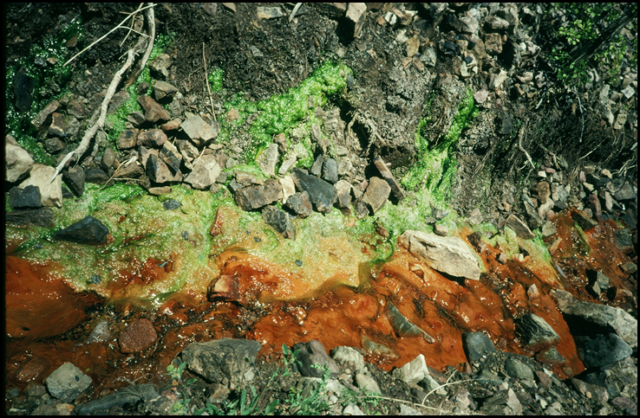
Interpretation of ABA Results
Acid drainage at Eagle Mine, CO; photo by A. Maest
Many options that rely on %S and/or NP, AP
NP:AP, NNP (NP-AP), NCV ranges, etc.
Ideally compare to kinetic testing results or actual mine drainage
NP:AP
Likely not acid-generating: > 3 (or 2 or 4)
Uncertain: 1–3 (or 2 or 4)
Potentially acid-generating (PAG): < 1 (or 0)

Slide 21
Short-term Leach Testing
What: Readily soluble components of mined materials; some states have regulatory levels (often 100x MCLs)
How:
Synthetic precipitation leaching procedure (SPLP) (20:1 = water:rock ratio)
Nevada meteoric water mobility procedure (MWMP) (1:1)
California waste extraction test (WET) (10:1)
British Columbia special waste extraction procedure and modification (BC SWEP) (3:1)

Slide 22
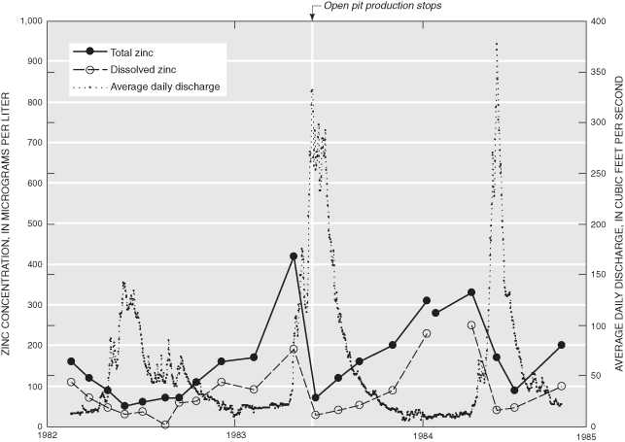
Short-term Leach Testing (cont.)
Advantages/use: Estimates leached concentration ranges from storm/hydrologic events
Limitations:
Avoid use of unweathered materials
Not for predicting long-term behavior – only 18–48 hr tests
Water:rock ratio (Nevada MWMP has lowest w:r ratio, more conservative for arid climates)
Questa Mine, NM, graph: Maest et al., 2004; http://pubs.usgs.gov/sir/2004/5063/

Slide 23
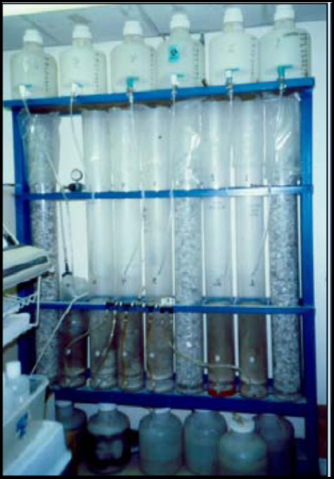
Kinetic Testing
What: Estimates long-term potential to generate acid and other contaminants
How: Crush rock, apply water, measure
Laboratory kinetic tests
Humidity cell
Column (aerated, subaqueous)
Field kinetic test
Waste rock or tailings test piles
Wall washing
Minewall approach (Morin and Hutt, 2004)
2-yr kinetic tests, Montana Tunnels, MT; Photo by A. Maest
Notes:
Crush rock (<6.3 mm for waste rock, 150 mm for tails), place in column
HCT: 3-d alternating humid air/dry air cycles, flush every week, 20+ wks
Measure pH, sulfate, metals, etc. in leachate
Column tests – larger columns and particle size (<~25 mm), “trickle leach”

Slide 24
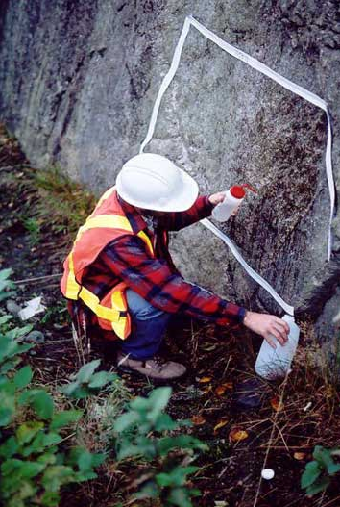
Kinetic Testing (cont.)
Advantages/uses: Acid production rates, long-term weathering, input to geochemical models
Limitations
Representativeness, focus on uncertain ABAs
Field/lab discrepancies: particle size
Length of tests: 20 weeks standard HCT length; too short for most materials, especially if higher NP
Lapakko: tailings with 1.3 wt% calcite and 6.6 wt% pyrite took 112 weeks to generate acid; mix of rotary kiln fines and rock with 2.1 wt% S from Duluth complex took 581 weeks to produce acid
Photo: http://www.gardguide.com/index.php/ Image:WallWashing.jpg
Notes:
Should run kinetic tests on samples with full range of ABA results – need to know concentrations for input to geochemical models

Slide 25
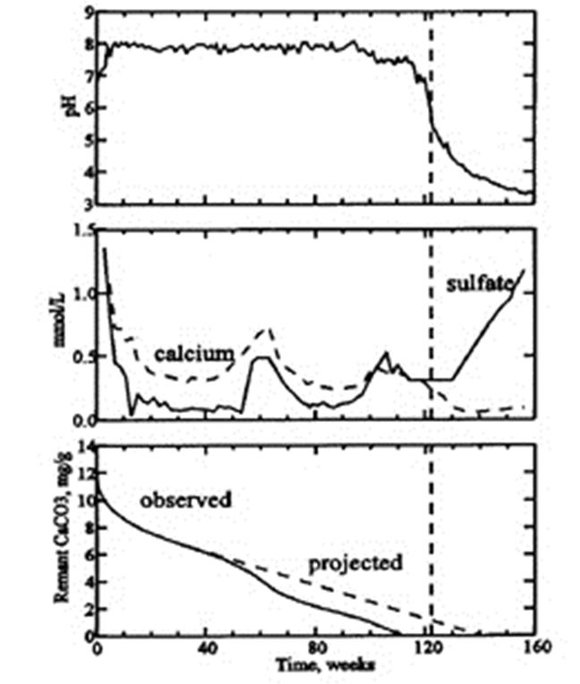
Kinetic Tests: Examples
pH < 6 at week 122
[Ca] < [SO₄] shows NP rate < AP rate
All calcite depleted at week 112
NP:AP = 0.09
Lapakko et al., 1998; http://wvmdtaskforce.com/proceedings/98/98LAP/98LAP.HTM

Slide 26
Kinetic Tests: Examples (cont.)
Nicholson and Rinker, 2000
Metal leaching under neutral pH conditions
Comparison of HCT and column test Ni and SO₄ concentrations

Slide 27
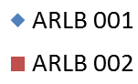
Lab vs. Field – Pebble West Pre-tertiary Mudstone (Cu)
Data source: PLP, 2011; Environmental Baseline Document, Chapter 11
Notes:
Compare field and HCT splits
First flush in weathered, then decreasing concentrations – “steady state” = last 5 week average
Different trends if weathered or not
Need to run even if ABA is PAG – to know concs for inputs to models

Slide 28
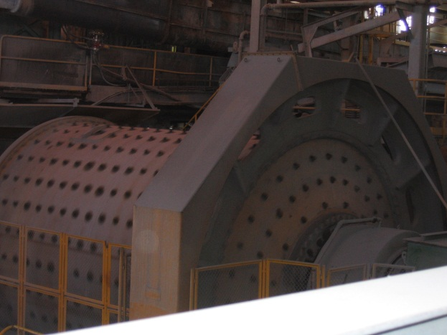
When to Characterize?
Exploration
Static testing (lithology, mineralogy, ABA…)
Geochemical testing units, block model
Mine development
Continue static, start kinetic including field tests
Operation
Continue lab/field testing; predicted/actual comparisons; waste leachate samples
Closure
Continue lab/field comparisons
See Maest et al., 2005 for more detail; Tintaya Mine, Peru, ball mill; photo by A. Maest

Slide 29
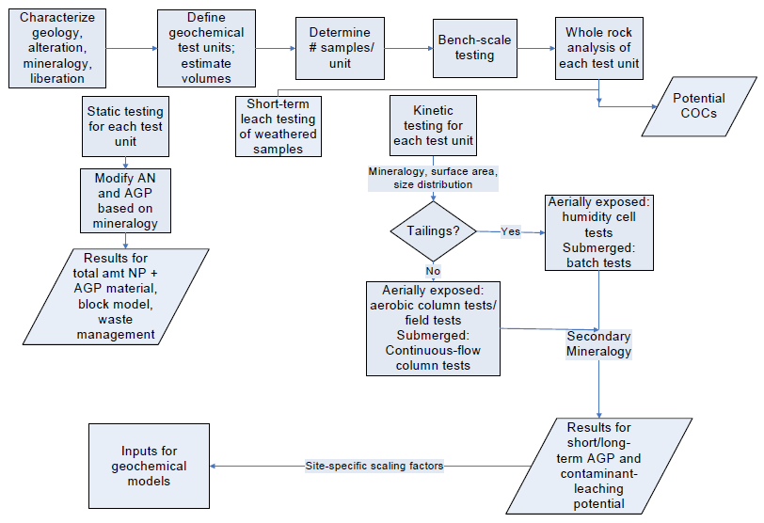
Geochemical Characterization Overview
Maest et al., 2005

Slide 30
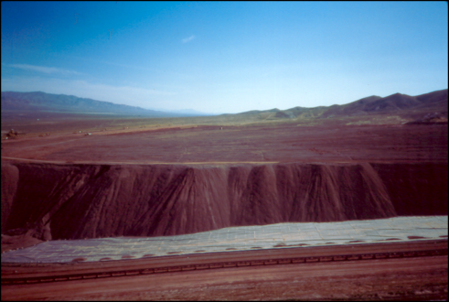
Summary
Rayrock Mine, NV, heap leach pad; photo by A. Maest
Geochemical characterization aims to identify potential contaminants of concern and simulate range of concentrations under mining conditions
Purpose is to inform mine management, including waste/ore placement, water quality monitoring, need for and type of water treatment and mitigation, effectiveness of mitigation measures
Very few required tests or interpretation approaches
Each method has advantages and limitations, and real crux is interpretation of results
Need to compare predictions from tests to real conditions as mining proceeds

