Slide 1
Managing Mine Slimes
and Other Lessons Learned
Todd Bragdon, CDM Smith
Brandon Ball, Parametrix
Bill Adams, EPA Region 10
Rod Zion, USACE Seattle
Jeff Johnson, US BLM
Rich Hamlin, Conti
Jack Waite Mine Removal Action
April 5, 2012

Slide 2
Introduction
Project Team
  Parametrix / CDM Smith; Engineering Design
  U.S. EPA Region 10;
  Lead Regulatory Agency
  U.S. Forest Service; Property Owner, Joint Lead Regulatory Agency
  U.S. Army Corps of Engineers – Seattle District; Construction Procurement and Administration
  Conti; Removal Action Contractor
Site Features
and 2011-2012
Removal Actions
  Removal of two
  tailings piles (TP1
  and TP2) and Mill
  area in alluvial valley
  Consolidation to two repositories: TP3 and Borrow Area 2 (BA2)
  Rehabilitation of Tributary Creek
Managing Mine Slimes – Jack Waite Mine Removal Action

Slide 3
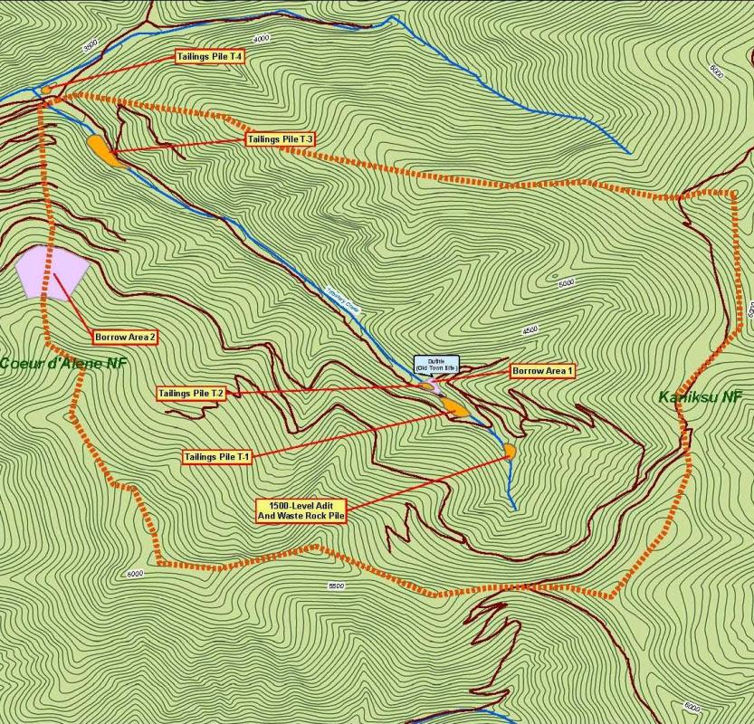
Jack Waite Mine Layout
Tailings Pile TP4
N
Tailings Pile TP3
Borrow Area 2
Borrow Area 1
Tailings Pile TP2
Tailings Pile TP1
1500-Level Adit
and Waste Rock Pile
Managing Mine Slimes – Jack Waite Mine Removal Action

Slide 4
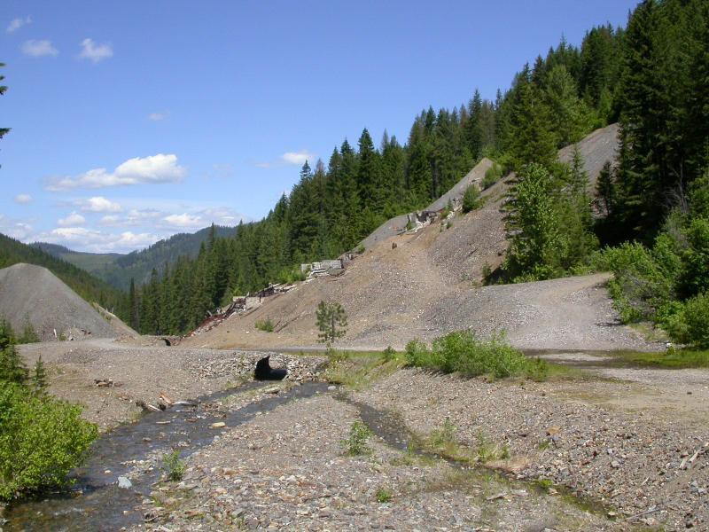
Tailings Pile 1, Mill Area, & Tributary Creek
TP-1 (110,000 cy); Mill Area (14,000 cy); Alluvium (2,900 cy)
TP1
Mill
Tributary Creek
Managing Mine Slimes – Jack Waite Mine Removal Action

Slide 5
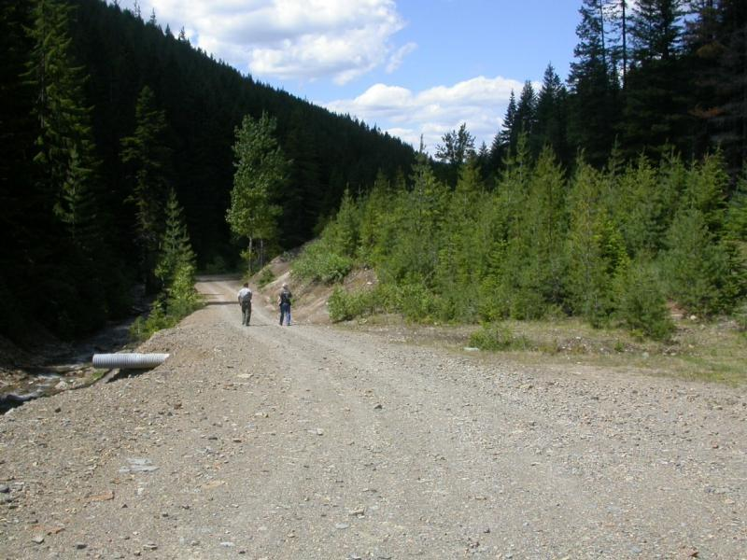
Tailings Pile 2
TP-2 (15,000 cy Tailings)
TP2
Managing Mine Slimes – Jack Waite Mine Removal Action

Slide 6
Materials Management & Restoration (MMR) Issues
2011 MMR Issues Encountered at the Jack Waite Site
  Difficult material types
  Additional waste volumes
  Insufficient borrow soil gradation characterization
  TP3 alluvial repository configuration
  Remote high elevation site; limited construction season
Issue Discussion
  Design approach
  2011 construction issue
  Solutions / lessons learned
Managing Mine Slimes – Jack Waite Mine Removal Action

Slide 7
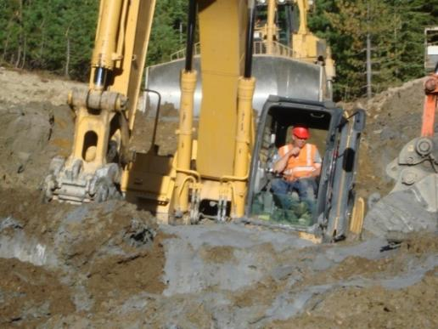
Difficult Material Types
Design Approach
  Borings and cone penetrometers
  completed through tailings piles
2011 Construction Issue
  TP2 slimes encountered in July 2011
  Difficult to excavate material
  Difficult to haul material – transportation
  caused separation of solids / liquids & spills
Solutions / Lessons Learned
  Temporary stockpile material to dewater, addition of Portland Cement (5%); transportable; achieved good compaction
  For tailings piles, focus on potential volume of this material
Managing Mine Slimes – Jack Waite Mine Removal Action

Slide 8
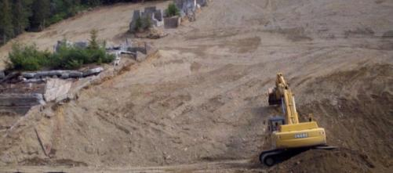
Additional Waste Volumes
Design Approach
  Aerial survey / LiDAR data (2-ft. topographic contouring)
  Test pit and boring extent / depth of mine wastes
  Mine waste volumetrics developed using CAD 3D
  Contingency volumes included (~30 Percent)
2011 Construction Issue
  Additional waste rock volume at Mill Site (34,000 vs. 14,000 cy)
  Additional tailings volume at TP2 (23,000 vs. 15,000 cy)
  2012 concerns with waste volume in Tributary Creek alluvium
Solutions / Lessons Learned
  Flexibility in repository design
  to allow additional capacity
  Steep slopes and alluvial
  interface difficult to estimate
Managing Mine Slimes – Jack Waite Mine Removal Action

Slide 9
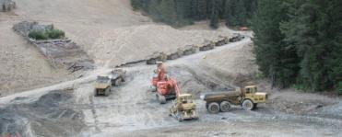
Insufficient Borrow Soil Gradation Characterization
Design Approach
  Repository cover / rehabilitation area growth media and fill primarily developed from Borrow Area 2
  Test pits used to estimate
  depth of borrow soils
  Field observations / geotechnical data used to evaluate gradation (oversize
  vs. granular material)
  Borrow soil volumetrics developed using CAD 3D
  and gradation
2011 Construction Issue
  Significantly more oversize
  material - 19,000 cy vs. 11,000 cy
  Limited stockpiling areas / double handling in steep terrain
Solutions / Lessons Learned
  Design approach should use
  grizzly / screening for oversize rock
Managing Mine Slimes – Jack Waite Mine Removal Action

Slide 10
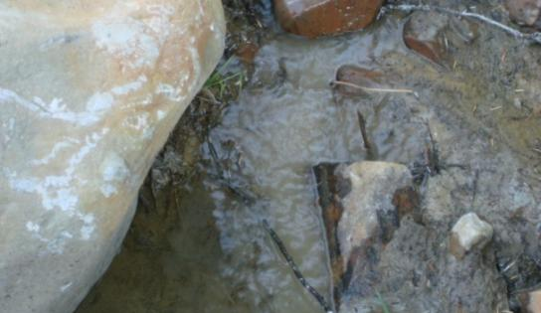
TP3 Alluvial Repository Configuration
Design Approach
  EE/CA and Action Memorandum
  included TP2 repository located
  in Tributary Creek alluvial valley
  Volume and cost constraints
  Maximize mine waste in BA2 repository
  Utilize low permeability cover to reduce infiltration
  Utilize riprap toe armoring (100-yr event) ; HEC-RAS model
2011 Construction Issue
  Tailings piping observed
Solutions / Lessons Learned
  Revised design to include toe drain system
Managing Mine Slimes – Jack Waite Mine Removal Action

Slide 11
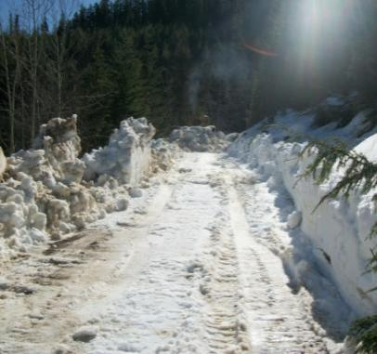
Remote High Elevation Site
Design Approach
  Completed design / contracting process
  in 2010 (utilized $1.2M ARAR funding)
  Allowed for snow removal in bid for early mobilization
  Allowed for flexibility in bid for one or two-season construction
2011 Construction Issue
  Snow plowed in May; heavy precipitation
  in June; limited site construction until July
Solutions / Lessons Learned
  Field conditions can
  significantly impact schedule
  Consider summer traffic on hauling
Managing Mine Slimes – Jack Waite Mine Removal Action

Slide 12
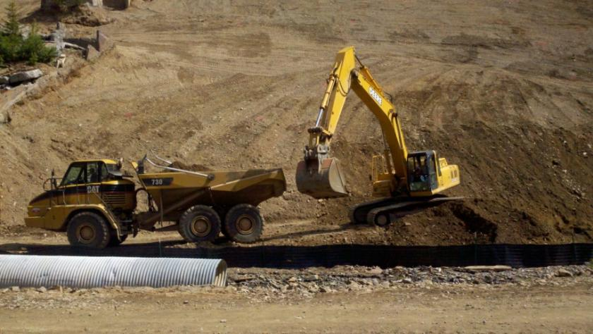
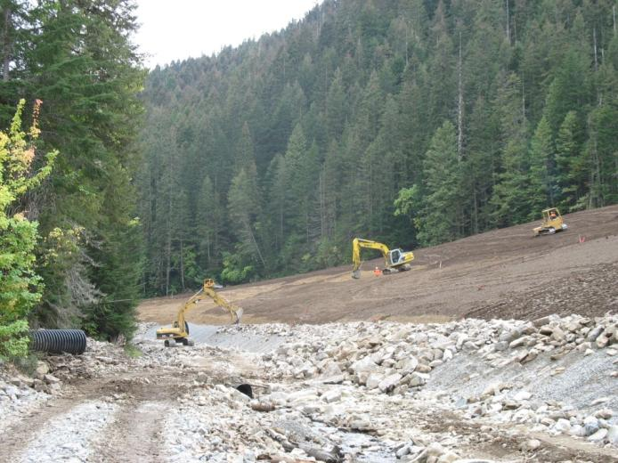
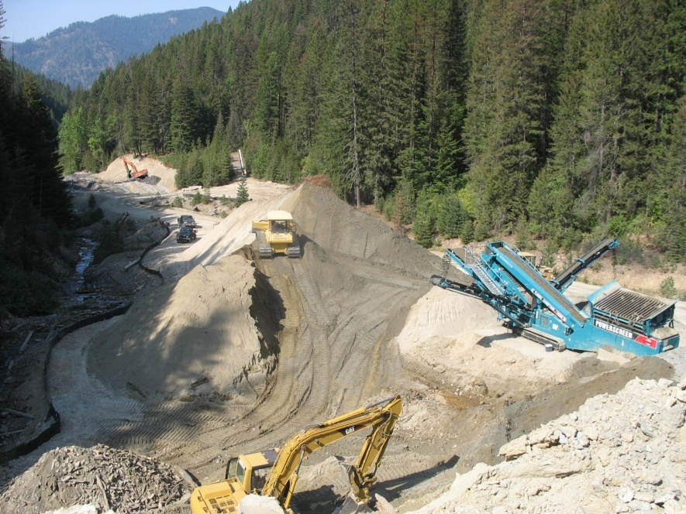
Questions
Managing Mine Slimes – Jack Waite Mine Removal Action

