Slide 1
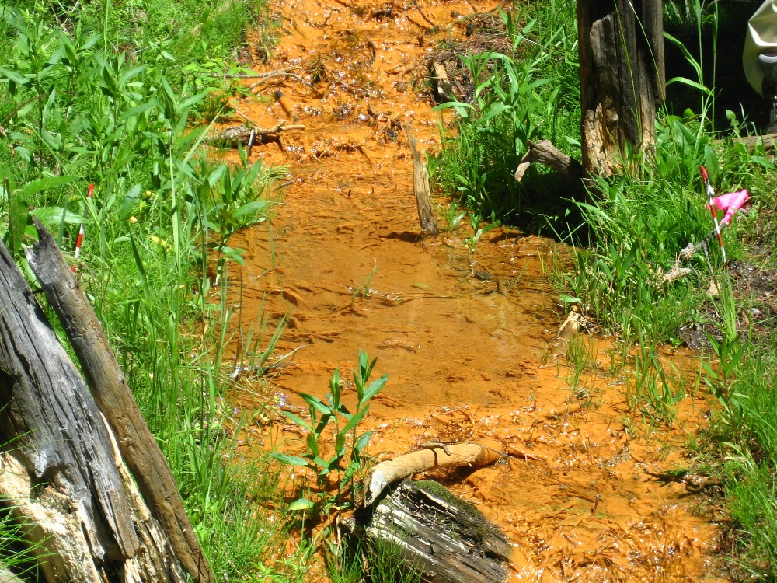
Acid Mine Drainage Source Control Program Design Investigation
Angela Frandsen, PE
Helena, Montana
Upper Tenmile Creek Mining Area Site
April 3, 2012

Slide 2
Overview
Tenmile Creek Superfund Background
Adit Discharge Source Control Program
Susie/Upper Valley Forge and Lee Mountain Source Control Findings
Upcoming Work

Slide 3
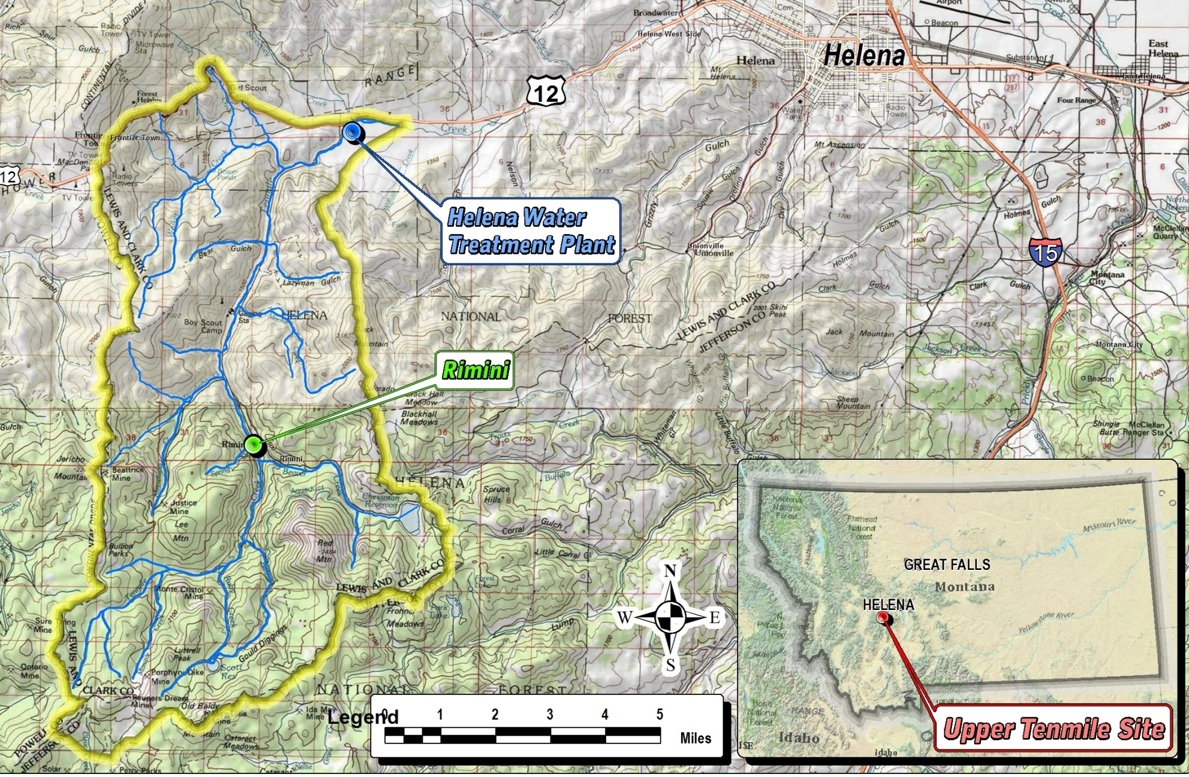
Site Background
Over 150 abandoned mines
About 40 discharging adits
Primarily gold, lead, and zinc
70-80 percent of the municipal water supply for Helena
EPA –Fund Lead – no PRPs

Slide 4
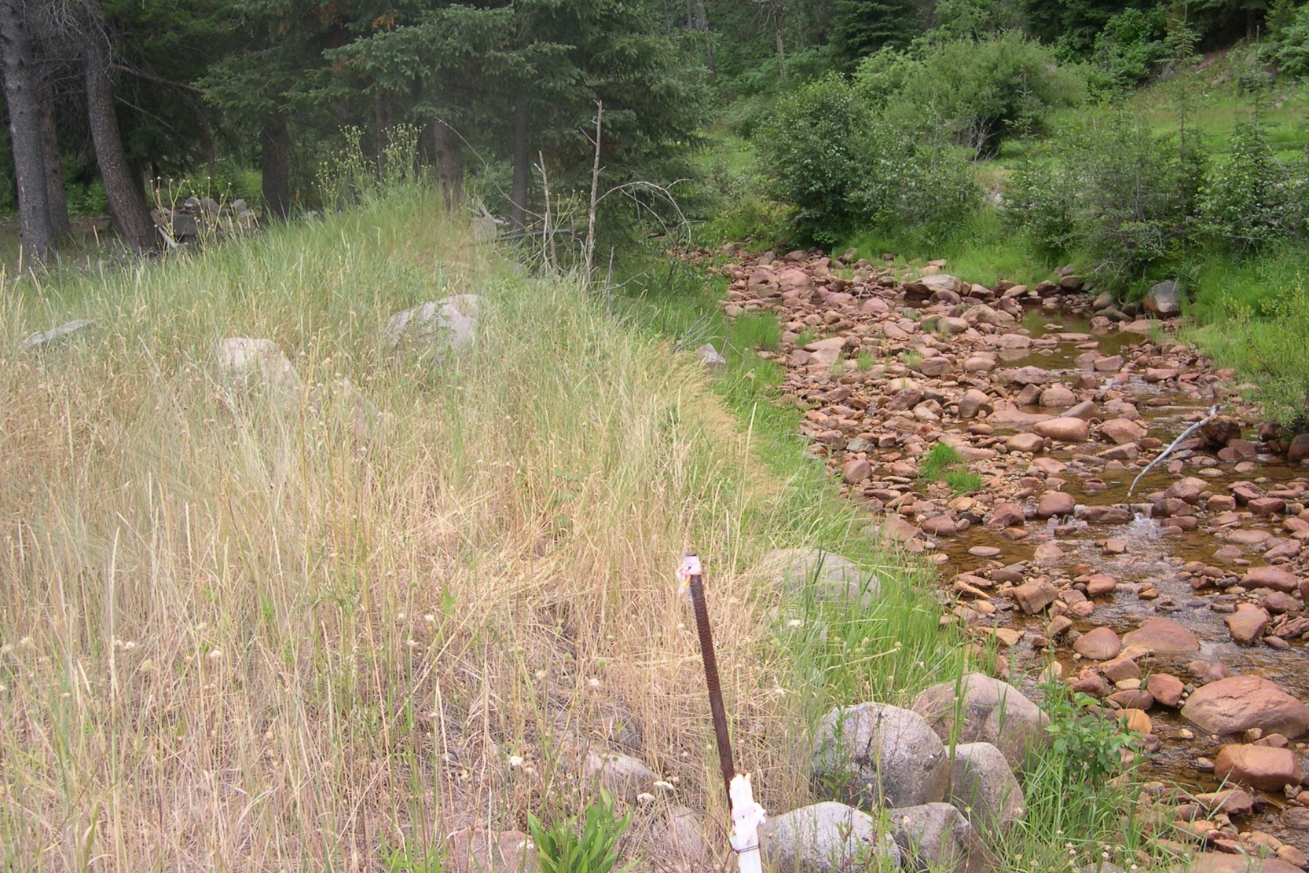
Tenmile Creek in Rimini
Low flows due to city water diversions
Elevated Arsenic Cadmium, Lead, and Zinc

Slide 5
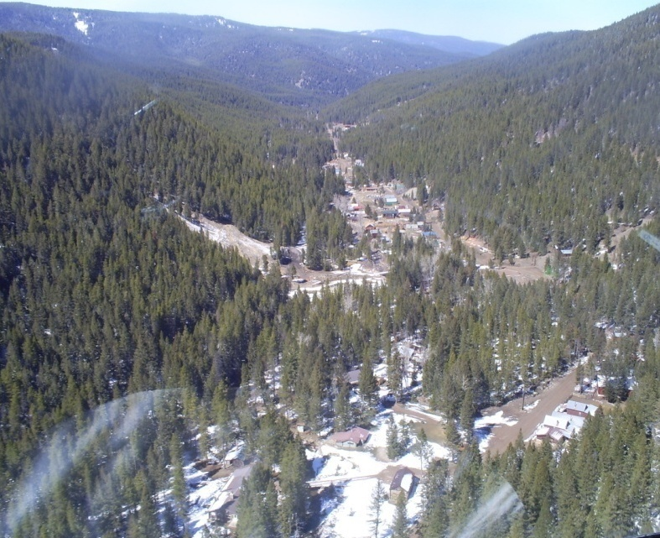
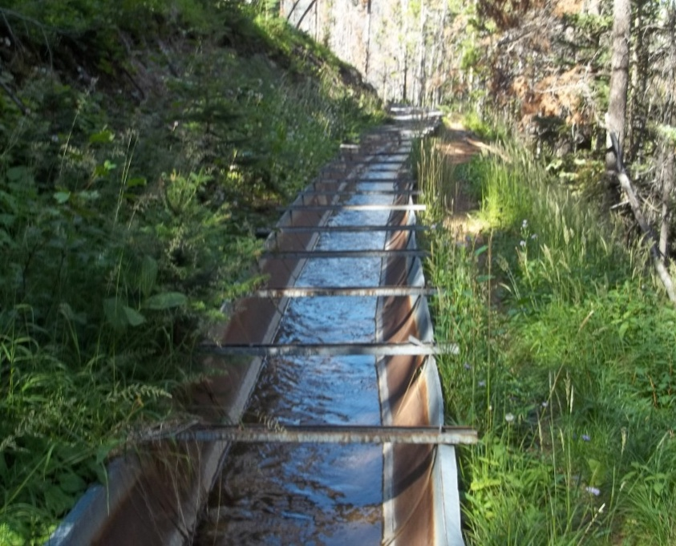
Record of Decision (2002)
Overall Goals of Selected Remedy:
Protect watershed which serves City of Helena
Remove mine wastes from 70 abandoned sites to repository
Remove contaminated residential yard soils to repository
Adit discharge source control and treatment

Slide 6
Tenmile ROD Requirements for Adit Discharge
“Four-Phase” Source Control Program to reduce contaminant loading from discharging adits to the watershed.
Three adit discharges qualify as “Principle-Threat Wastes”
  Lee Mountain
  Susie
  Red Water
  “…source materials considered to be highly toxic or highly mobile that generally cannot be contained in a reliable manner or that would present a significant risk to human health or the environment should exposure occur”
Expectation of treatment under the NCP
These three account for 70-80% of metals loading from adit discharge

Slide 7
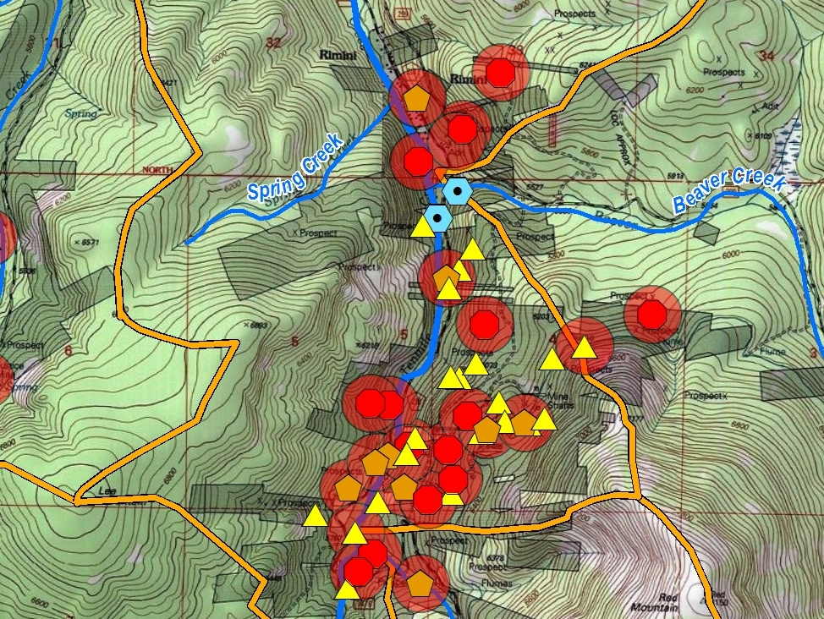
Rimini
Susie
City of Helena Water Intake
Lee Mt
Red Water

Slide 8
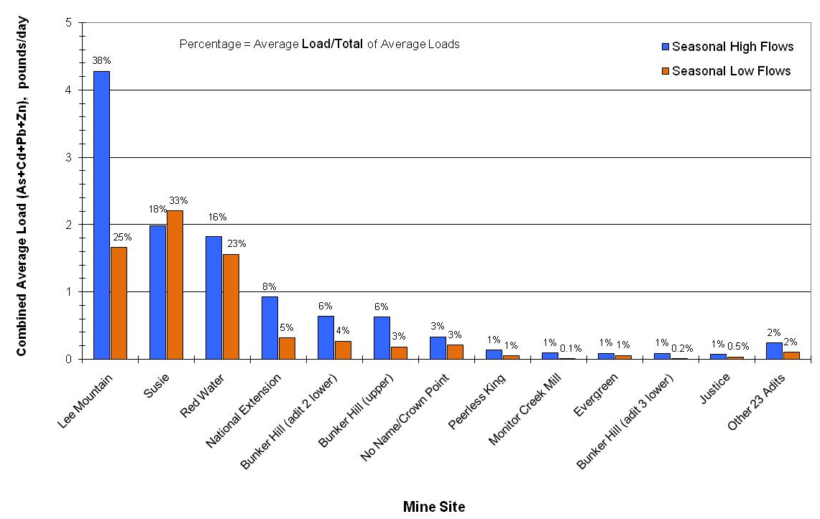
Site Wide Mass Load Ranking

Slide 9
Source Control Program
Phase 1 – Initial Design Investigations
  Site Prioritization
  Figure out the unique hydrology/geochemistry of the mine
  Tracers, historic workings maps, flow measurements
Phase 2 – Source Control and Flow Reduction Design Studies
  Pilot scale - regrading, rerouting drainages, plugging, grouting, flooding, dewatering
Phase 3 – Source Control and Flow Reduction Implementation
  Implement full scale if successful
Phase 4 – Design and Construction of Treatment Facilities – Passive or Active

Slide 10
Phase I Design Investigations on the
Susie and Lee Mountain Adits
Two discharging adits on opposite sides of the canyon
Within the Community of Rimini
Less than 1,500 feet apart
Understanding the internal workings is critical to reducing flows and contaminant loading
Results – these two adits require different source control strategies

Slide 11
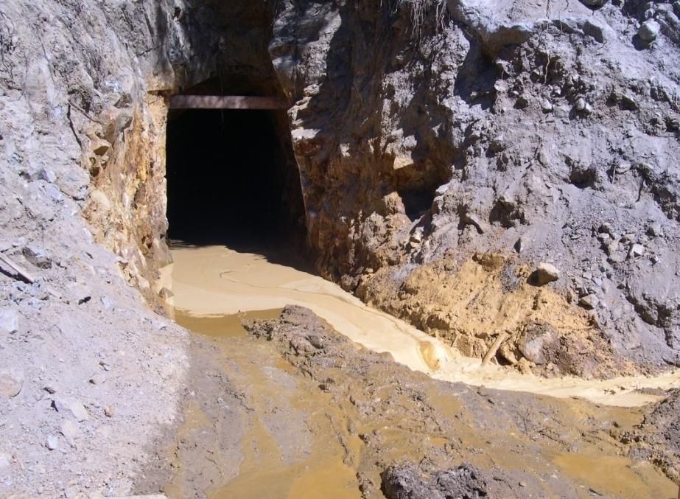
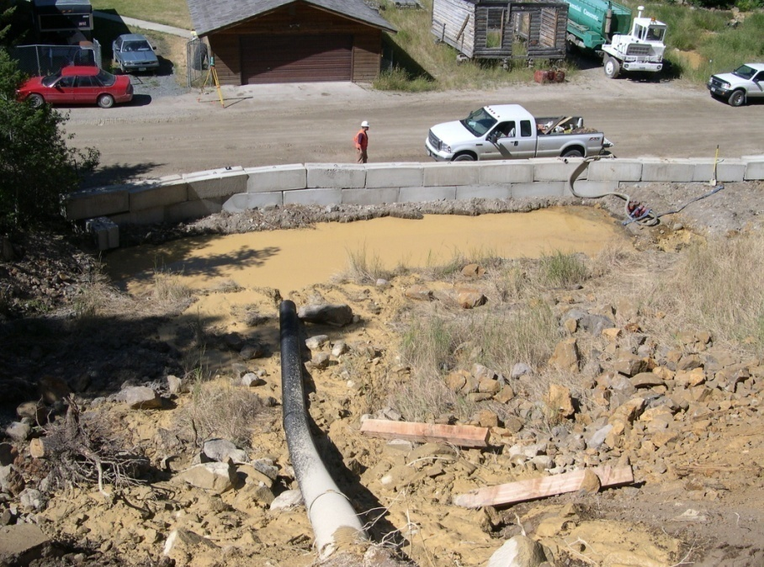
Susie Adit
Drains Upper Valley Forge
5-10 gpm
pH 3.5-4.3
As = 10-20 mg/L
Fe = 150-200 mg/L
Al ~ 1 mg/L
Cd ~ 200 ug/L
Zn ~ 30 mg/L
These are several orders of magnitude above water quality standards
Adit reopening in 2005

Slide 12
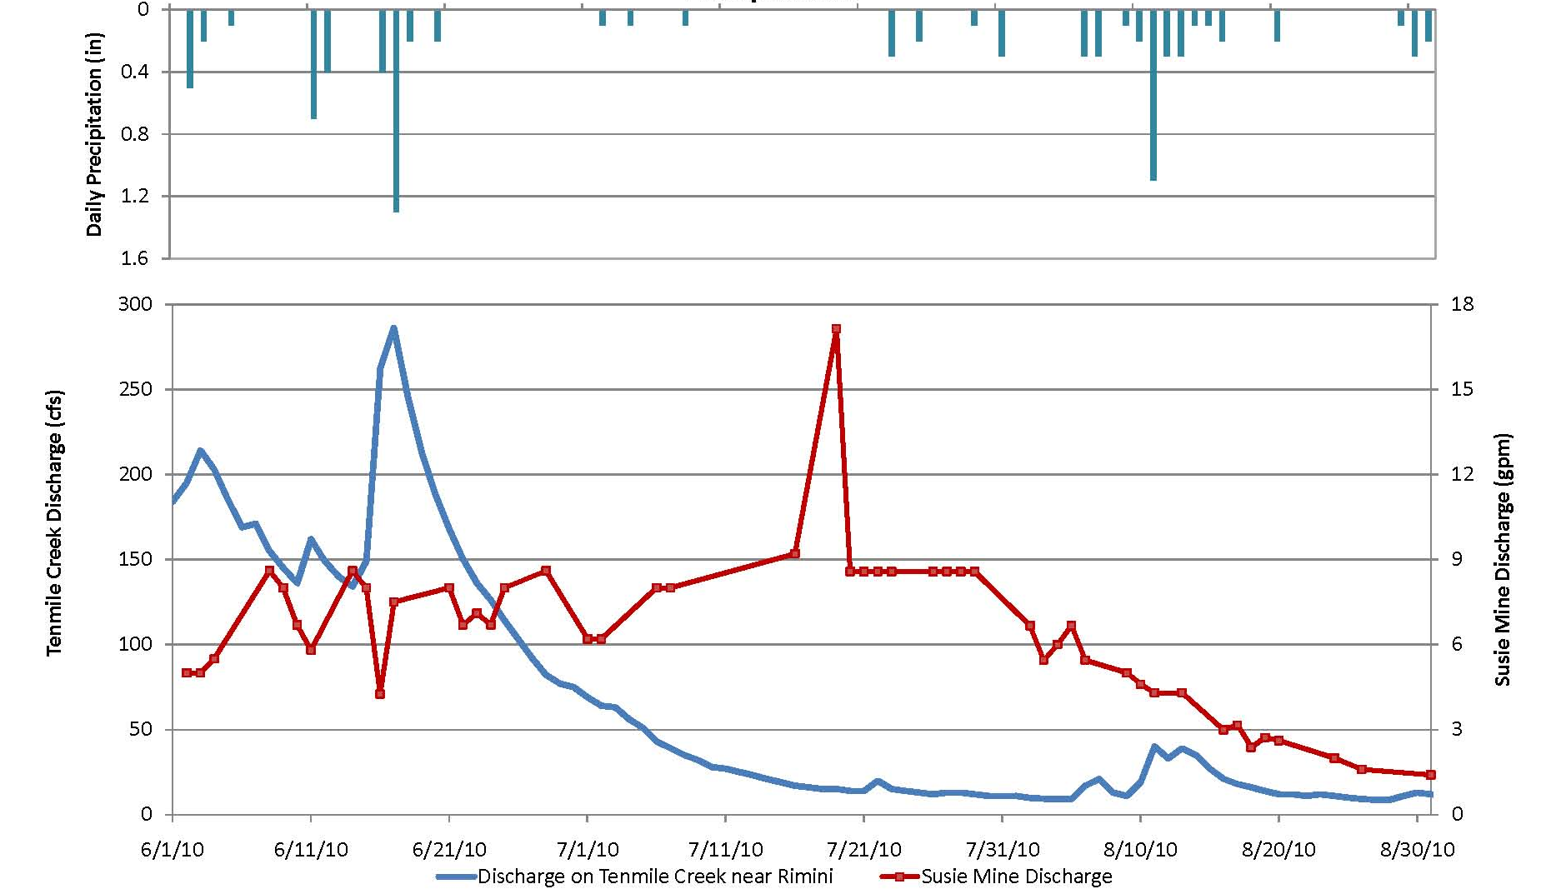
2010 Susie Discharge
No immediate response to precipitation

Slide 13
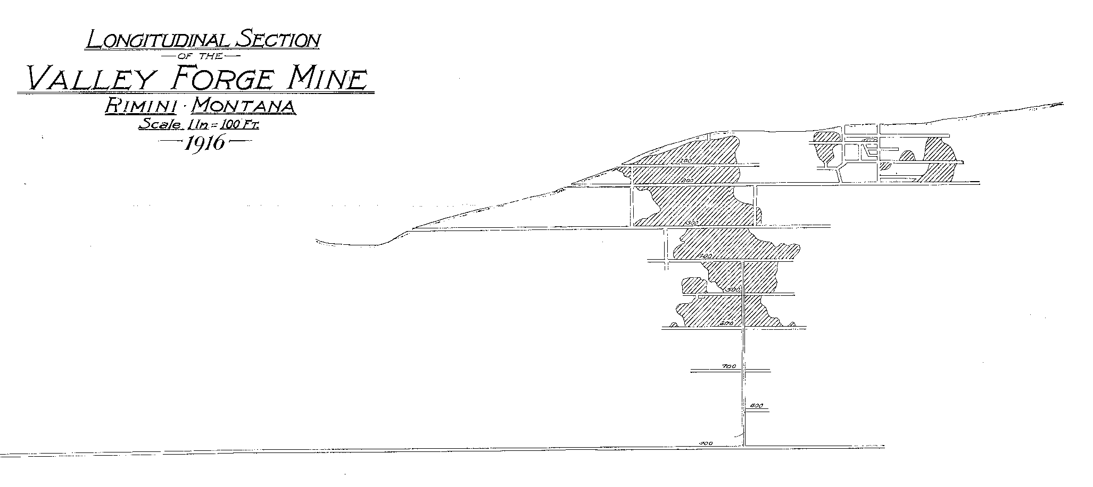
Historic Mine Workings
Susie Adit Drains the Upper Valley Forge Mine Workings
← 1 mile!

Slide 14
Historic Mine Workings – Plan View
Susie Adit
Can we reduce infiltration from the surface to the workings?

Slide 15
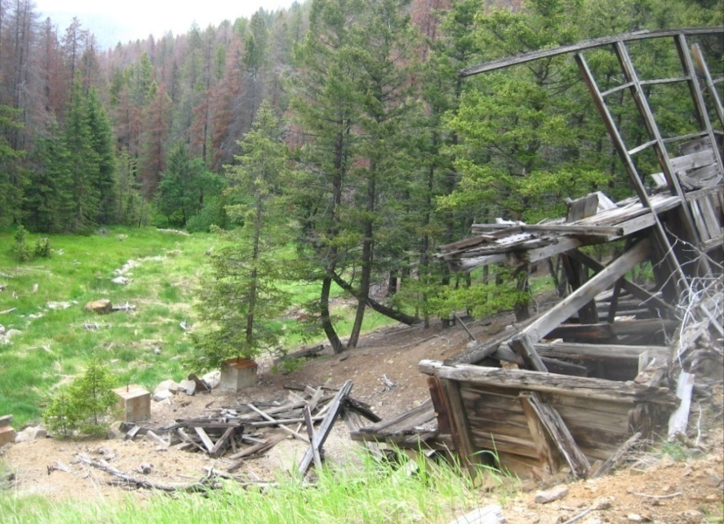
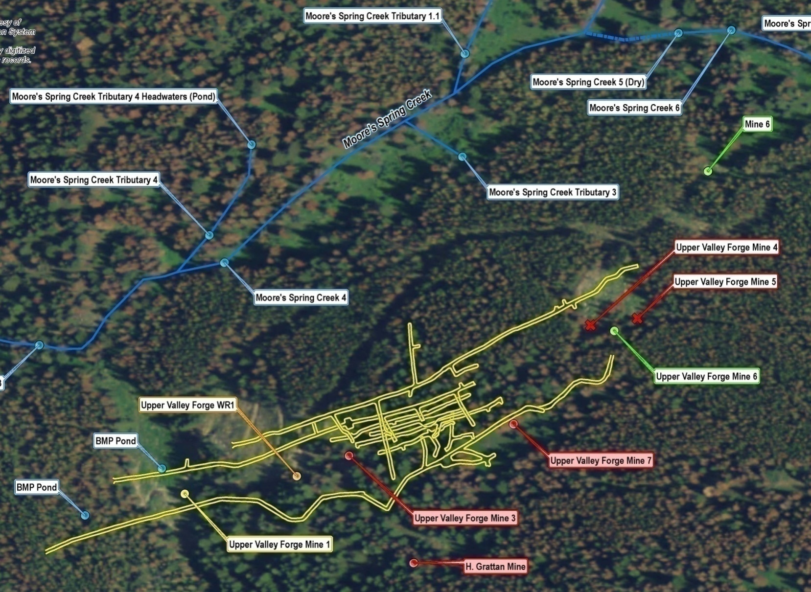
2010 Site Reconnaissance
Dry Reach
Identify possible areas of recharge
Plan Tracer Study
Two Ponds

Slide 16
2011 Tracer Study
Determine if hydraulic connection between surface water bodies and the adit discharge.
Presence/Absence
Three injection points dosed with three different dyes:
  Two small ponds
  Losing reach of Moore’s Spring Creek
From a remediation standpoint, the two ponds and the creek are the features that could most easily be altered to limit infiltration to the mine workings

Slide 17
2011 Tracer Study
5 pounds of Eosine introduced in Moore’s Spring Creek
6 pounds of Fluorescein introduced into Pond 2
5 pounds Rhodamine WT introduced into BMP Pond
Activated carbon sample points:
  Susie Adit
  Two residential wells upgradient and downgradient of the adit
  Mouth of Moore’s Spring Creek
  Residential springs upgradient and downgradient of Moore’s Spring Creek

Slide 18
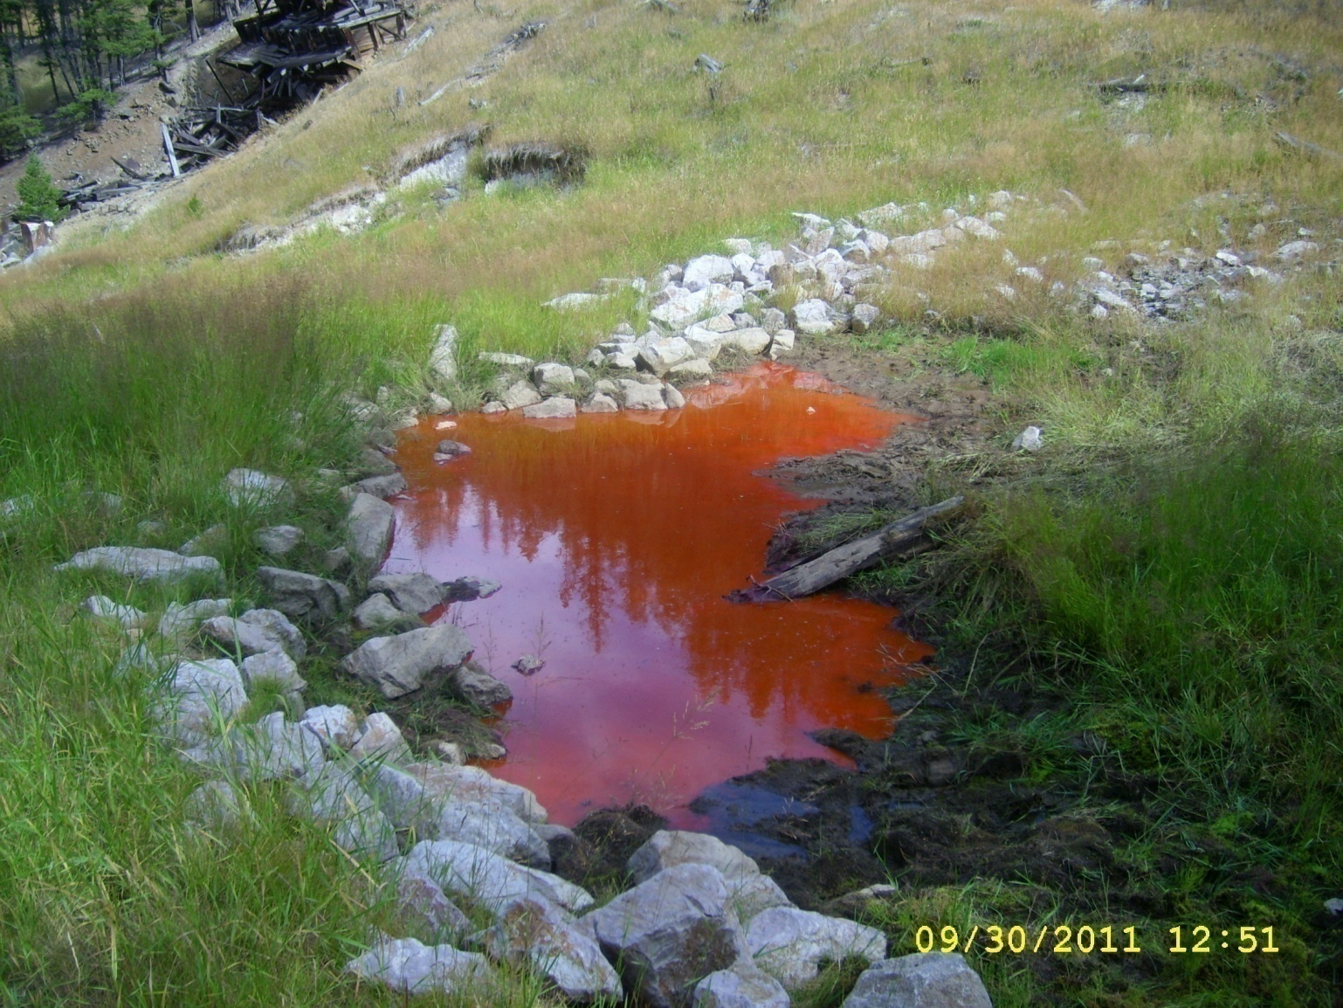
Tracer Study

Slide 19
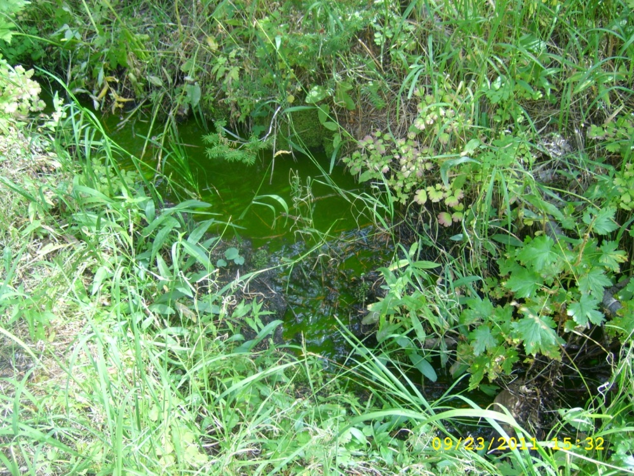
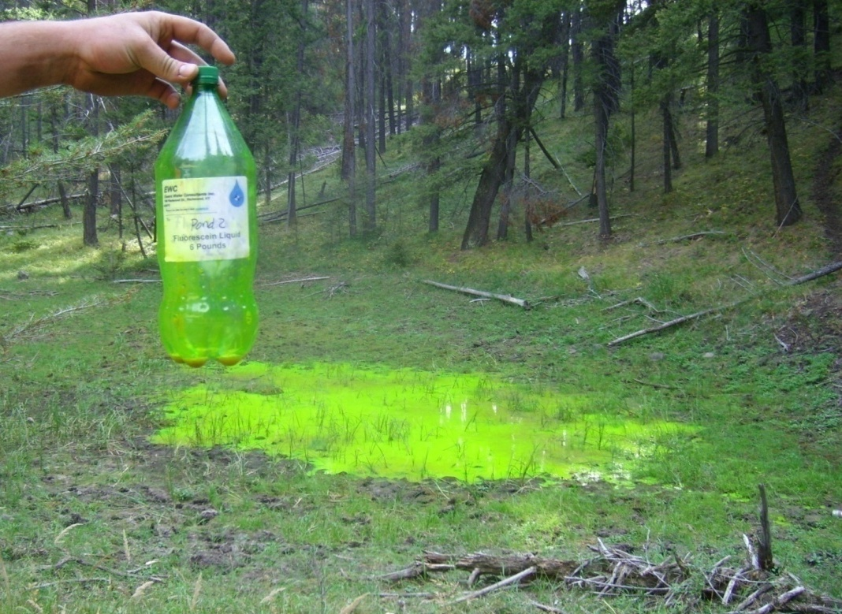
Tracer Study

Slide 20
Tracer Results
Dye tracer detected at mouth of Moore’s Spring Creek
  Expected
No detections in Susie adit, springs, or groundwater wells
  Travel time?
  Insufficient tracer mass?
  No connection?
Still sampling once per month

Slide 21
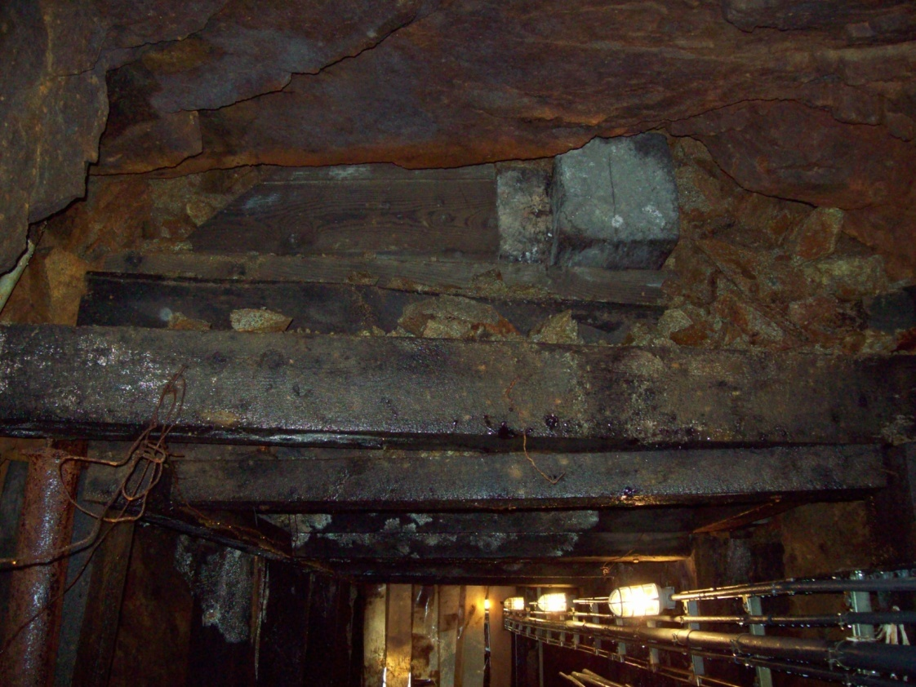
Susie - Next Steps
Bulkhead evaluation
  Would the water discharge somewhere else?
  Any other unmapped connected workings?
Stability and safety going underground
Safety of Rimini residents
Ceiling Void

Slide 22
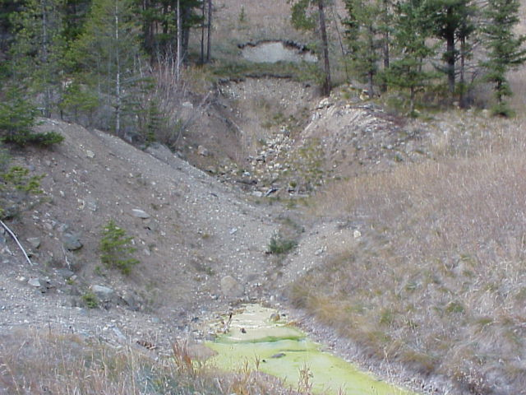
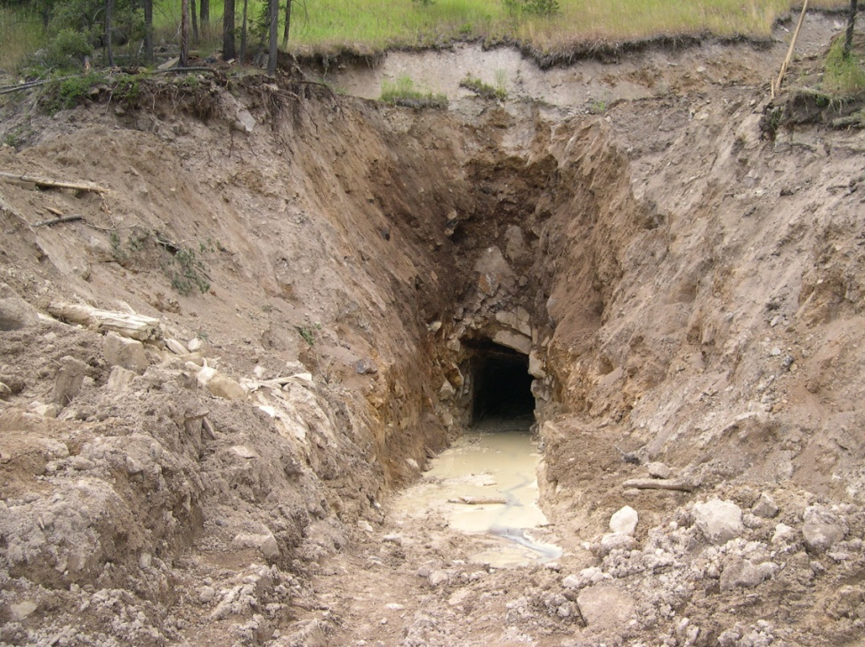
Lee Mountain Adit
2-8 gpm
pH <3 (2.5-3)
As ~ 25-30 mg/L
Fe ~ 250 mg/L (dissolved)
Al ~ 20 mg/L (dissolved)
Cd ~ 0.5-1 mg/L
Zn ~ 50-80 mg/L
Pb ~ 0.3-0.6 mg/L
Orders of magnitude above standards
Adit reopening in 2005

Slide 23
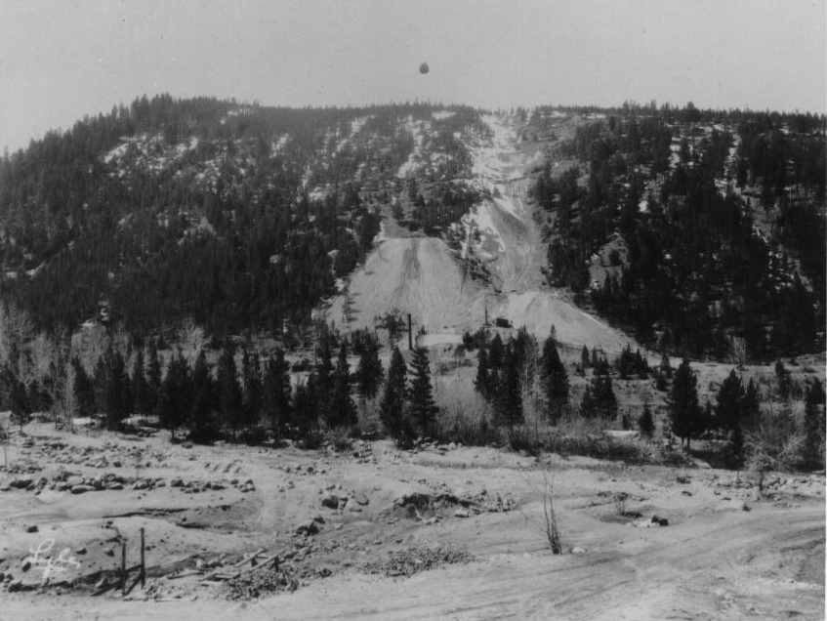
Lee Mountain – Waste Piles
Adit

Slide 24
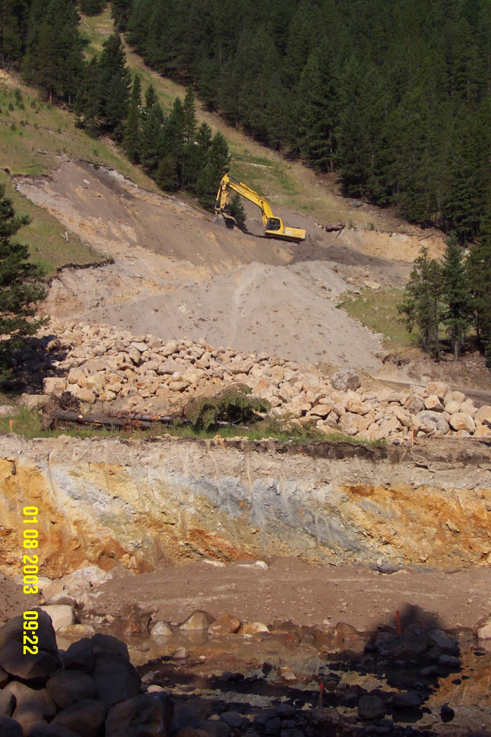
Lee Mountain
Waste removals occurred incrementally
Waste Removals

Slide 25
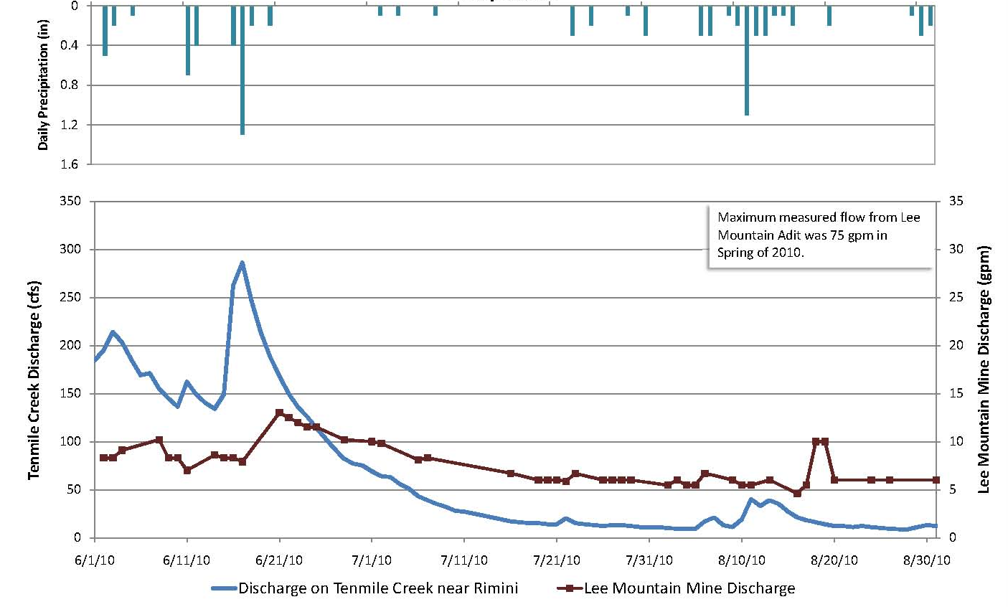
2010 Lee Mountain Discharge
Increased flows after precipitation events
Unusually high flow observed prior to regular monitoring

Slide 26
Lee Mountain Cross Section - 1918
Adit

Slide 27
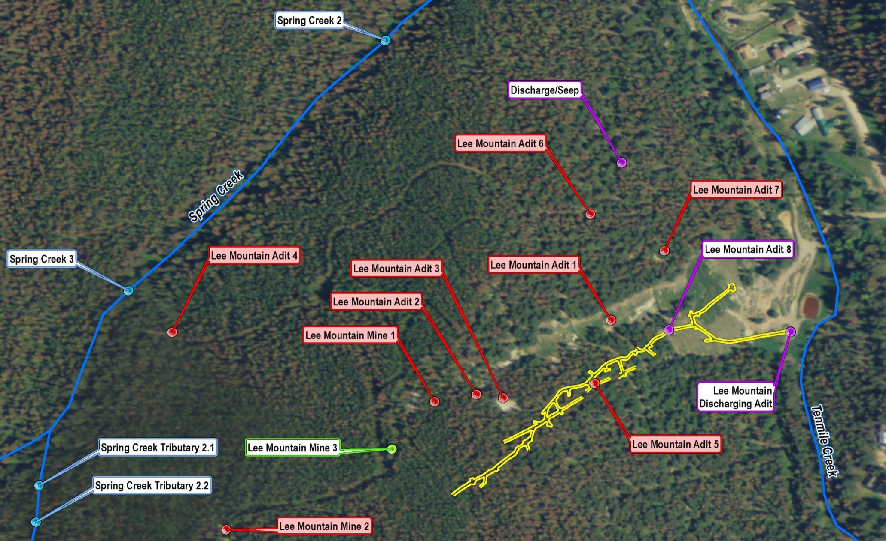
700-Level Workings and Reconnaissance

Slide 28
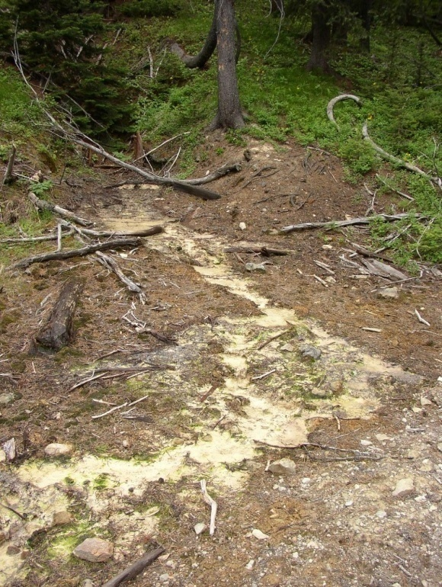
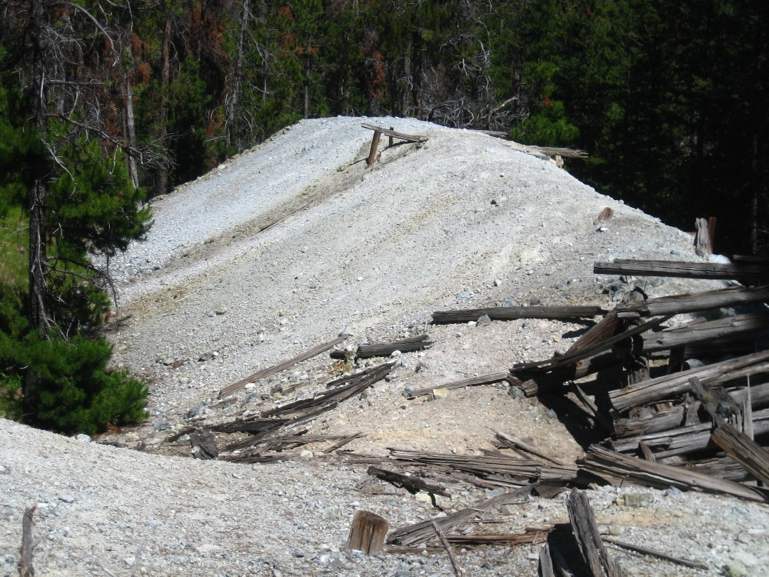
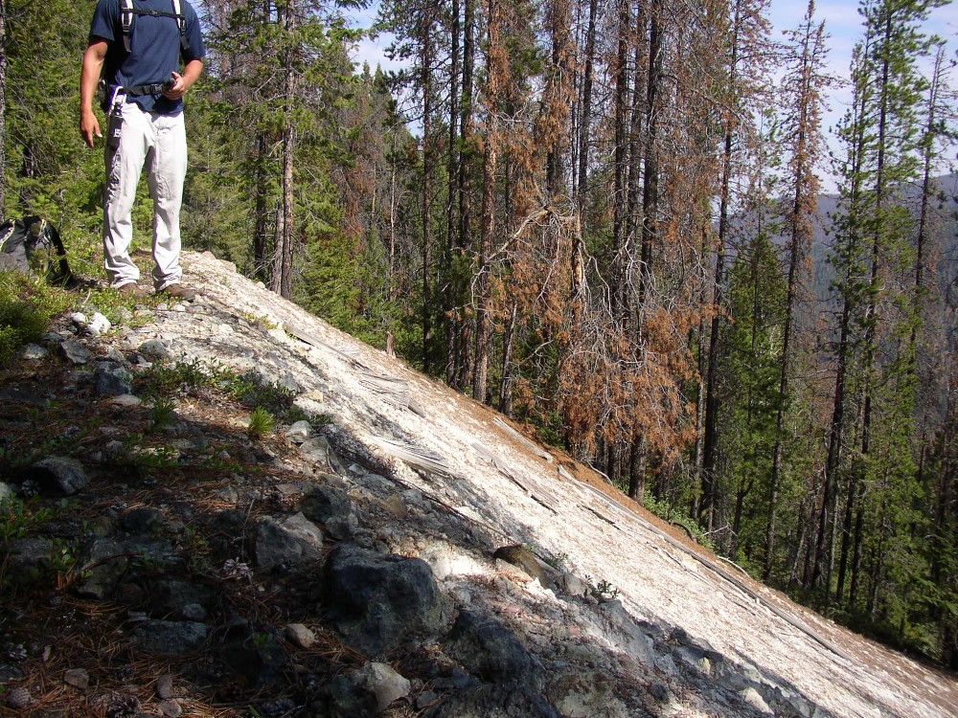
2010 Reconnaissance
Adits and shafts and waste rock farther up very steep hill
Previously unknown discharging adit – “Caplice” mine
Shaft with snow inside
Deep exploration trenches
Minimal connection with nearest creek

Slide 29
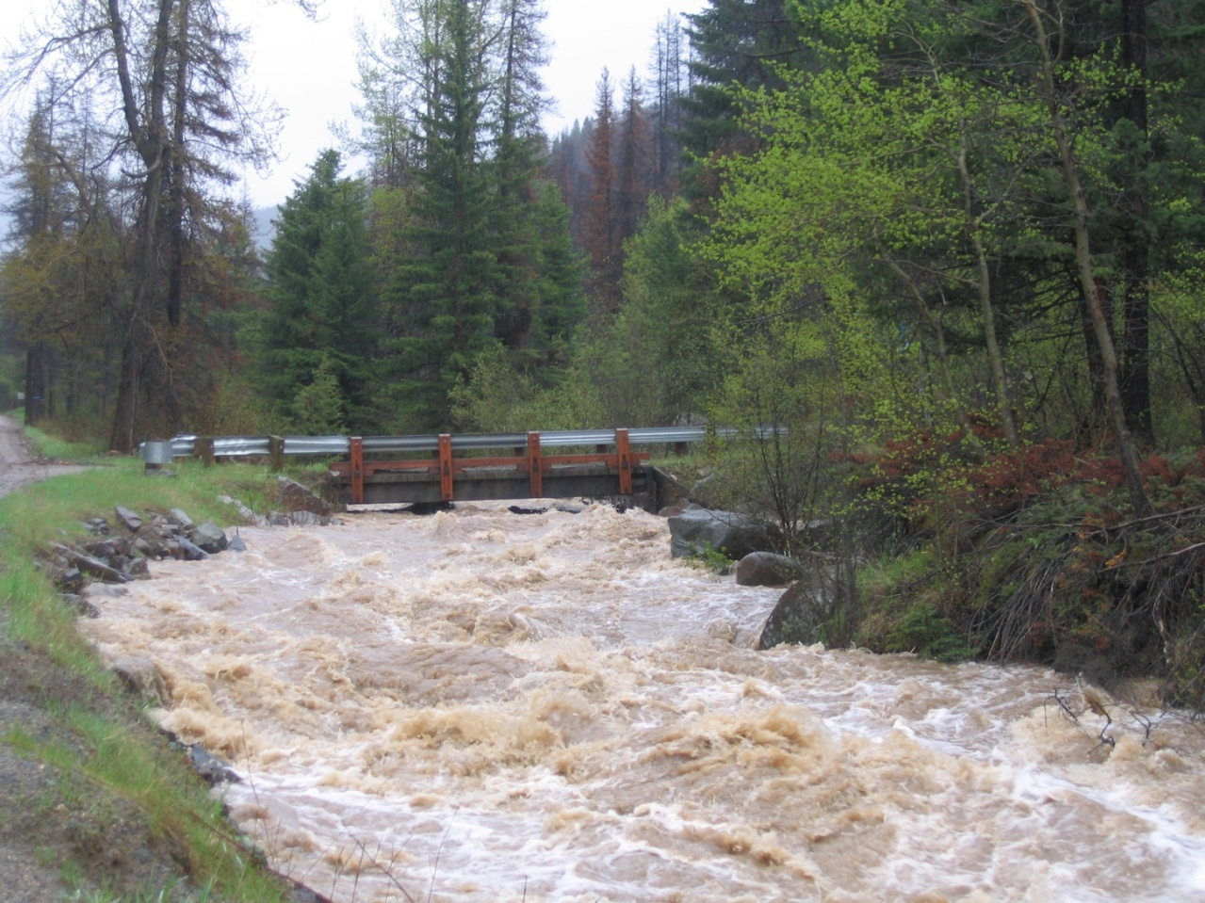
2011 Flow Measurements
Install continuous recorder prior to spring runoff to capture the peak and to determine flow variation
Tenmile Creek reached over 600 cfs on June 7, 2011

Slide 30
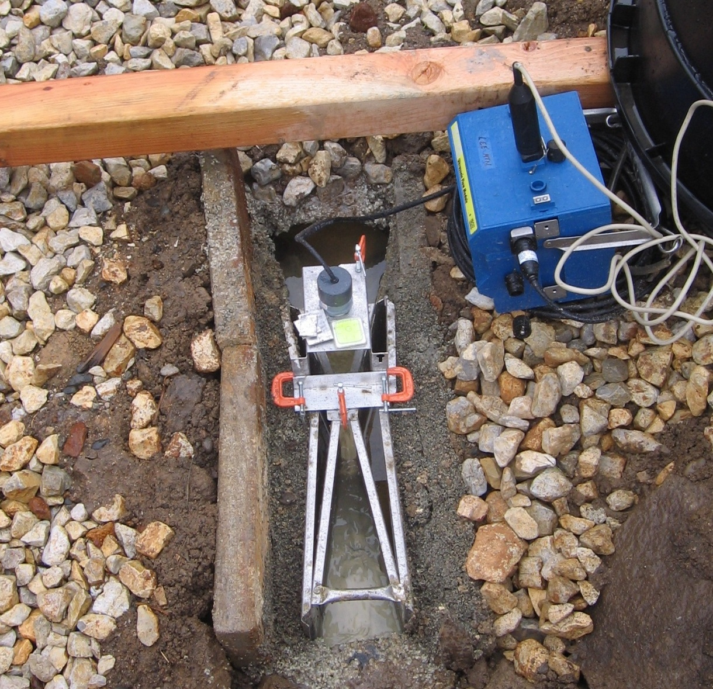
Cutthroat Flume and Stage Recorder

Slide 31
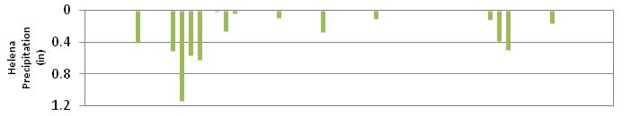
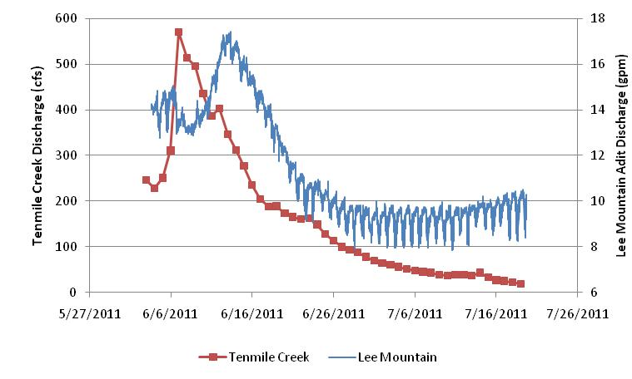
Lee Mountain Discharge - 2011
Confirmed flows increase after precipitation
Daily snowmelt signature

Slide 32
Lee Mountain - Next Steps
Bulkhead ruled out due to interconnected workings and adits higher on the mountainside
Can we drill horizontal wells to dewater the mountain away from the mine workings?

Slide 33
Upcoming Work and Tough Questions
Scoping for bulkhead feasibility (Susie) and horizontal drilling (Lee Mountain)
Red Water adit investigation
Evaluate further source control costs versus long-term water treatment costs – is it worth chasing these source control measures for these two adits?
  Good access and existing infrastructure
  Success of source control uncertain – if 75% reduction is achieved, are we still killing fish? Will we still need treatment?
Each mine site is unique!!

