Slide 1

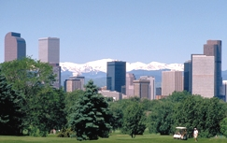

The Mining Legacy and EPA ORD: Past, Present and into the Future
David J. Reisman, EPA*

Slide 2
I am Required to Inform You a.k.a, “The Disclaimer”
The following slides and words from this Gentleman’s mouth represent his thoughts and musings and surely do not represent U.S. EPA policy. Of course that has been true for the last 33 years, so why would today be different?
Notes:
In planning this plenary session and talking with several folks, one person struck a strong chord of talking about his company does not do mining any more, but has a long list of sites that they are working on remediation plans or actual remediation. I thought back on my start in this area and EPA ORD’s start. Today the three speakers all following the break have one strong tie. They were there at the beginning of what is now common place. With each of them, I asked that they spend ½ their allotted time (joke of 25 minutes gentlemen) on the past, and the rest of the time on the future—what do they see as needs wishes or hopes.
Of course I never ask my consultants and contractors to do anything unless I would do it myself…(joke)
Personal Glimpse on 5 areas where I see the future in Mining Influenced Water and Material Remediation.
Yes many of you still haven’t adopted the MIW or BCR terms, but that is changing. I think I have finally found an acronymn to describe a technology that everyone can remember and understand….it of course took one of those after meeting meetings that took place in an establishment that sells better alcohol that we feed some bacteria…

Slide 3
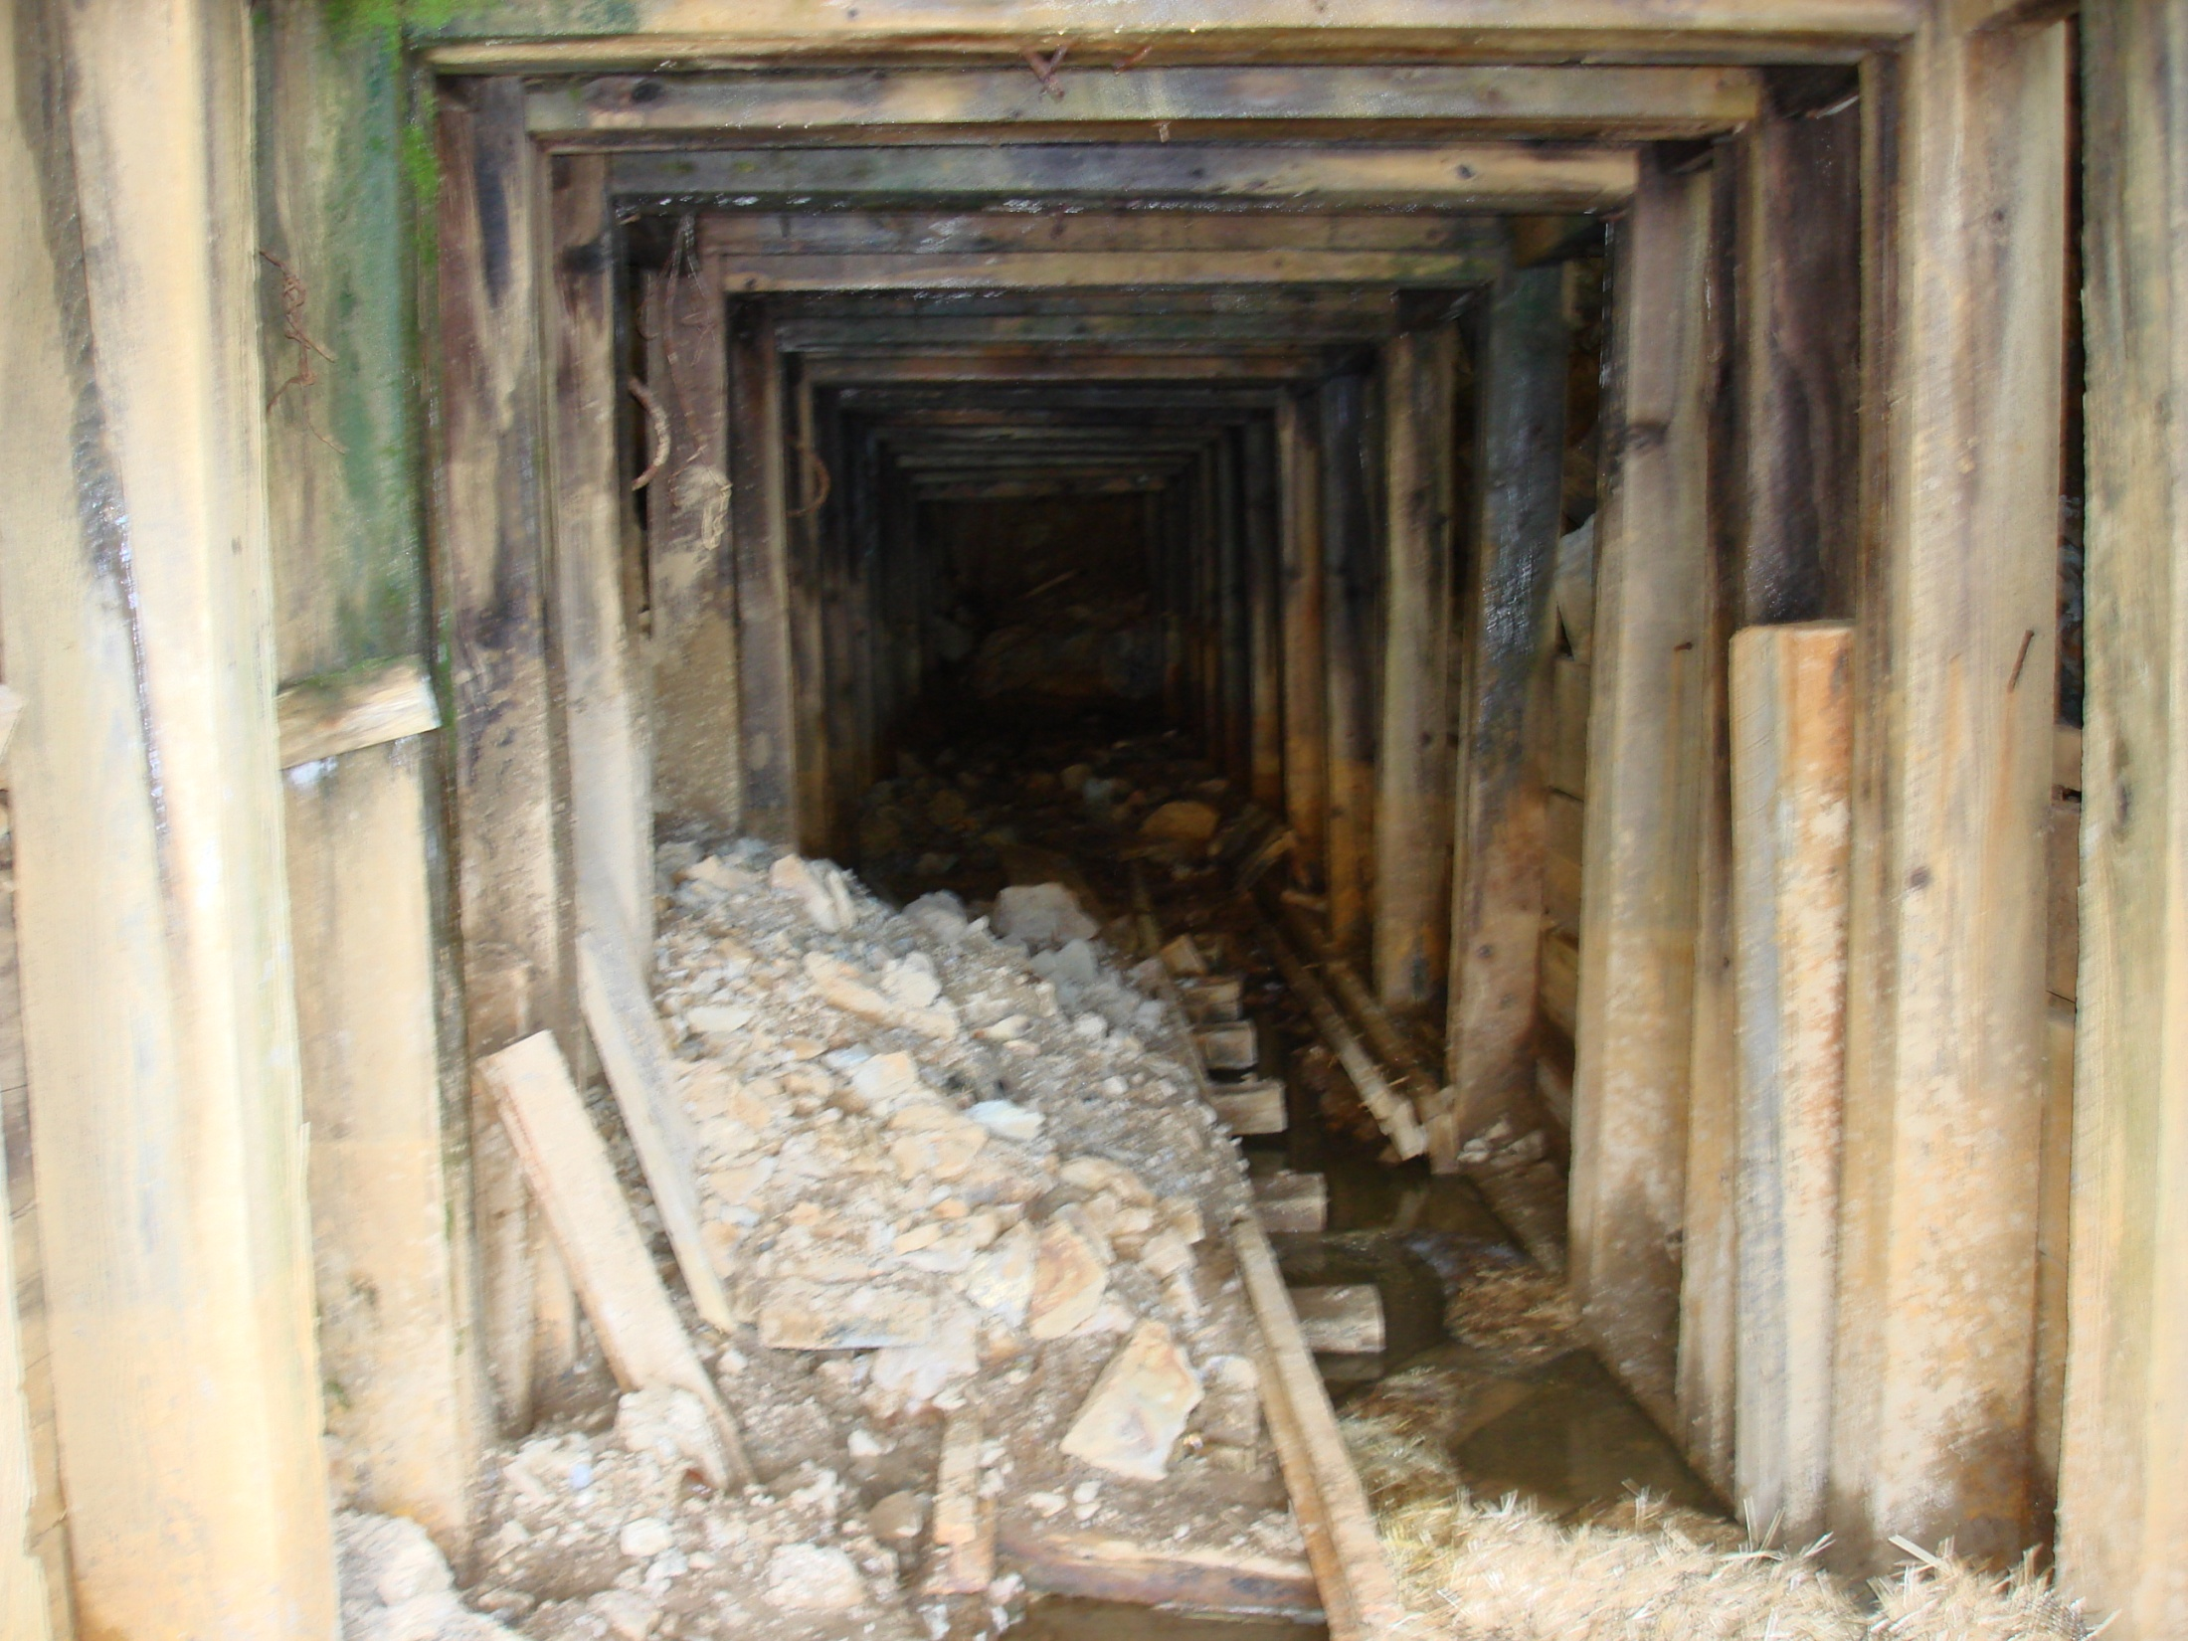
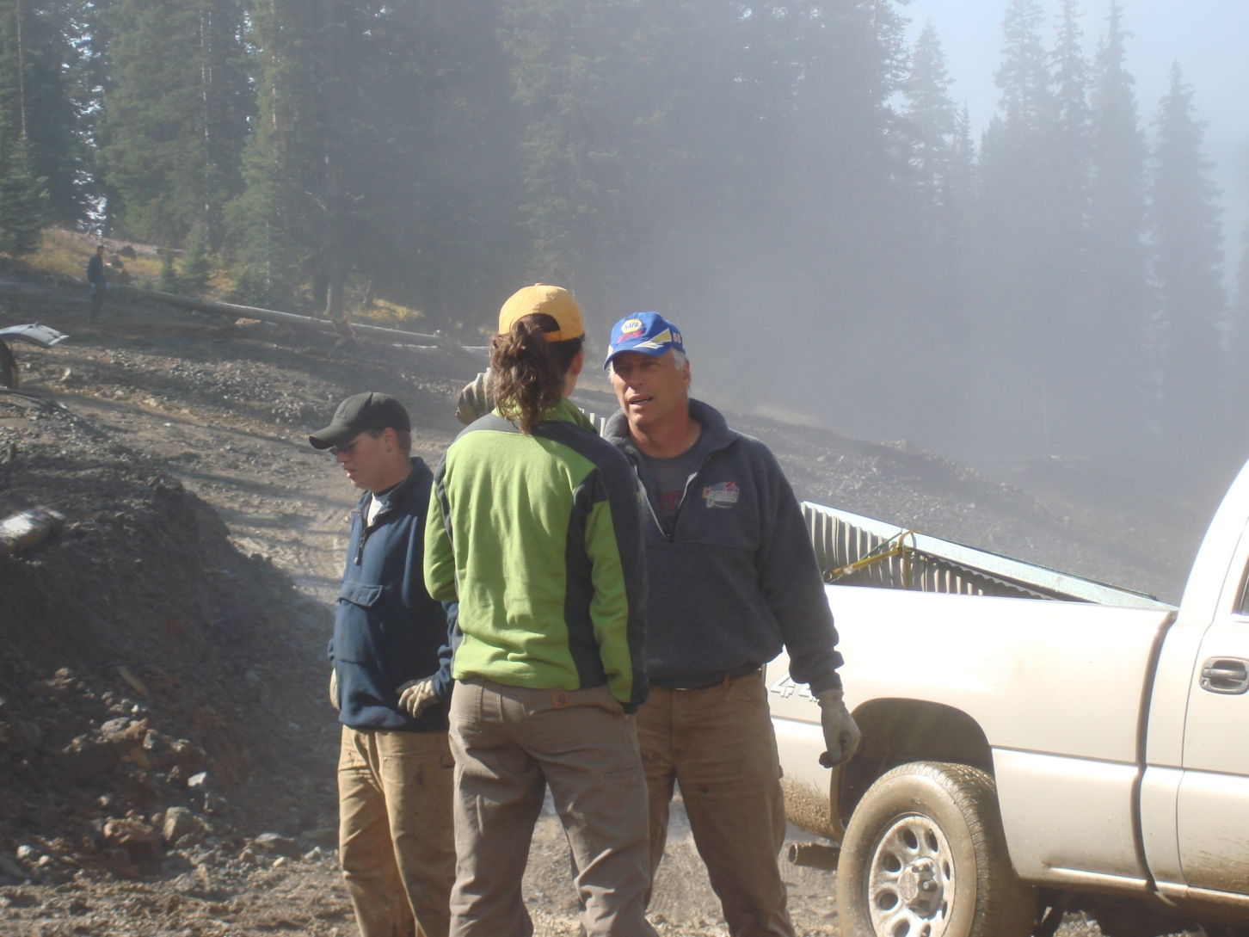
Who said there is light at the end of the tunnel?

Slide 4

Engineering Technical Support Center
s
The Planned Talk
Present An Overview of EPA ORD Mine Remediation Research through Technical Support
Through the Crystal Ball Glimpse at 21st Century Mine Material and Water Remediation

Slide 5
Engineering Technical Support Center
AND NOW A WORD FROM OUR SPONSOR
EPA ORD Engineering Technical
Support Center
ETSC is our Acronym
Established in 1987
Located in Cincinnati, Ohio
Center within ORD
Notes:
And now a word from our main sponsor AND OSP AND THE SOCIALITES SPONSORS LIST

Slide 6
How Did We Get Here?
The Mining Legacy
Legacy -- something from the past: something that is handed down or remains from a previous generation or time.

Slide 7
The Modern Legacy
Legacy – You Got It Whether You Like it or Not.
The Modern Definition:
Deal With IT.

Slide 8
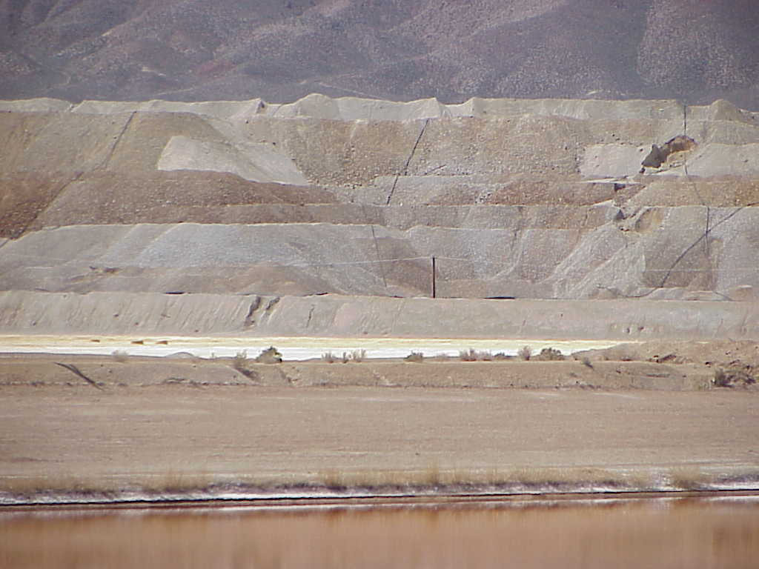

Slide 9
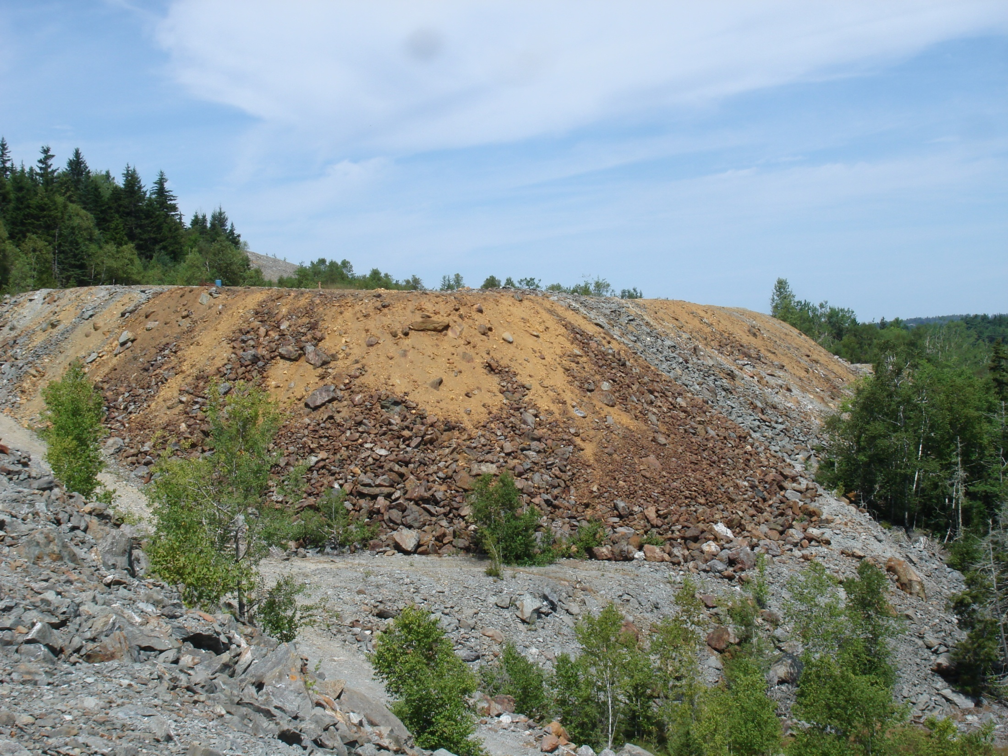

Slide 10
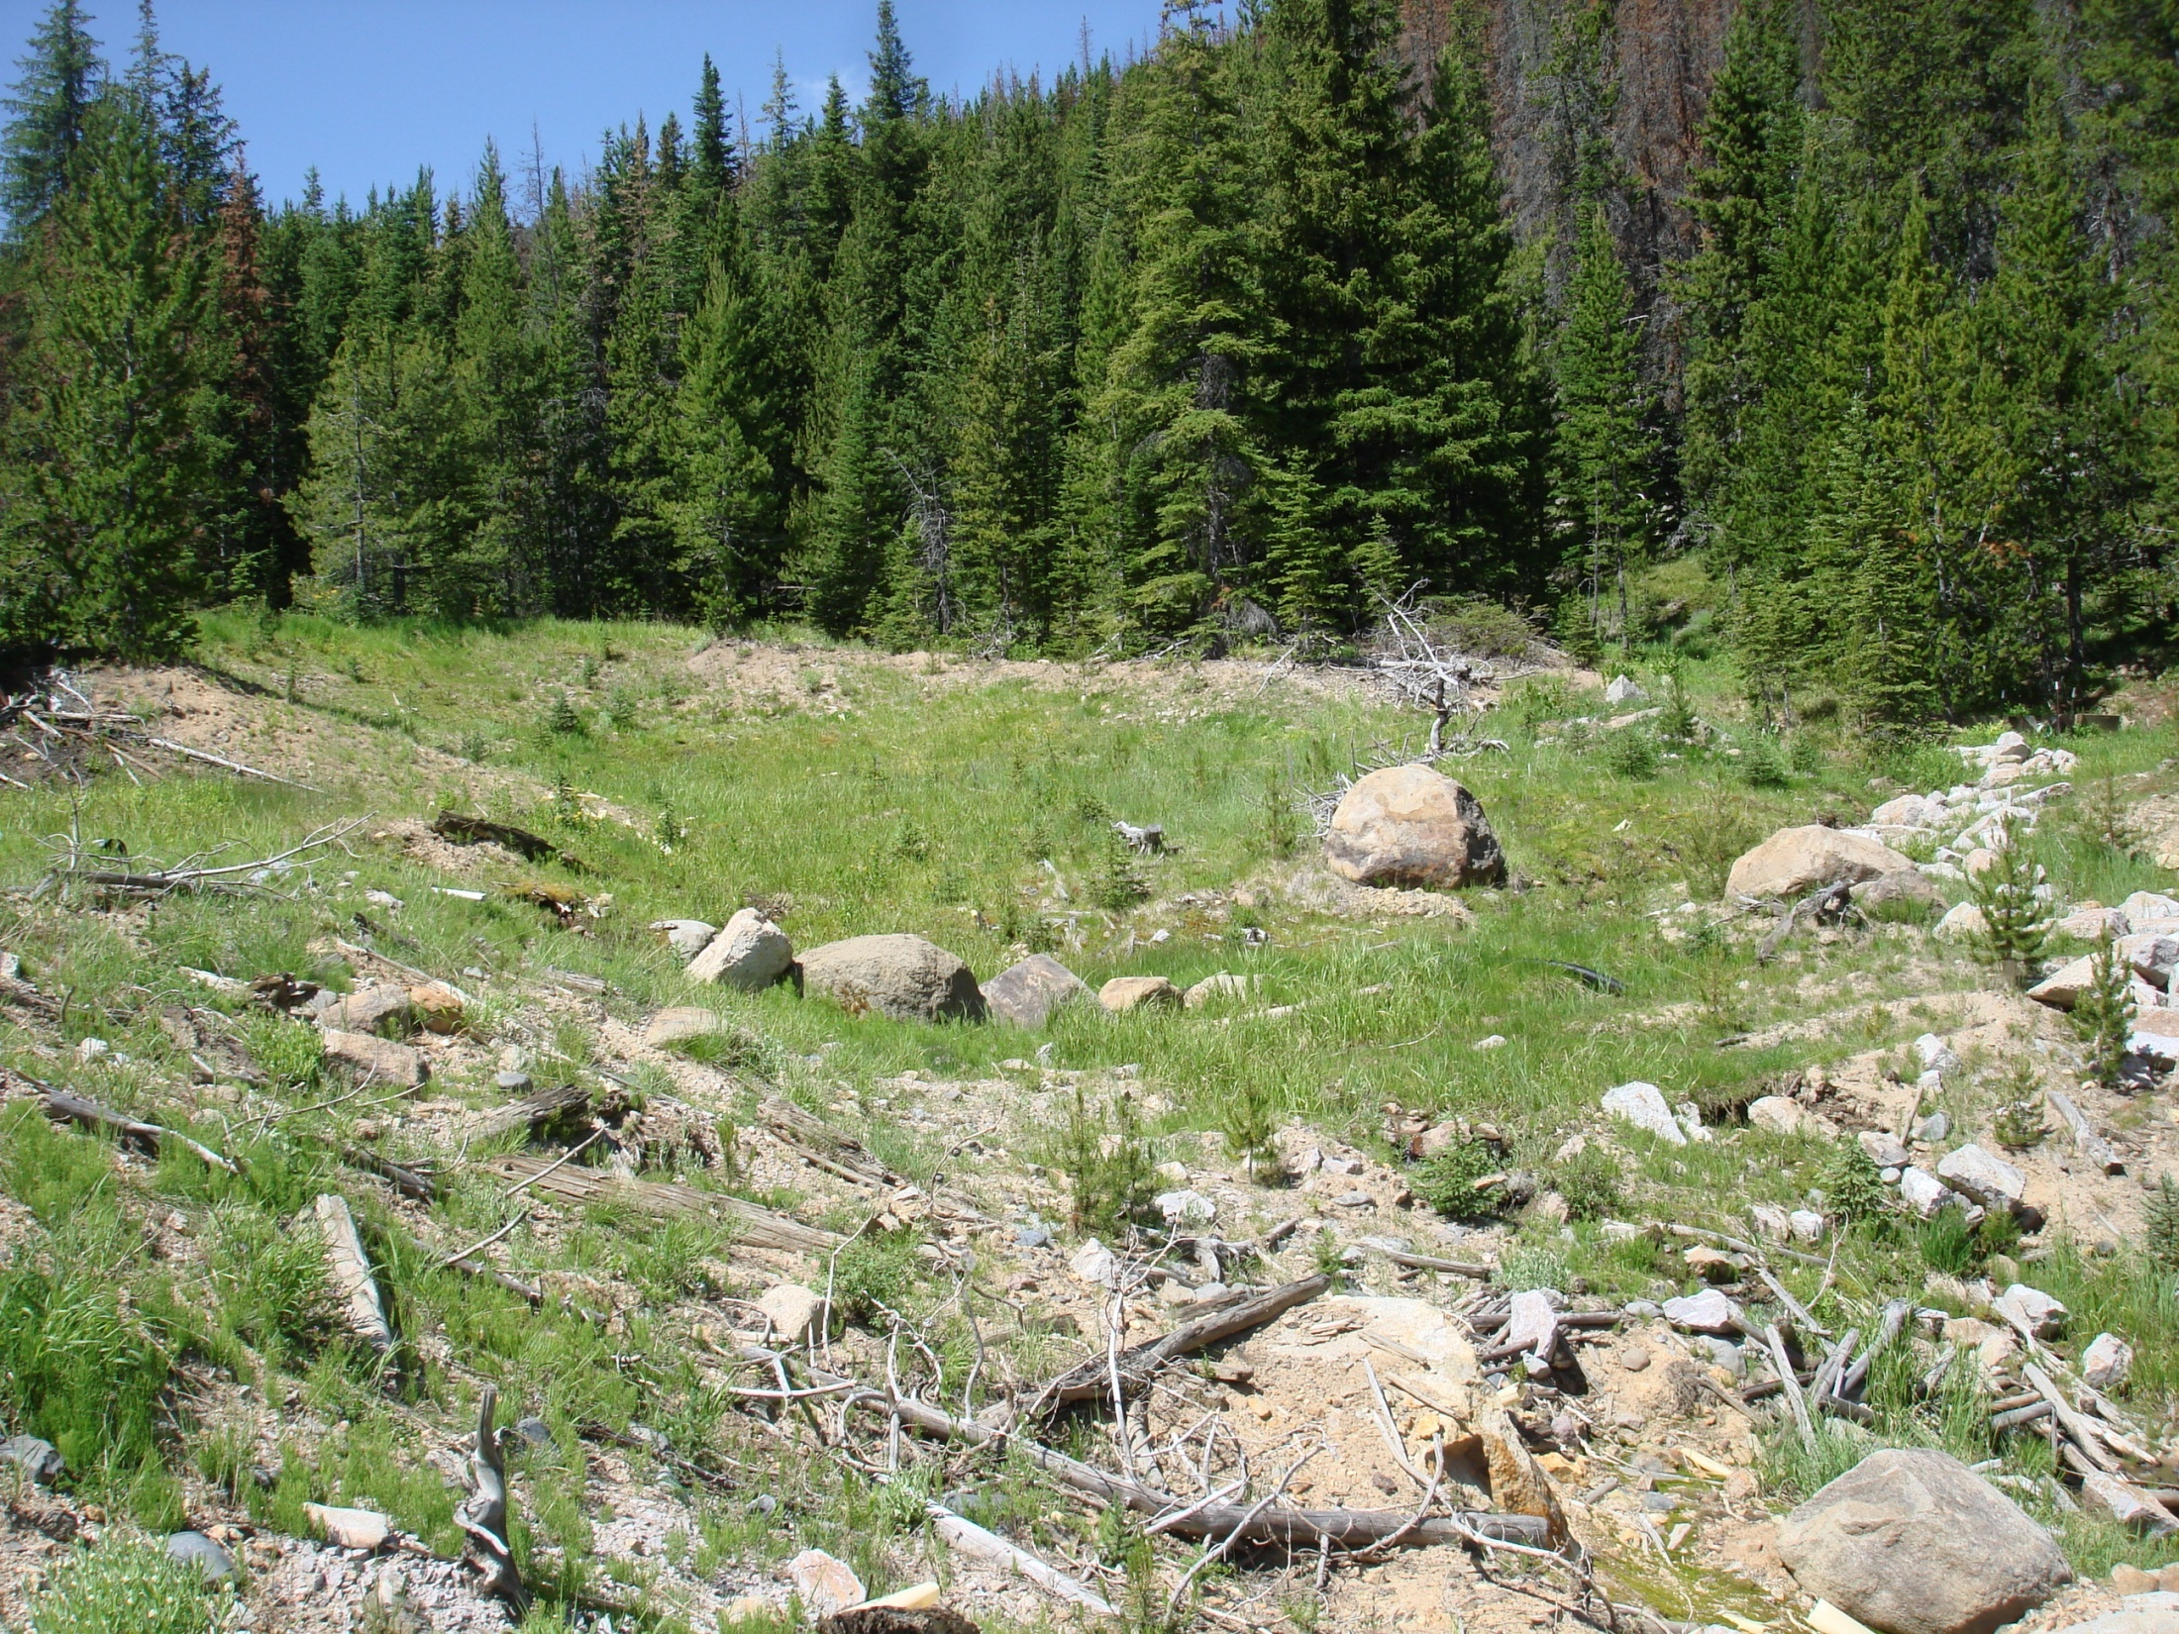
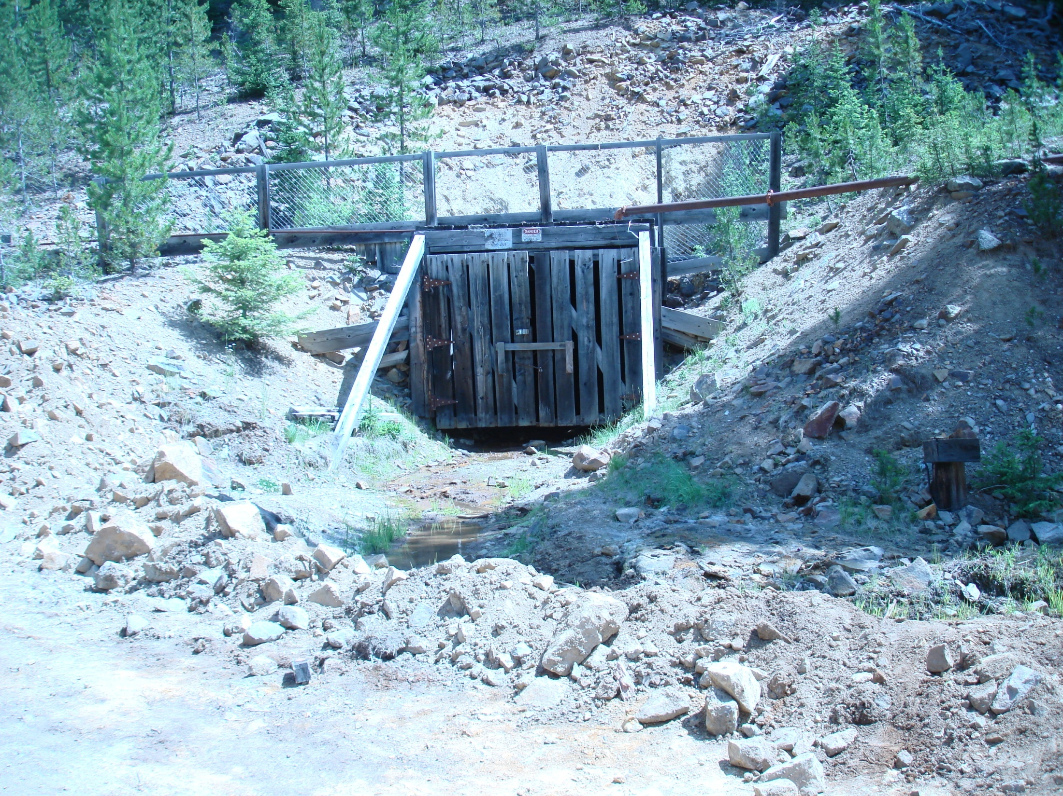
This is not Bruce Springsteen’s Tunnel of Love

Slide 11
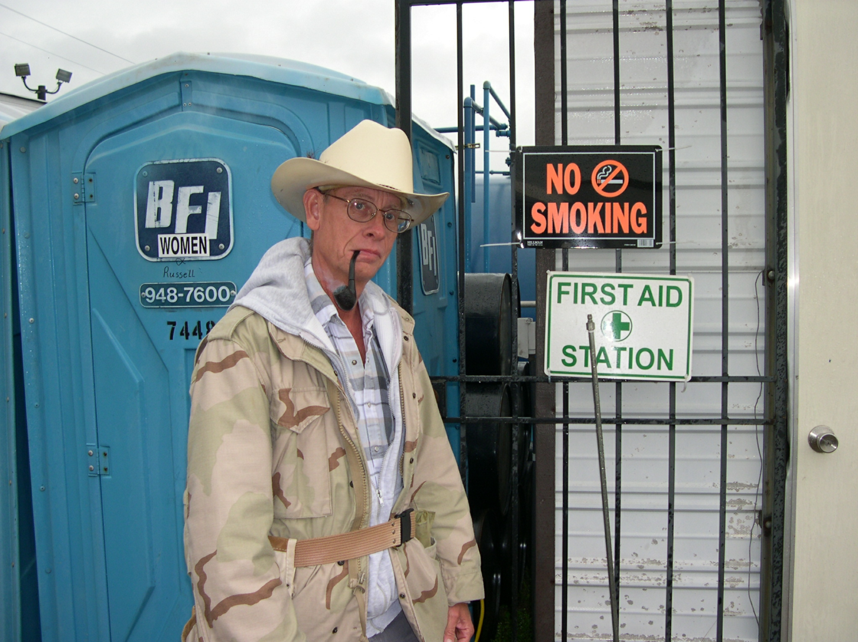
This is Where I Digress
Outside the box

Slide 12
The Three Gentlemen Talk and Talk
After this Talk and the break, they will Talk …..
The First Part of their Talk was to Talk about the Early Days (You guess which one is older…)
The Second Part of their Talk was to Talk about their view of:
Where Do We Go From Here?
Notes:
Hope you ate a big breakfast cause these guys can talk and talk…

Slide 13
Engineering Technical Support Center
The Early Years of EPA HR Remediation
Big 5 and Burleigh Tunnels
Lime, Alkaline Channels, Lagoons

Slide 14
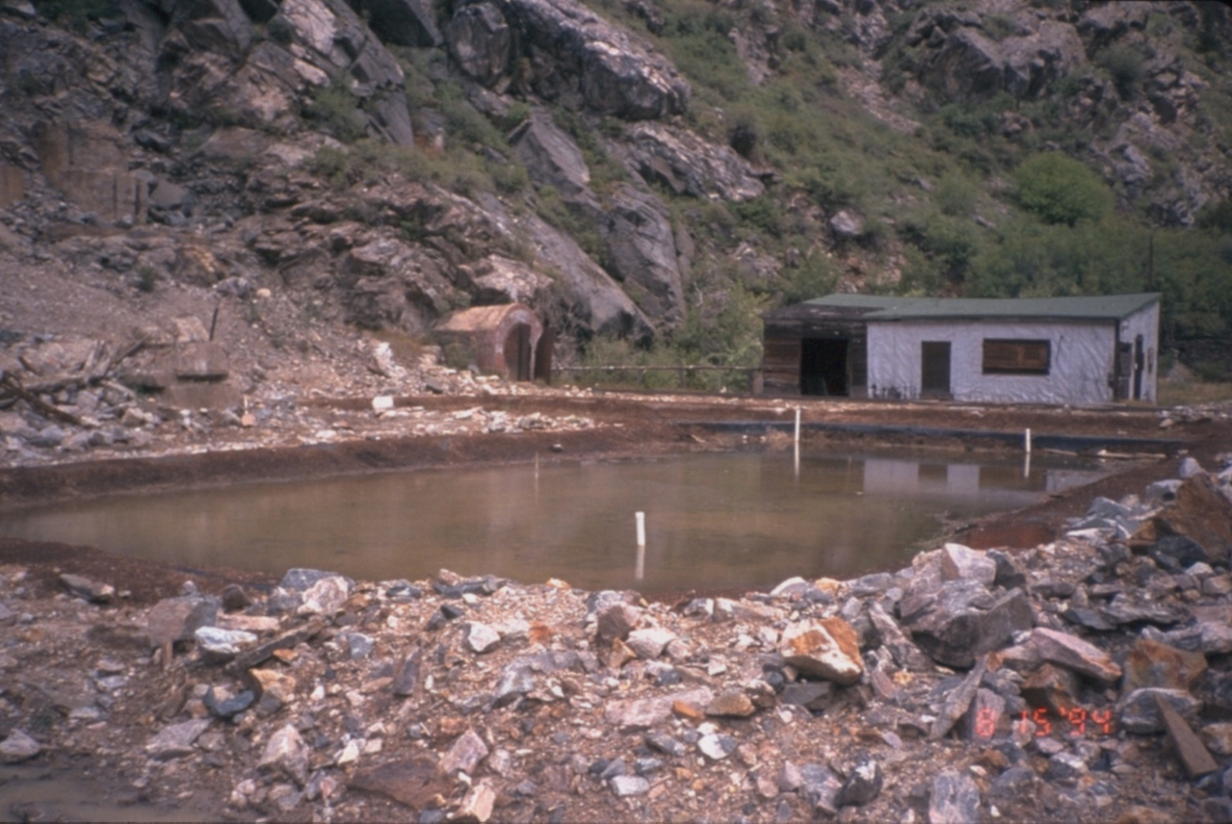
Burleigh Tunnel, CO

Slide 15
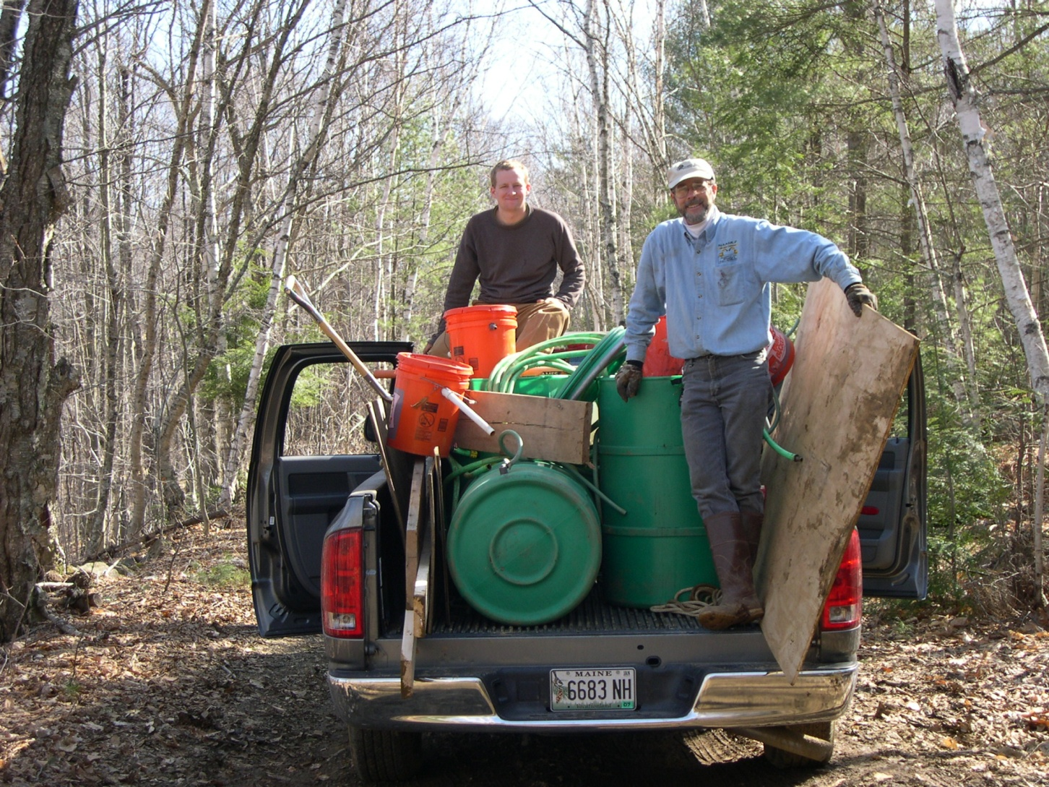
Would you allow these guys on your job site?

Slide 16
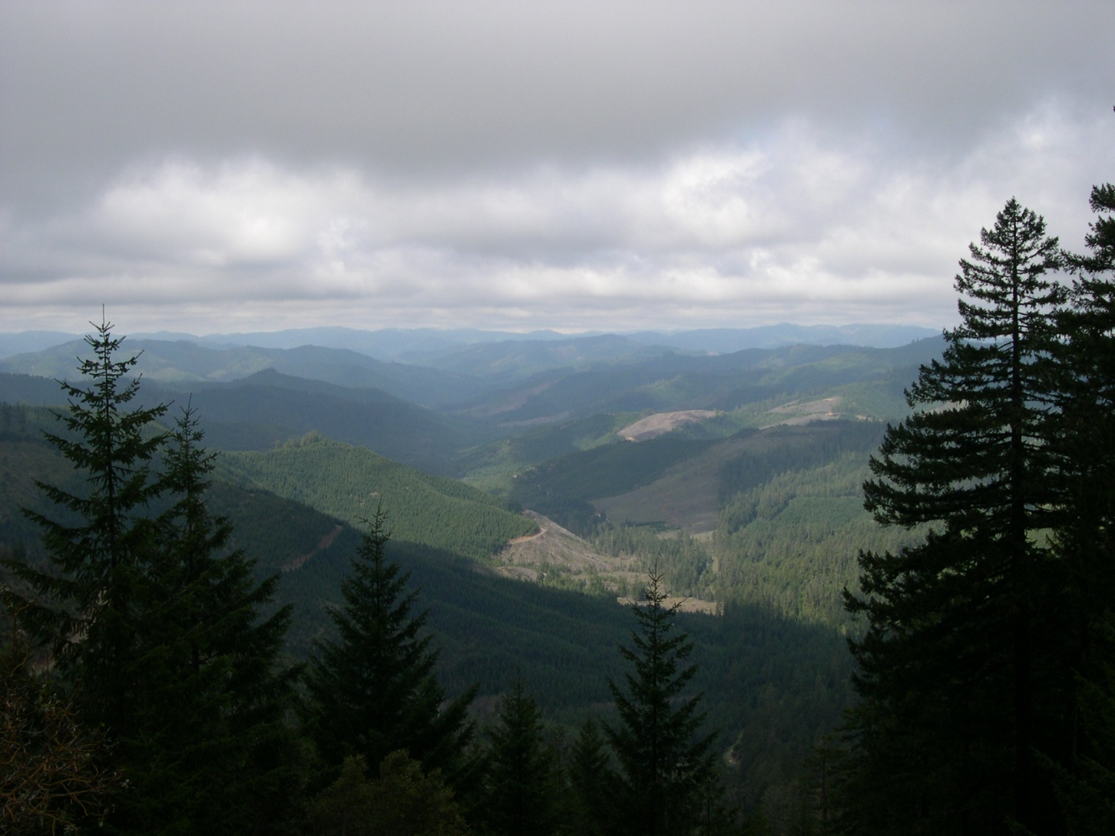
EPA ORD ETSC

Slide 17

What Has ETSC Staff Done in the Mining Area in the Last 10+ Years?
Developed Treatability Study Plan for Scientific Testing
Conducted Bench and Field-Scale Studies for BCRs
Tested Different Substrates for BCRs
Compared Solid Substrate vs. Liquid BCRs
Researched Lab / Field Measurements for Sulfates & Sulfides
Sampled, Analyzed and Identified Bacteria Inside BCR
Developed a Year ’round Sustainable Treatment System
(with renewable energy and gravity-feed)
Developed High Altitude Field Pilots
Developed WASP Meta4 Model for Metals Loading

Slide 18
What Has ETSC Staff Done in the Mining Area in the Last 10+ Years?
Tested Remote Remedial Data Delivery (R2D2) Systems
Researched Changes in Stressed MIW Bacterial Communities
Created Problem-Solving Workshops on Mine Drainage Issues
Conferences For Technology Transfer and Development
Built Larger & Sustainable Gravity-Fed BCRs
Tested Low Power Mobile Treatment Systems
Re-use of Chat in Asphalt; Tailings in Cement
Establish Performance Guidance for BCRs (ITRC)
BCR Effluent Toxicity Studies and Treatment Methods

Slide 19
For Those of You Distracted
This is the second part of the talk:
Through the Crystal Ball Glimpse at 21st Century Mine Material and Water Remediation

Slide 20
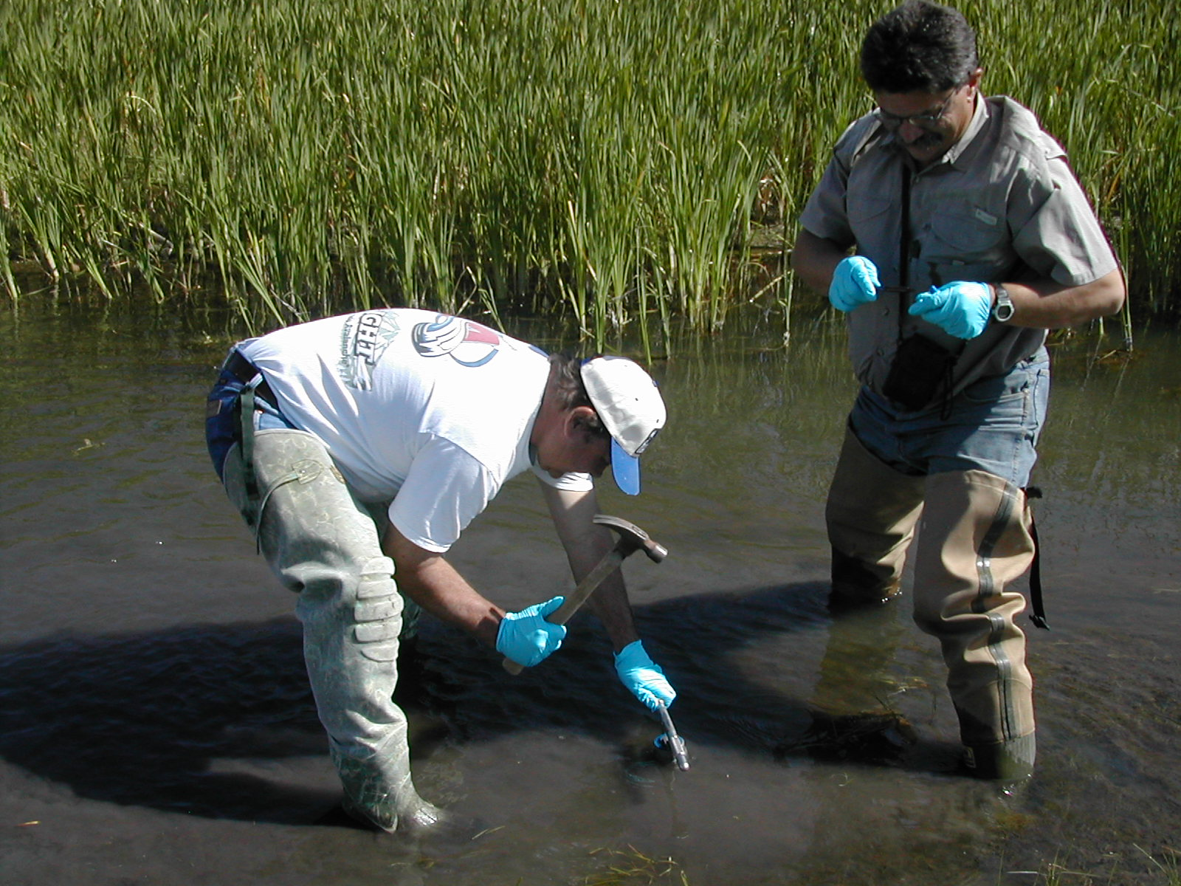
Instrument of Truth
Notes:
So the first image in my crystal ball….

Slide 21
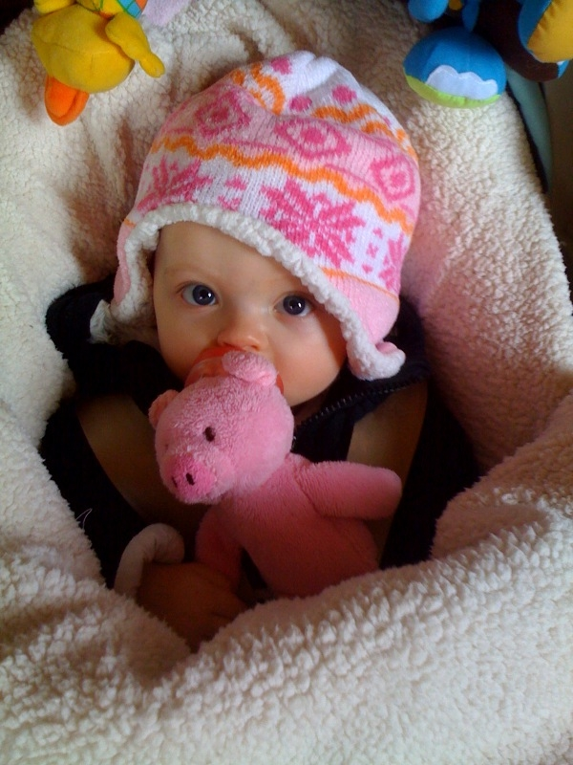
1
The “Other Dave” Has a Top Ten List
“This Dave” Has a “TOP 4 List”
Kyra says “Listen to Papa!”

Slide 22
THINK “in situ” MIW Treatment
Injection of Alkaline Material Means Higher pH Seeps
Treatment Systems and Iron Pre-Treatment are out of sight, out of “mind”
Immediate Surface Water Improvements
Weather Issues May Be Averted
Anaerobic Systems Can Thrive!
Multiple Benefits; Less Risk; Reduce Exposure
Notes:
Since we are on the subject of in situ treatment, a bigger push has to be made… I am surely not advocating in situ for every sites… Maybe guidance has to be developed. And of course, more MSHA training…but we have very few sites in the US where in situ treatment is being done. Start with injection behind a bulkhead….

Slide 23
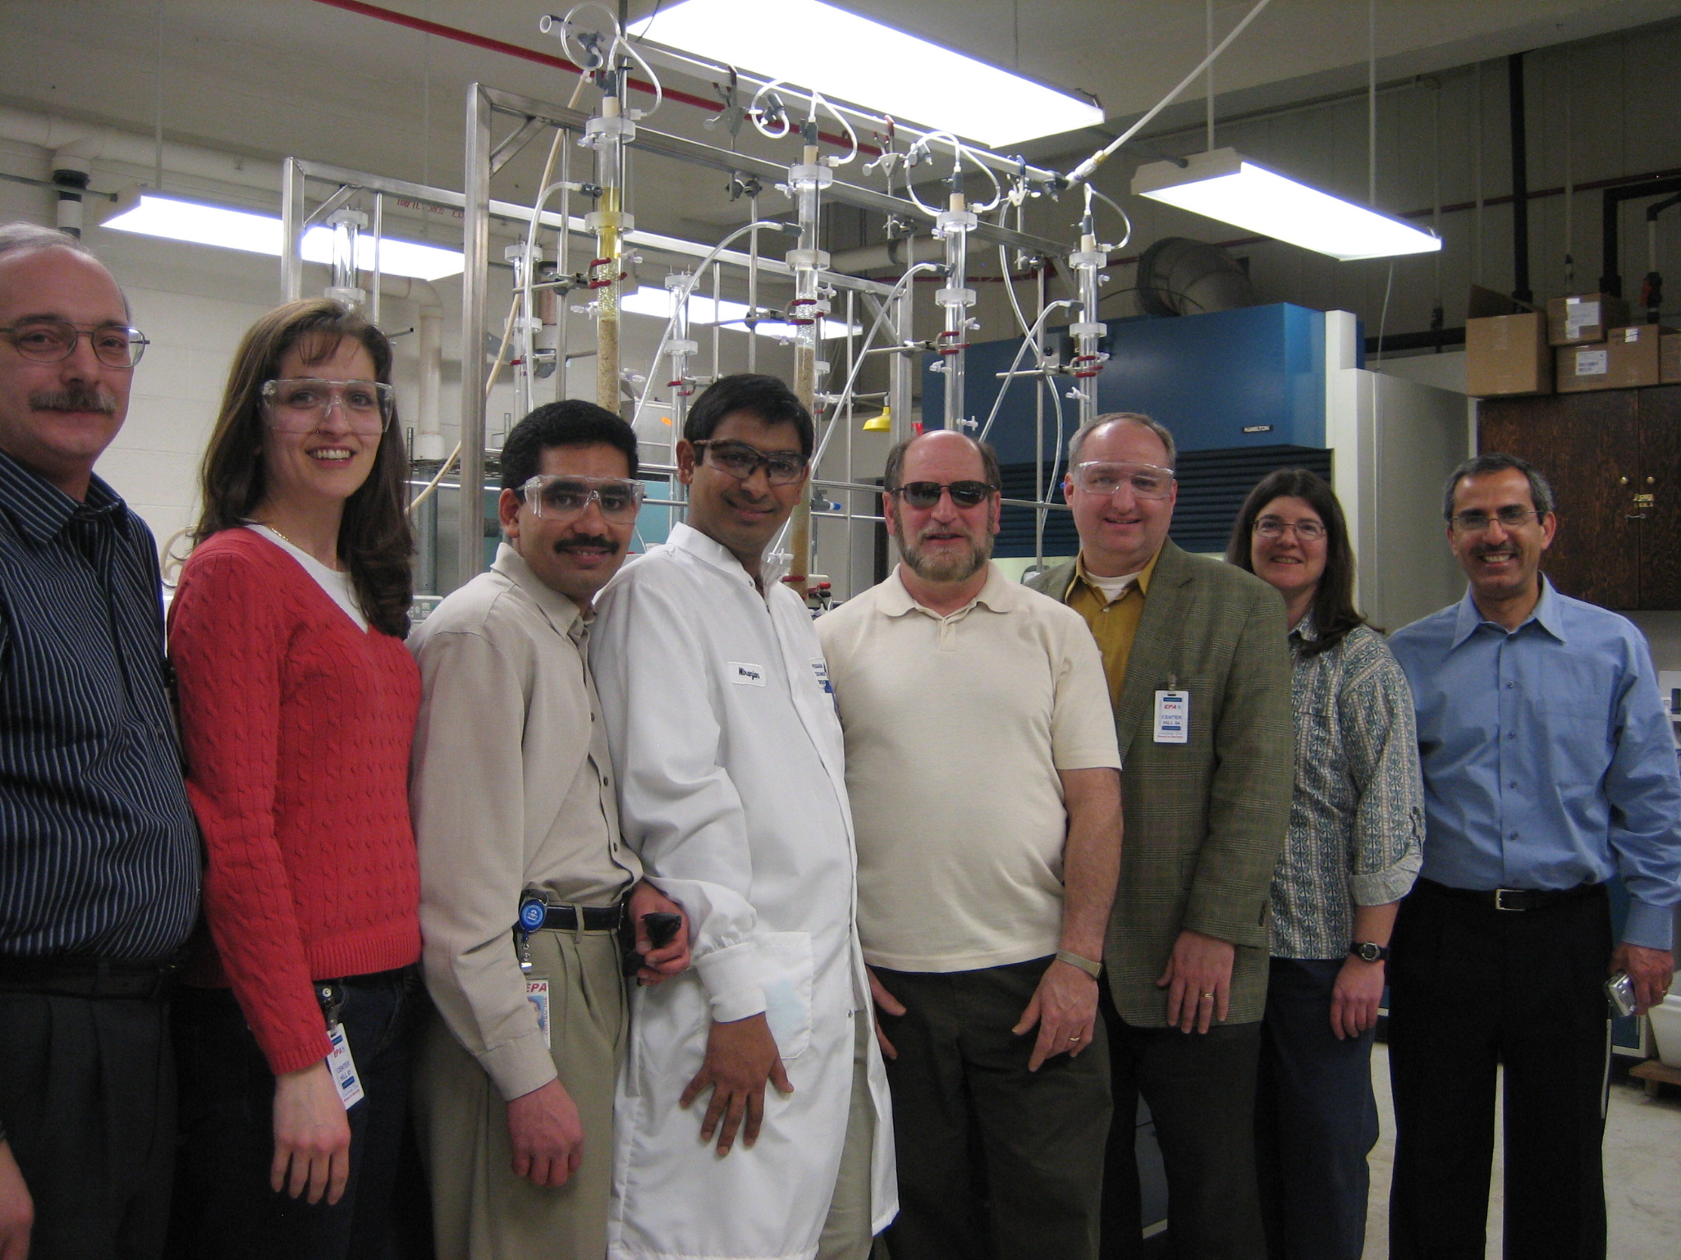
2

Slide 24
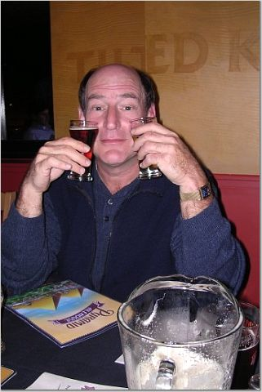
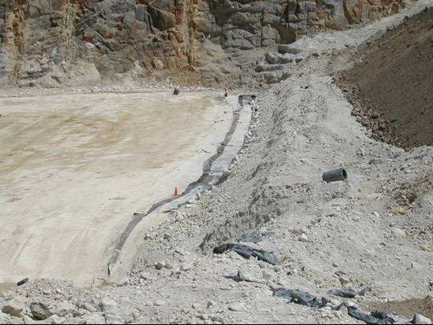
BEER
Bio-Engineered Environmental Repository
Notes:
Of course, you think that I am not serious, but I really am. EPA, BLM and the Forest Service have a repository guidance, and we need to move to the next phase. At the Captain Jack Mine near Ward, Colorado, I joined with my Region 8 project manager and their management to convince people that in situ treatment of MIW can be done. Although I tried this year on one site, I truly believe as we move towards constructing more repositories for containing of disposed mine materials, we can design reactive barriers to intercept the water before it becomes leachate leaving these repositories. Think about it. Once the cap is on, the system will turn anaerobic, bacteria and alkaline material and carbon…by the time that material runs out, the pile may not even have that much acid-generating material left. No it won’t happen tomorrow, but EPA and others did it with energy production at landfills so the possibility is there.

Slide 25
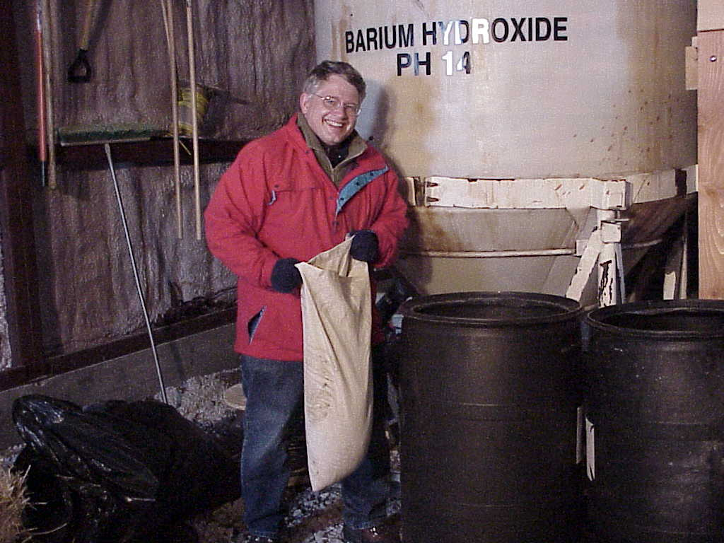
3 He smiled until he opened the bag…..

Slide 26
Metals Recovery / Material Re-Use
Recovery of Metals from MIW, Mine Materials
Economics, Environment & Other Factors
Closed Systems
Mimic Natural Processes
“Re-Use is Real Use!”
Notes:
Need to recover metals rather than have effluent and discharges with metals…look at better technology for metal recovery from our many thousands of mine tailings piles and impoundments

Slide 27
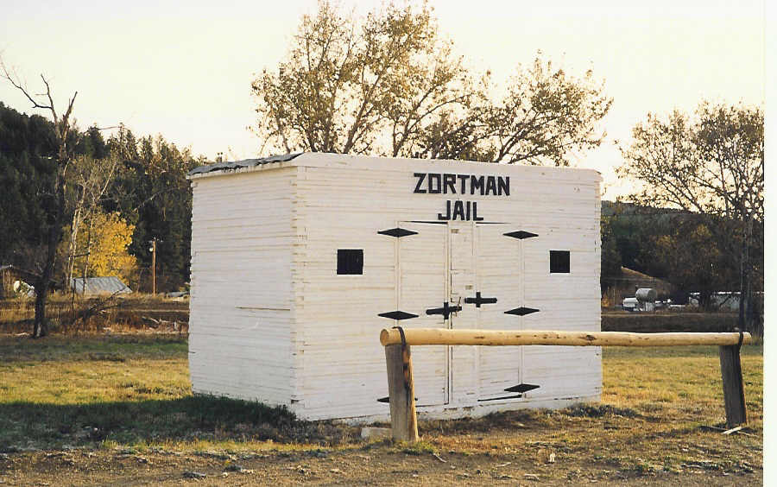
4

Slide 28
BCR Applied Research
Build for Treatment; Publish Data for Knowledge
Involve More Biologists & Chemists
Understand the “Sulfide” Effect
Alternative Substrates!!!!!!
More Efficient; Higher Volumes, Loads
Longevity is a Non-Issue….Ask Me!

Slide 29
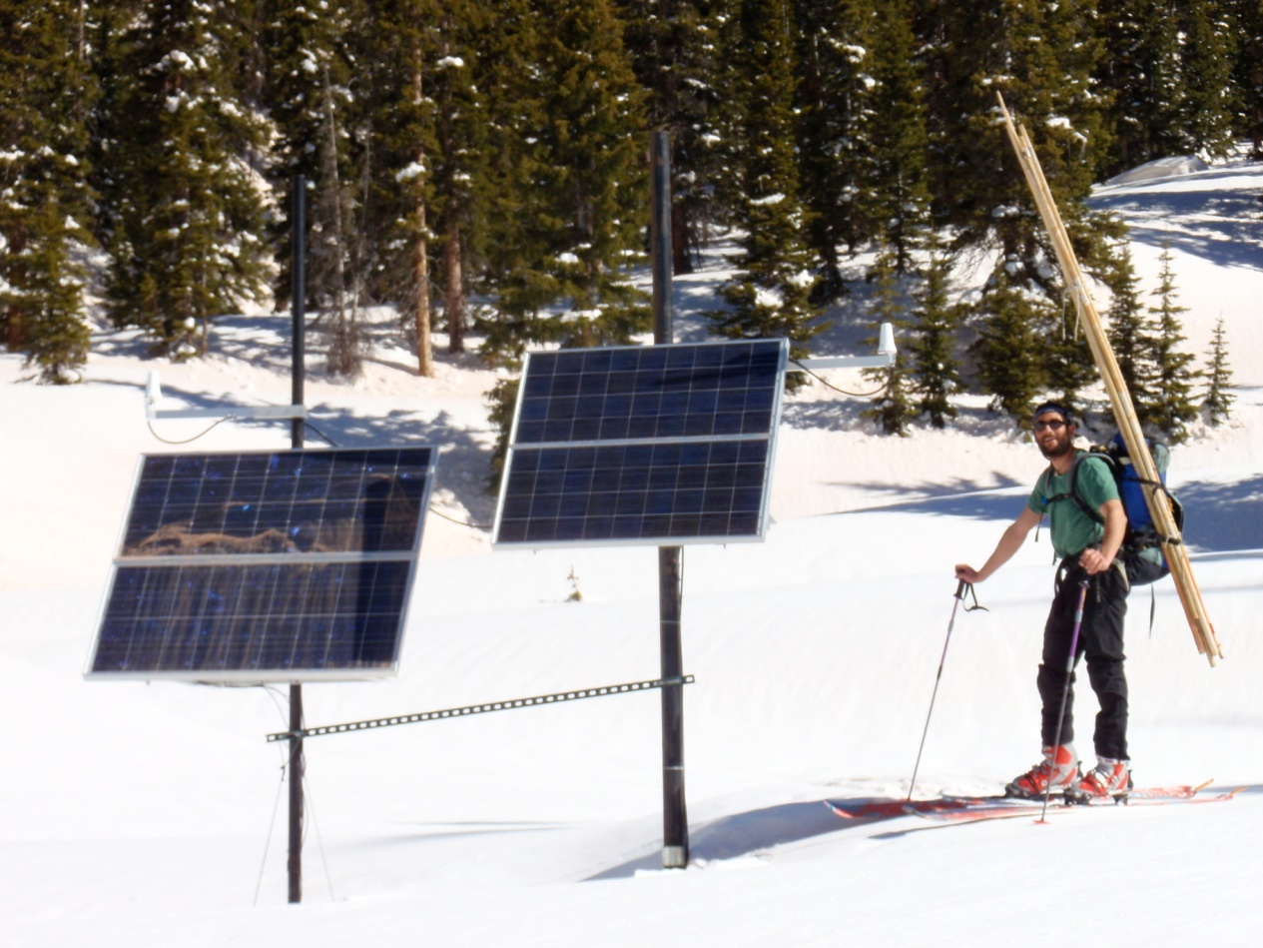
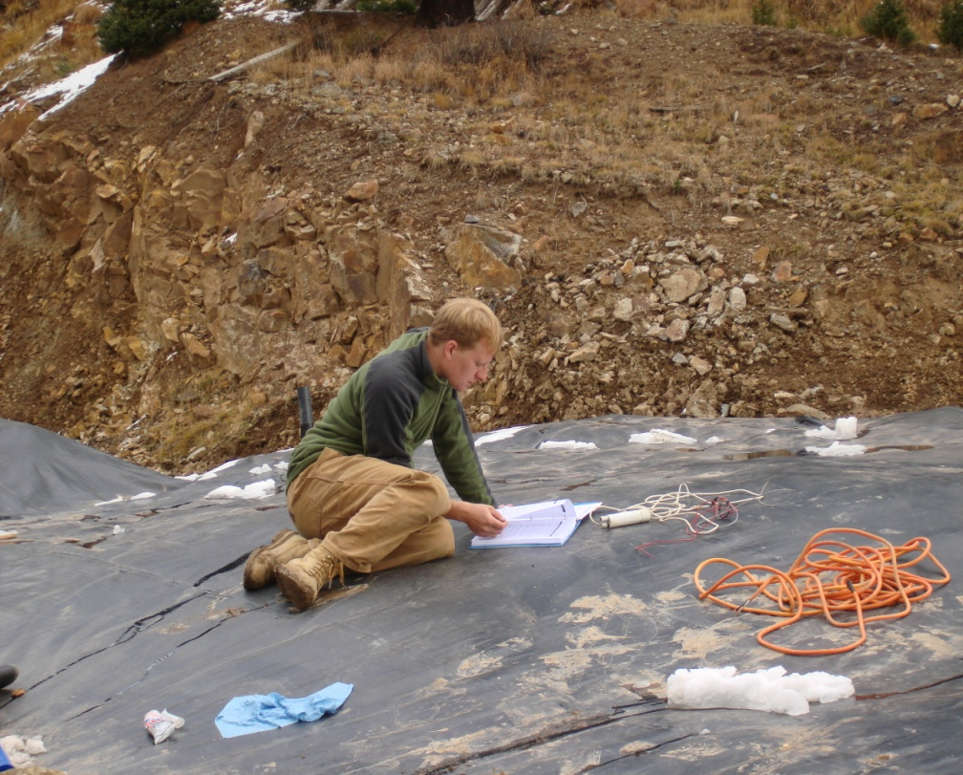
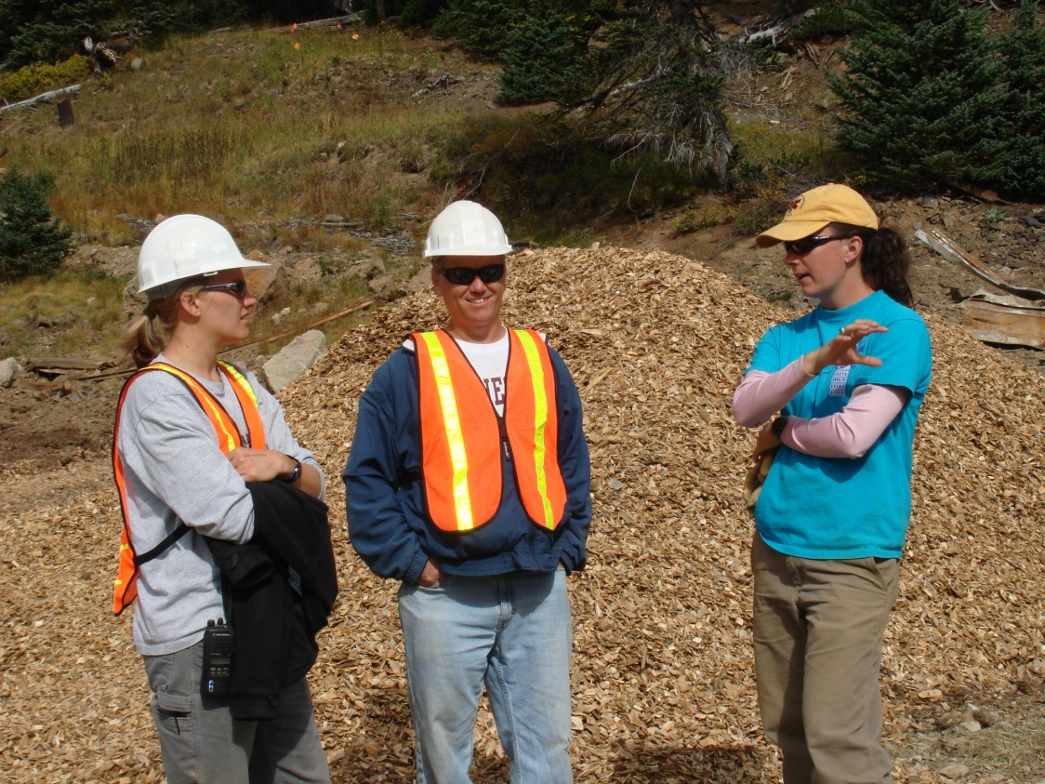
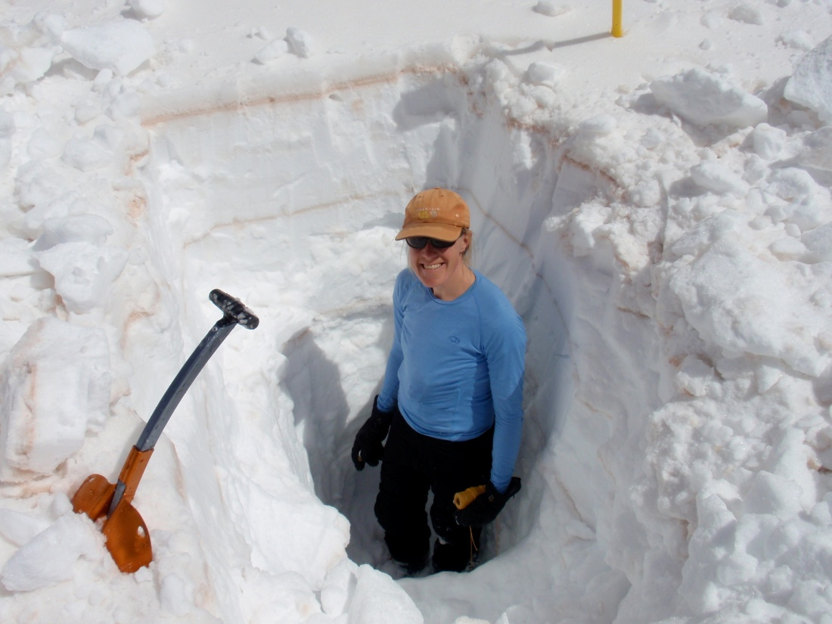

Slide 30
Acknowledgements & Tributes
ALL of YOU….for your work on this issue and for coming this week
Co-Workers / Colleagues in & out of EPA
EPA Contractors & Universities
The Airlines for getting me there safely!
Most of All --- We’re in this Together; Let’s Set an Example!
Notes:
B1-Thank the Presenters and Co-Chairs and Committee. Alina Martin SAIC
B2 – EPA Managers for giving me the freedom to develop the mining applied research program…for my work where my vocation is my vacation and I can be passionate about my work
B3 – Many off you in the audience today have been great to work with…y’all bring some new knowledge to every project…for sure I am not as well-trained as a lot of you—I have just been allowed and had the opportunity to view. Witness and participate in a lot of mine remediation projects
And B4 – I have to include the contractors in the audience, some of you have been with me since the beginning and are not only contractors but fellow researchers and friends.
B5 and of course the airlines for transporting me a million miles safely—I did not say without some incidents and long layovers—but I have got a lot of work done at 30,000 ft…
And on that note, My final point is let’s tell the people in this beautiful building to take an example from all of us and start working together to keep this the greatest nation on earth.

Slide 31
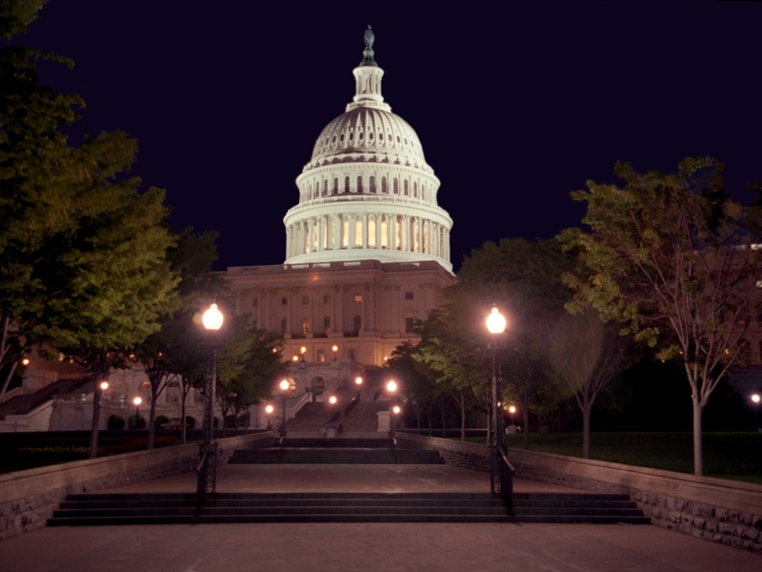
Comments or Criticisms? Reisman.david@epa.gov

