Slide 1

Identification and Quantification of Arsenic Species in Gold Mine Wastes Using Synchrotron-Based X-ray Techniques
Andrea L. Foster, PhD
U.S. Geological Survey GMEG
Menlo Park, CA

Slide 2
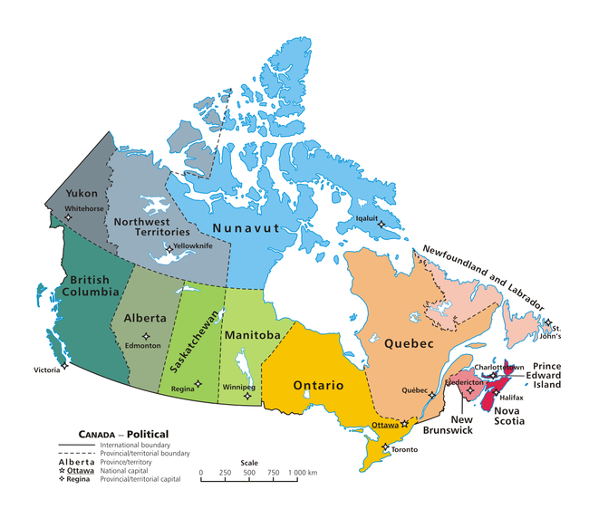
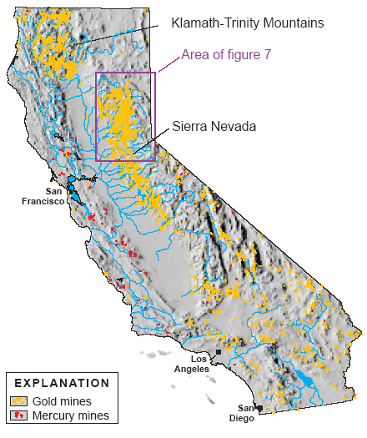
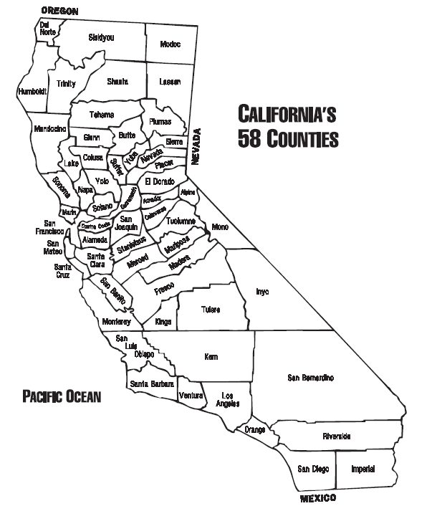
Arsenic is an element of concern in mined gold deposits around the world
Spenceville (Cu-Au-Ag)
Lava Cap (Nevada)
Empire Mine (Nevada) low-sulfide, qtz Au
Ketza River (Au)
sulfide and oxide ore bodies
Argonaut Mine (Au)
Don Pedro
Harvard/Jamestown
Ruth Mine (Cu)
Kelly/Rand (Au/Ag)
Goldenville, Caribou,
and Montague (Au)

Slide 3
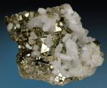
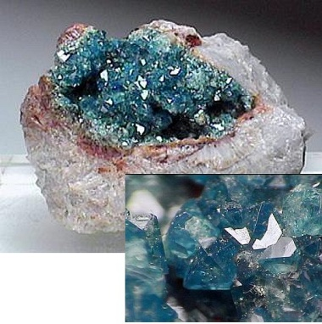
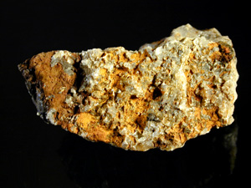
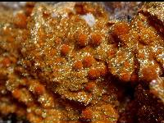


The common arsenic-rich particles in hard-rock gold mines have long been known
Primary
Secondary
Secondary/Tertiary
“arsenian” pyrite
As⁻¹ pyrite Fe(As,S)₂
Iron oxyhydroxide (“rust”) containing arsenic up to 20 wt%
Scorodite FeAsO₄ 2H₂O
Kankite : FeAsO4•3.5H2O
Reich and Becker (2006):
maximum of 6% As⁻¹
Jarosite KFe₃(SO₄)₂(OH)₆
Tooleite [Fe₆(AsO₃)₄(SO₄)(OH)₄•4H₂O
Pharmacosiderite KFe₄(AsO₄)₃(OH)₄•6–7H₂O
Arseniosiderite Ca₂Fe₃(AsO₄)₃O₂·3H₂O
Yukonite Ca₇Fe₁₂(AsO₄)₁₀(OH)₂₀•15H₂O
Arsenopyrite FeAsS
arsenide
n = 1-3
n⁻
Notes:
These are all the phases, but depending on geochemistry you get different combinations

Slide 4
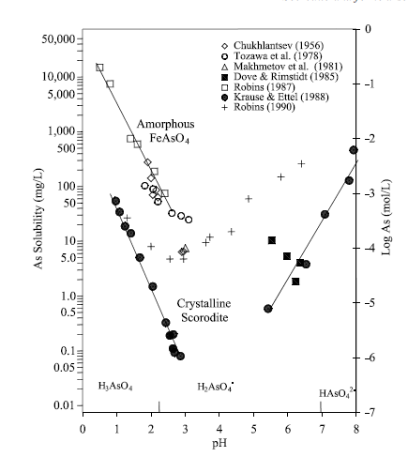
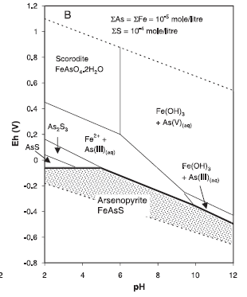
But it is still difficult to predict with an acceptable degree of uncertainty which forms will be present
thermodynamic data lacking or unreliable for many important phases
kinetic barriers to equilibrium
changing geochemical conditions (tailings management)
Langmuir et al. (2006) GCA v70

Slide 5
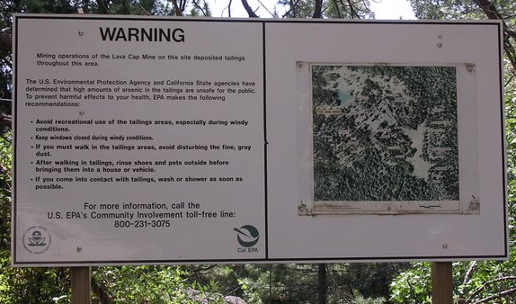
Lava Cap Mine Superfund Site, Nevada Cty, CA

Slide 6
Typical exposure pathways at arsenic-contaminated sites are linked to particles and their dissolution in aqueous fluids
ingestion of arsenic-bearing water
dissolution
near-neutral, low dissolved organic carbon, low salinity waters
solid-phase arsenic
inhalation or ingestion of arsenic-rich particles
dissolution
lung and gastic/intestinal tract fluids (saline, aqueous solutions-high dissolved organic carbon, enzymes, bile, some low pH, most near-neutral)
solid-phase arsenic
critical to know the form(s) of arsenic in the solid phase
only a subset of those forms may be reactive
Notes:
From hazard/risk assessment and remediation standpoints,the essential question is:
what are the processes controlling the mass transfer of arsenic from solid forms (e.g., mine waste) to dissolved forms
in tailings ponds, hyporehic zone, creek, reservoirs?
in human/animal bodies (ingestion, inhalation)

Slide 7
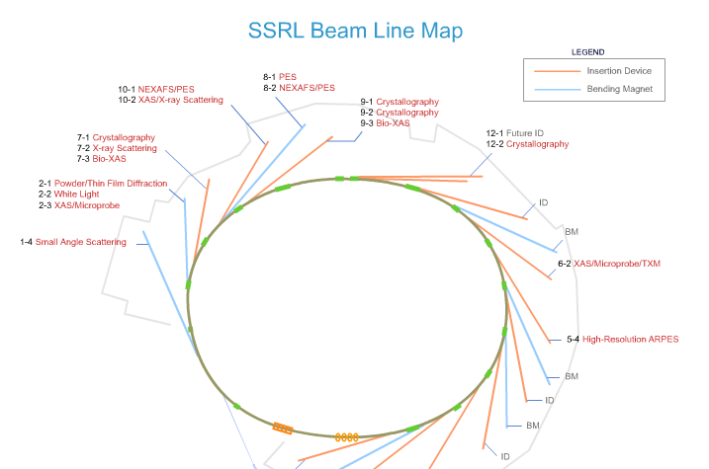
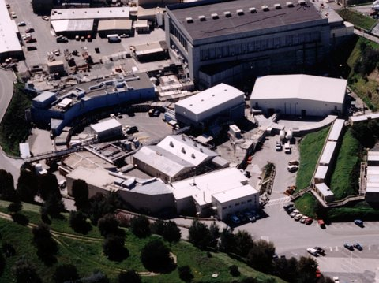
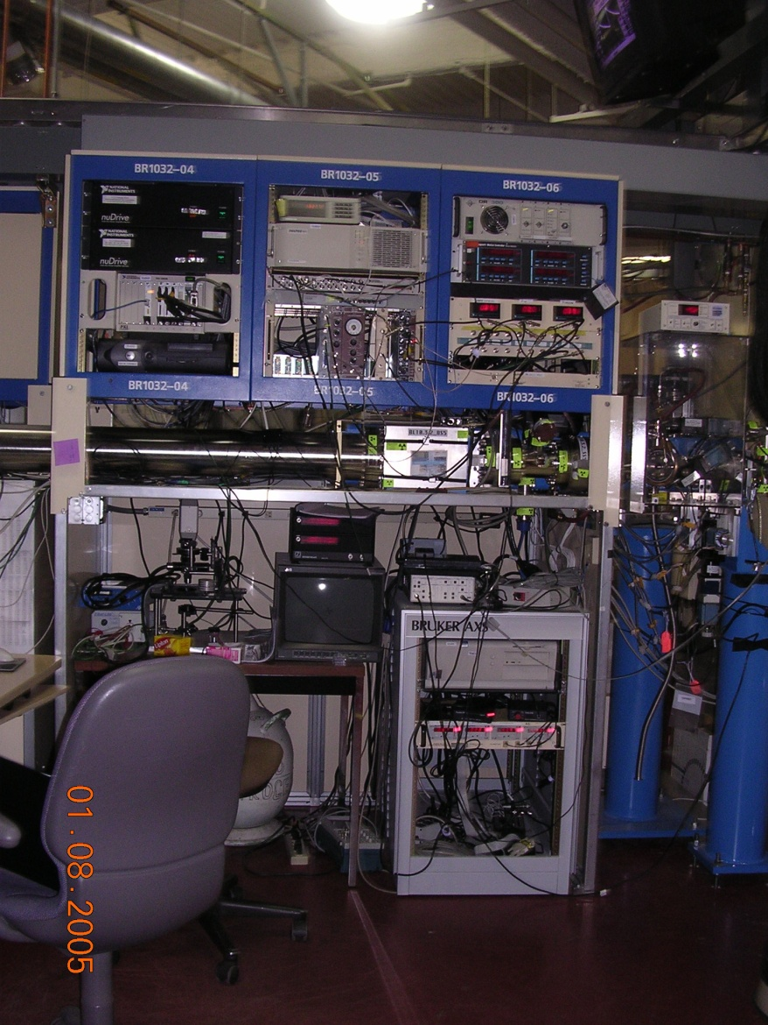
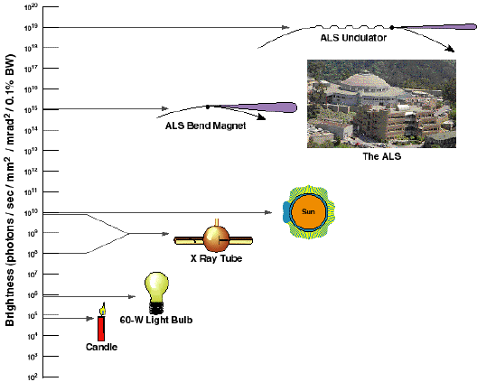

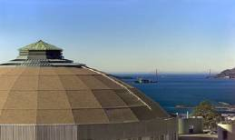
This talk will review the results of synchrotron
X-ray studies of arsenic speciation, with focus on gold mine wastes
Brilliant, high flux radiation produced at points tangent to
a circular orbit of electrons moving at near-relativistic speeds
Stanford
Berkeley
75 synchrotrons around the world
10 in US (4 suitable for environmental work)

Slide 8
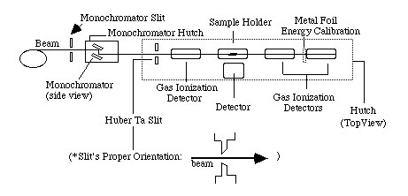
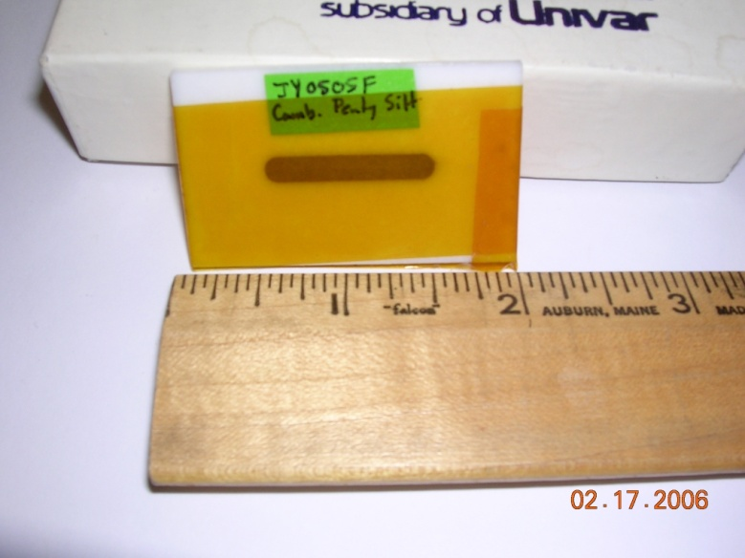
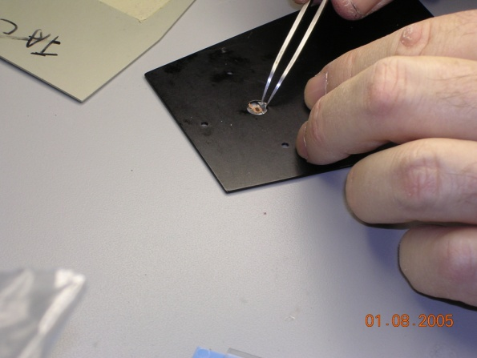
Large ( 1-10 mm) or small (2 -150 μm) X-ray beams are available for most techniques
Bulk
X-ray Fluorescence
X-ray Absorption Spectroscopy
X-ray Diffraction
X-ray Photoelectron Spectroscopy
Vibrational Spectroscopies
Magnetic spectroscopy
Small Angle Scattering
Microbeam
Precision stage
(micron)
CCD Detector
CCD detector
(diffraction)
Gas ionization
detector
Solid-state detector

Slide 9
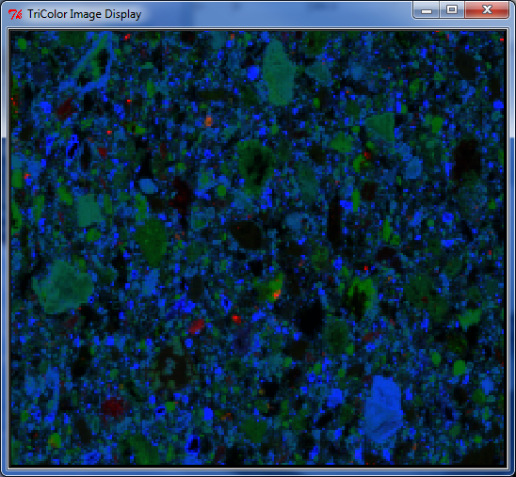

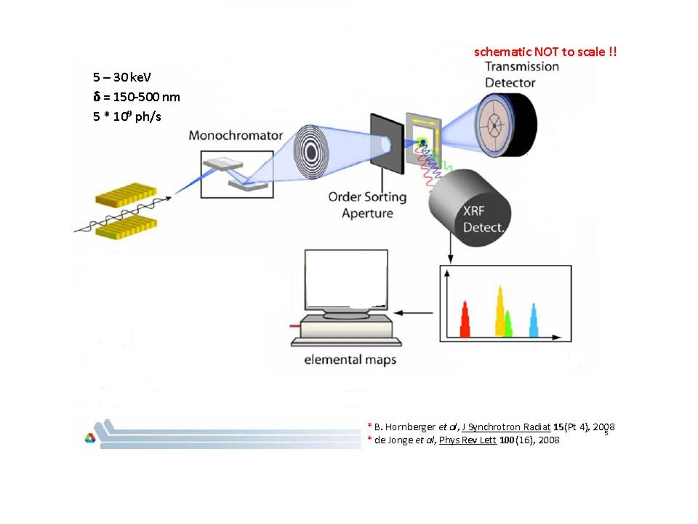
Synchrotron X-ray Fluorescence (XRF) Spectrometry
Bulk
Microbeam
Elemental ID
Element Correlation
Spatial distribution
One EDS spectrum
Per point (> 1000)
One average Spectrum
Elemental ID
Ca
Ca
As
Fe
Fe
As
Voltage (energy)
1800 microns

Slide 10
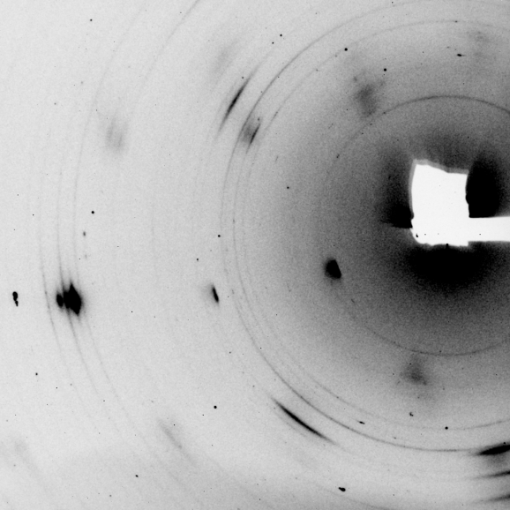
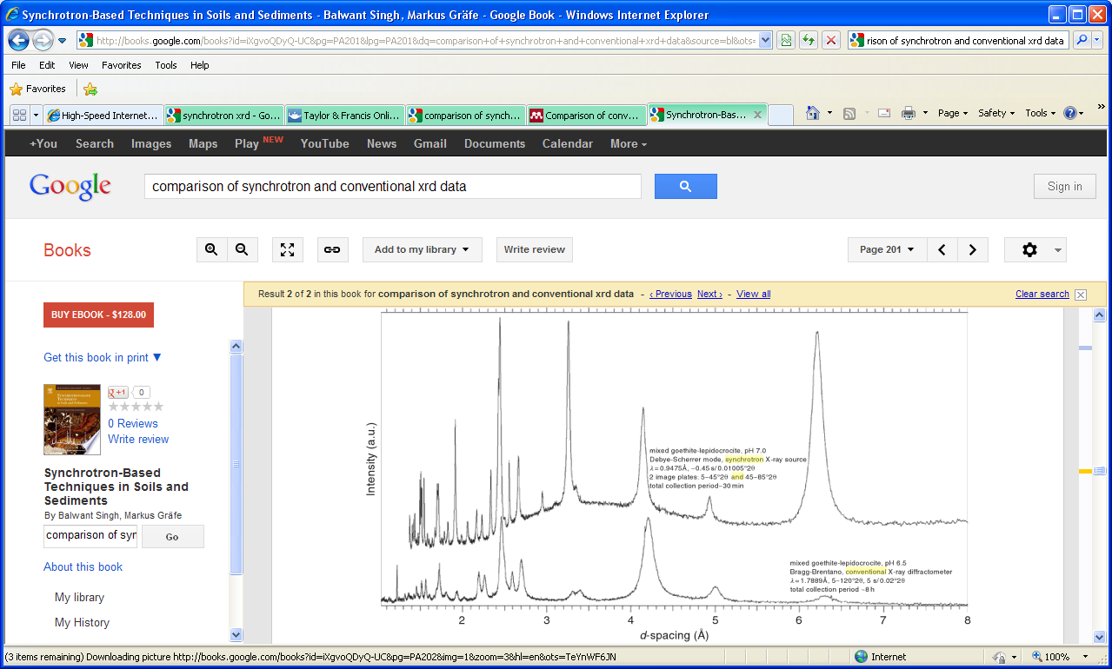
Synchrotron-based X-ray Diffraction (SXRD)
2-D pattern
goethite/lepidocrocite
mixture
Mineral ID
Mineral Mapping
Amorphous materials (scattering)
1-D patterns
Synchrotron XRD
20 min
Conventional XRD
8 hours
Notes:
Resolution
Detection limit for low abundance phases
Polarized beam
Collimated
In-situ studies
Tuneable incident energy

Slide 11
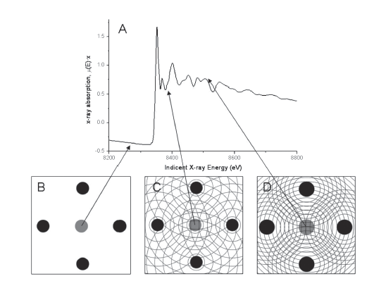
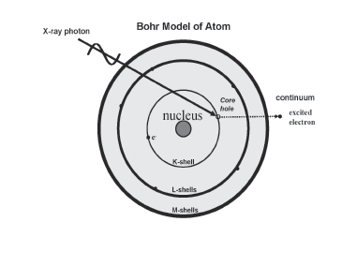
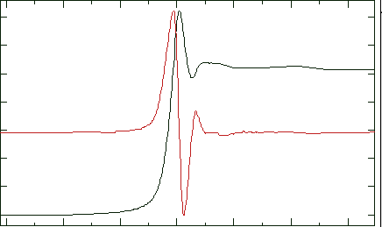
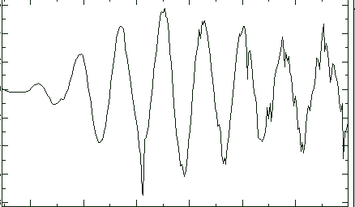
X-ray Absorption Fine Structure Spectroscopy
X-ray Absorption Near
Edge Structure (XANES)
Oxidation state, species “fingerprinting”
> 1 mg/kg
Absorbance
Extended X-ray Absorption Fine Structure (EXAFS)
Speciation = identity, #, distance of neighboring atoms
> 75 mg/kg
Energy (eV)
EXAFS function χ(k)
Photoelectron Wave vector k (Å⁻¹)

Slide 12
Spectral Deconvolution by Least-Squares Fits
XANES spectra
Energy increases with oxidation state
Arsenopyrite (As¹⁻)
Orpiment (As³⁺-S)
As³⁺ in water (As³⁺-O)
As⁵⁺ on rust (iron oxyhydroxide)
Bangladesh Aquifer Sediment
10-10.4 meters depth
11860
11880
11900
11920
Energy, (electron volts)
As³⁺
As⁵⁺
Unique spectral shape
13.5 % As⁵⁺
86.5% As³⁺
Notes:
Need to show a spectrum where they are mixed together…create some using sixpak and model compounds…

Slide 13
Principal Component Analysis of XANES or EXAFS Spectra
Principal Components
(= number of species)
Variance Plot
Set of Unknown XANES Spectra
n
N = 19
7
PC 2 (v₂*w_{2,i})
22% of variance
PCA
6
Component Intensity
5
4
Energy (eV)
3
PC 1 (v₁*w_{1,i})
35% of variance
2
1
Subset “best” model compounds
For LSA
Energy
Set of Model Compound XANES Spectra
Target
Transformation
Using principal components
N = 30
Energy (eV)

Slide 14
Synchrotron studies of As in Gold Mine Wastes
Early Days: 1994-2002
individual field and lab projects at “targets of opportunity, typically with limited connection to regulators’ needs
Bulk XANES + EXAFS
2003- present
collaborative projects at high-profile sites; research focused on addressing needs
Microbeam studies: 2005 and later
Coupled XAFS, XRD XRF
Coupled bulk and microbeam
Multi-metal XAFS
Complimentary Lab-based techniques
Micro Raman, XRD

Slide 15
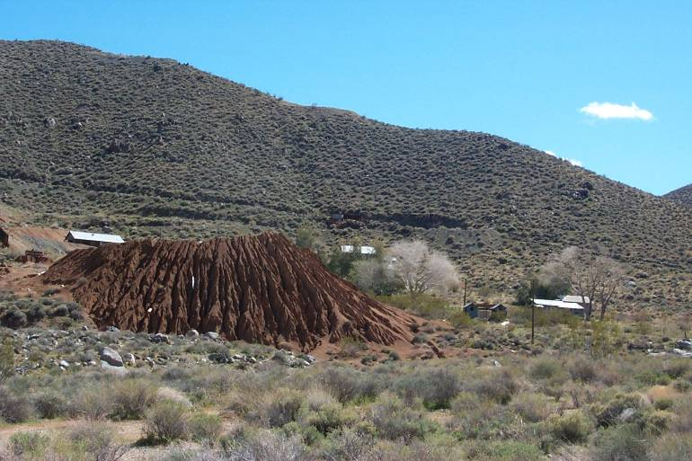
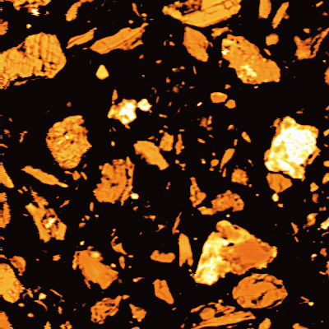
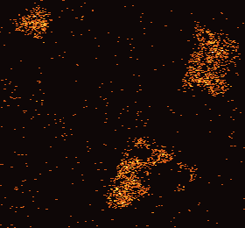
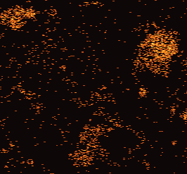
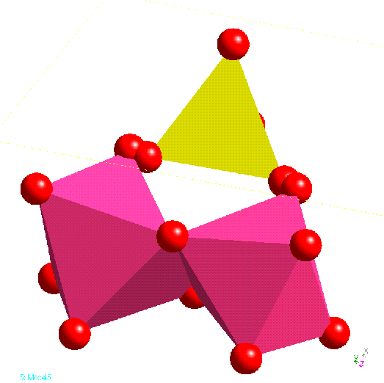
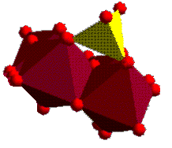
Ruth Mine: Ballarat District (Trona, CA)
Ruth Mine
Trona, CA
Tailings (ca 1000 mg/kg As) used for residential landscaping
50 μm
As Lα
As5+
D. Lawler, BLM
Fe Kα
11850
11900
11950
Energy (eV)
As-Al 3.16 Å
As
Al
Al
As
Fe
Fe
Foster et al., (1998) American Mineralogist 83, 553-568
As-Fe = 3.25 Å
Notes:
From:http://www.blm.gov/ca/st/en/prog/aml/project_page/ruth.html
Accessed on: 3/28/2012
CERCLA site (AML)
The historic Ruth Mine mill tailings were the result of a historic mining and milling activity in the Homewood Canyon Mining District, which was mined for its gold lode deposits during the early 1900’s to 1950’s time period. The Ruth Mill was constructed during the 1920s-1930’s period ’ with a rotary ball mill-cyanidation tank circuit. The mill tailings were produced by the rotary ball milling operations.
Approximately +20,000 tons of mill tailings were generated by mining and associated milling operations. These mill tailings were discharged from the mill site over a last +50-year period downslope onto the alluvial fan surface adjacent to Homewood Creek and a residential area downstream. The largest tailings pile forms an elongate-shaped deposit that is eroding into Homewood Wash. The Ruth Mine tailings contain elevated levels of arsenic.

Slide 16

Mesa De Oro: Should be “Mesa de Arsenico”
Gold tailings with 115 – 1320 mg/kg arsenic
40 homes developed on Mesa between 1975-1985
EPA emergency response
  halted new home construction
  removed and replaced about 1 foot of soil
  shored up sides of Mesa
San Jose Mercury News
Residents won 2,000,000 for loss of property value
http://consumerlawpage.com/article/environmental_pollution_1.shtml
http://www.pbs.org/newshour/bb/environment/superfund_4-16.html (transcript of 1996 show called “Paying for the Past”)
Time Magazine Sept 25, 2000
George Wheeldon, “geologist”: arsenic from the mine is in a form that is not dangerous

Slide 17
XANES spectra of Mesa de Oro soil samples demonstrate that arsenic is not in arsenopyrite form
Range of Mesa de Oro
Samples (n =4)
Arsenopyrite (As¹⁻)
Arsenopyrite FeAsS
As⁵⁺ on rust (iron oxyhydroxide)
11.86
11.88
11.90
11.92
Energy (KeV)
Mr Wheeldon’s Error: assuming that arsenic stays in original form
Arsenic (V) on Rust
A. Foster, R. Ashley, and J. Rytuba, USGS: unpublished data

Slide 18
Lava Cap Mine Superfund Site, Nevada Cty, CA

Slide 19

Arsenic species in mine-impacted sediment from the Lava Cap Mine
Our first studies at Lava Cap showed that submerged tailings from the private lake contain As in its original forms. Tailings exposed to air after the burst of a log dam in 1998 have oxidized considerably.
pyrite
arsenopyrite
typical ore
0.8
minimal
oxidation
Pyrite-rich ore
0.6
69% Fe(As,S)₂
0.4
submerged
tailings
0.2
Arsenopyrite-rich ore
(FeAsS)
k³-weighted EXAFS
subareal tailings
PC 2 (v₂*w_{2,i})
22% of variance
0
≈ 65% FeAsS
-0.2
-0.4
subareal tailings
≈ 30% FeAsS
pronounced
oxidation
-0.6
2
4
6
8
10
12
14
photoelectron wave vector k (Å⁻¹)
-0.7
-0.6
-0.5
-0.4
-0.3
-0.2
-0.1
0
PC 1 (v₁*w_{1,i})
35% of variance
Foster et al., (2010) Geochemical Transactions

Slide 20
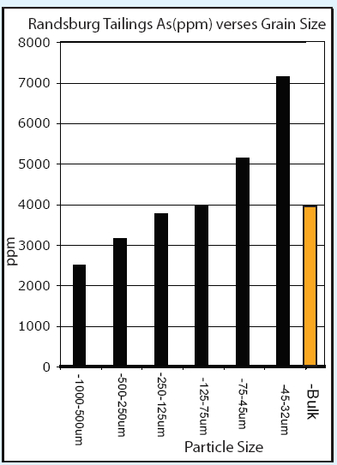
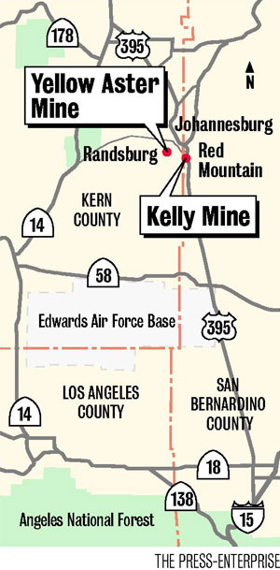
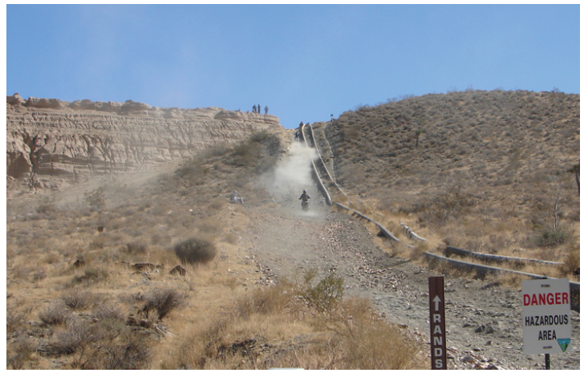
Kelly/Rand Mines: Ultra-high arsenic in mine tailings
gold-silver mines operated until 1947
approximate volume: 100,000 tons
breach of tailings levee; migration of tailings into residences in Randsburg
3000->10,000 mg/kg As
remote, Federal Land (BLM), popular with OHVers
Kim, C.S., Wilson, K.M., and Rytuba, J.J. (2011) Particle-size dependence on metal distributions in mine wastes: implications for water contamination and human exposure. Applied Geochemistry 26, 484-495.

Slide 21
Secondary arsenates and As⁵⁺-rich sulfate phases predominate in Kelly/Rand tailings
Low-grade
Ore
Tailings
Secondary crusts
“background”
soil
120
100
FeAsO₄ 2H₂O
80
Ca₂Fe₃(AsO₄)3O₂ 3H₂O
Linear Combination fits to EXAFS
am-FeAsO4
60
KFe₃[(S,As)O₄)](OH)₆
40
As-FeOOH
20
0
no evidence for primary sulfide phases (below detection? Oxidized?)
solubility and kinetics of dissolution of precipitates is expected to be very different than that of arsenic on ferric oxyhydroxide
Kim, C.S., Wilson, K.M., and Rytuba, J.J. (2011) Particle-size dependence on metal distributions in mine wastes: implications for water contamination and human exposure. Applied Geochemistry 26, 484-495.

Slide 22

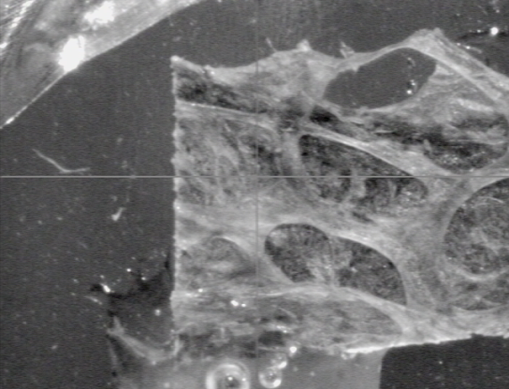
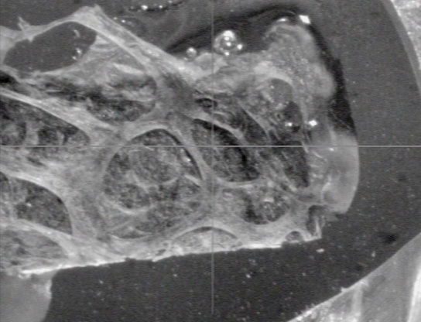
Lungs of tortoises collected near mines contain particles similar to those found in mine tailings
687 lung tissue
As
3.5 mm
1
2
4.6 mm
scorodite
Spot 2
jarosite
Spot 1
A. Foster, unpublished data
11860
11880
11900
11920

Slide 23
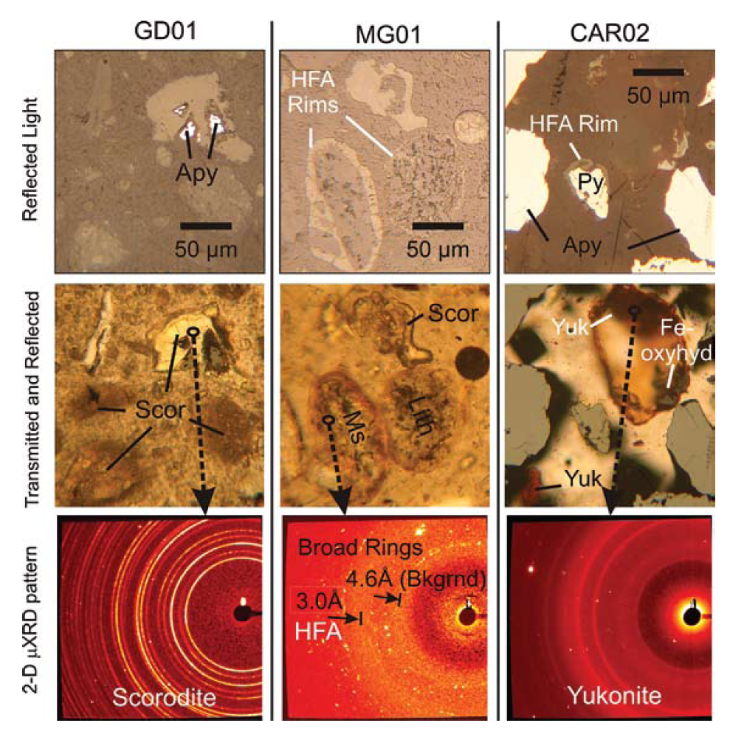
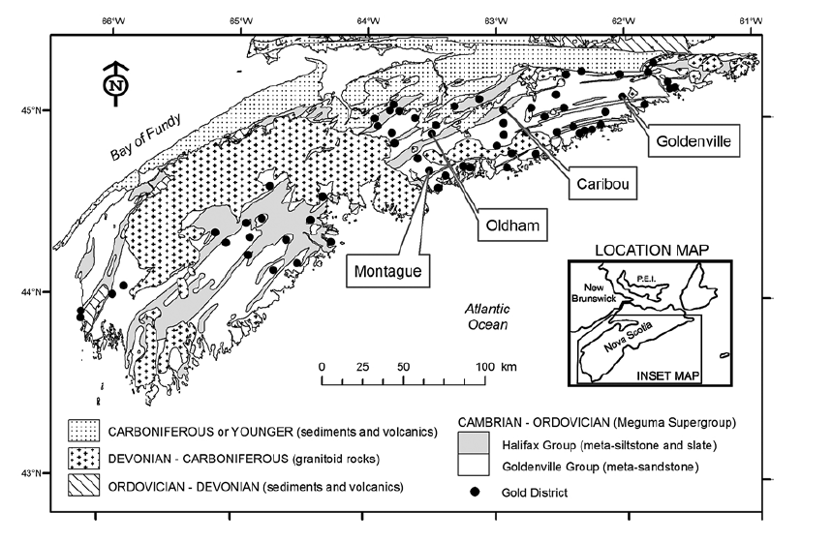
Ultra-high As gold mines in Nova Scotia, Canada
Walker et al (2009) Canadian Mineralogist v 47

Slide 24
Current and Future directions in synchrotron-based arsenic research
Validated method for As bioaccessibility test
  Coupled to geochemistry, As speciation
Bioreactors (anaerobic and aerobic)
  Aerobic: naturally-occurring microbial consortia?
  Anaerobic: relative bioaccessibility of As in neo-sulfides vs. organic compounds (biomass)
Plants
  Finding more accumulators, maximizing uptake
  Coupling genetics, protein expression, and location of metal (As) sequestration

Slide 25
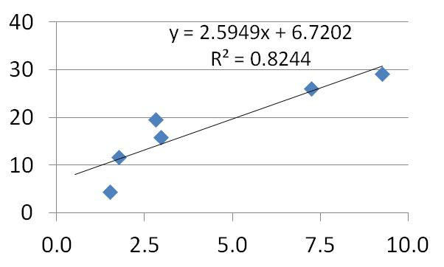
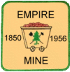
Arsenic Relative Bioavailability Project (Empire Mine State Historic Park)
Helping to find a cost-effective means of evaluating the potential for
re-development of mined lands contaminated with arsenic
N =25
In vitro
25
% Bioavailable
In vivo
  Chemistry
  X-ray diffraction
  Electron Probe
  QEMSCAN
  Particle size analysis
  “Bulk” Synchrotron studies
% Bioaccessible
Model of mineralogical control on As bioaccessibility
  “Microfocused”
  Synchrotron studies
Correlation with easily-measured parameter
This study is conducted through a proposal by CA Department of Toxic Substances Control and USGS that was funded by US-EPA (Brownfields Program)

Slide 26
Principal Component Analysis predicts 4-5 unique arsenic species
N =19
Variance can be visualized on additional
Component axes (3, 4, 5)
Component 2
Outlier removed
N =18
Component 1
Component 2
Component 1

Slide 27
Bioaccessibility and Bioavailability have similar trends with key arsenic species
Ca-Fe-Arsenate
% relative bioavailability
Pyrite/Arsenopyrite
SEE MORE AT ALPERS TALK TOMORROW SESSION 10

Slide 28
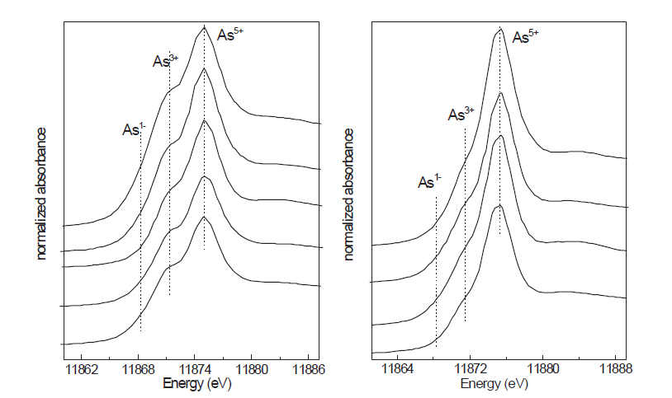
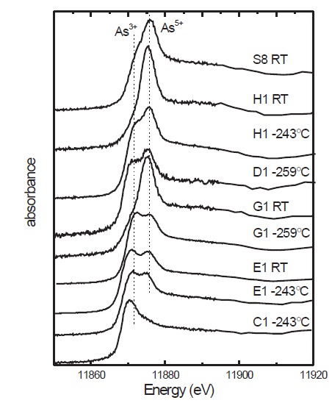
Arsenic in roasted ore treated by an anerobic biochemical reactor
Anerobic Reactor Samples
Mostly As3+, but organic
NOT SULFIDE (??)
Maghemite-rich
More As3+
Hematite-rich
Less As3+
As³⁺
S
CH₃
CH₃
Paktunc et al. (2008) Proceedings of the 9th Intl Conference for Appl. Mineralogy

Slide 29
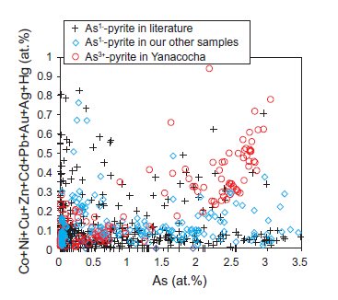
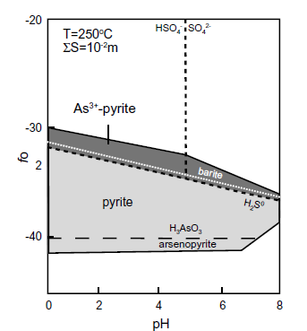
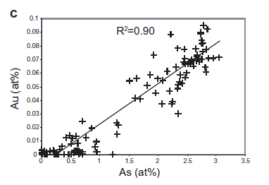
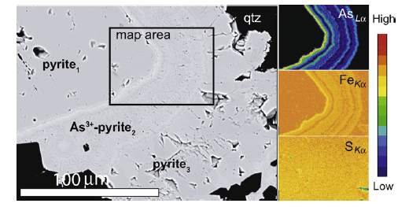
New and improved pyrite: now with As³⁺
Deditius et al (2008)
Yanacocha , Peru
(Fe,Au)(As,S)₂
Should be present in other low-sulfidation epithermal deposits: Nevada Au?
Notes:
Reich M. and Becker U. (2006) First-principles calculations of the thermodynamic mixing properties of arsenic incorporation into
pyrite and marcasite. Chem. Geol. 225, 278–290.
Deditius et al (2008). A proposed new type of arsenian pyrite. Geochem. Cosmochim. Acta. V72, 2919-2933.

Slide 30
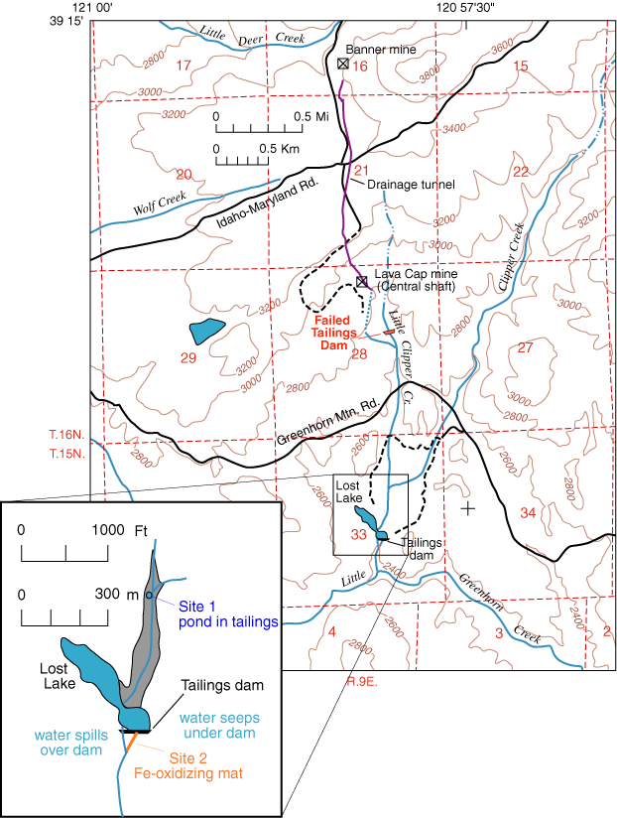
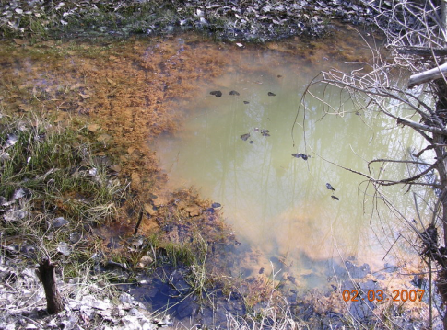
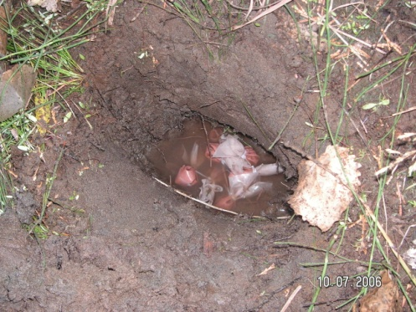



Arsenic attenuation by naturally-occurring microbial consortia: Lava Cap Mine (NPL), CA
30000
LL1
LL2
LL10
25000
LL1adj
LL2sed
LL2 fe floc
20000
LL2 Fe floc
LL2 sediment
algae
LL1
LL1adj
LL2 algae
15000
Arsenic (mg/kg)
LL10
10000
LL1
LL10
5000
LL1 adj
0
Foster et al, USGS Open File Report 2009-1268
Biogenic Fe-(hydroxide) accumulates arsenic to levels several times to orders of magnitude greater than the original mine tailngs (yellow horizontal line)
Notes:
We had observed these types of clearly biogenic Fe flocs, sampled some on a whim, and found that they contained as much or more As than the mine tailings themselves.
EPA superfund mandate: green remediation (try to use native materials in cleanup)

Slide 31
Monitoring the performance of a natural passive bioreactor
As
100
Fe
Mn
90
80
70
LL1
LL10
60
% removed between
LL1 and LL10
50
40
30
20
10
0
Jun 06
Oct 06
Nov 06
Feb 07
Mar 07
Aug 07
Oct 07
Mar 08
Concentration range at LL10
EPA cleanup goal:
As: 12-30 μg/l 10 μg/l
Mn: 235-2000 μg/l 300 μg/l

Slide 32


Arsenic is associated with Fe Oxyhydroxides rather than with biological materials (contrast the anerobic treatment of Paktunc)
00AF-LCD1a
post-rinse
0.16
99AF-wLL5
00AF-LCD1a
v₂*w_{2,i}
As(V)-FeOOH
dominant
-0.10
0.11
0.46
v₁*w_{1,i}
1000x
EPA region 9 Superfund has a pilot aerobic /anerobic treatment in place at the adit, but is not supplanting it with the native microorganisms

Slide 33



As Speciation in Pteris vittata Hyperaccumulating Fern
Webb et al (2003) ES&T
Pickering et al. Environ. Sci. Technol., 40 (2006) 5010-5014.

Slide 34
Synchrotron techniques have had great utility in the study of arsenic speciation in gold mines..there is more to come!
Primary (ore, concentrates)
n
O
n = -1, +3
S
Near-neutral
Ca minerals
Pyrite
Arsenopyrite
Fe
acidic
Ca-Fe arsenates
+ Ca
3⁺
As-poor
As-rich
5+
FeOOH
Fe sulfates
Fe arsenates
Notes:
These are all the phases, but depending on geochemistry you get different combinations

Slide 35

The End
Leptothrix ochracea from the Lava Cap Mine

