Slide 1
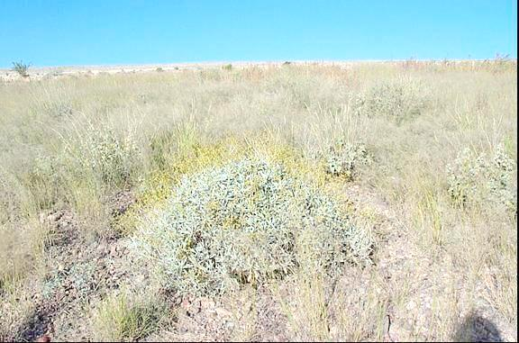

The Effect of Tailings Characteristics on Cover System Success
(or: What have we learned in 40 years?)
Monisha Banerjee
Michael Milczarek
Jason Keller
Tzung-mow Yao
Meg Buchanan
Thanks to Freeport McMoRan, BHP Billiton, ASARCO

Slide 2
Physical, Geochemical and Spatial Tailings Characteristics

Slide 3
Physical Characteristics
Tailings are poorly graded
  Mostly silt size
  No soil structure
  Highly erosive (high intensity precipitation/wind)
Impoundment construction results in additional sorting and layering
  beach (sands)
  slimes (silts)
  mixed areas
Moisture retention and permeability varies by material types
Variable saturation and drainage

Slide 4
Tailings Segregation and Structure
Beach (sand)
Slimes (silt)
Mixed
Zone
(sand & silt)

Slide 5
Geochemical Characteristics
Can be moderately saline to hyper-saline
Ore body mineralogy can result in:
  High acid generation potential (and acidity) with high plant available metals (i.e. arsenic)
  Moderate salts with no/ low plant-available metal content
Typically low plant nutrient content
Lack of organic matter and microbiota

Slide 6
To Cap or Not To Cap?

Slide 7
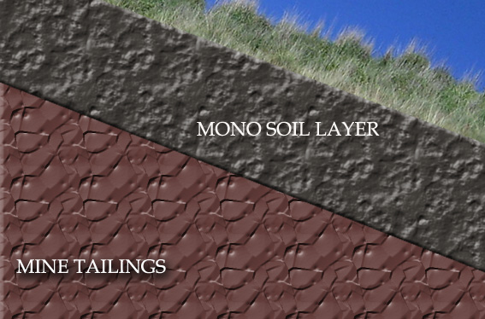
Reclamation Goals and Methods
Goals:
Establish vegetation
Minimize erosion and stabilize tailings
Minimize deep percolation
Methods:
Soil covers
Direct revegetation w/
tailings amendments

Slide 8
Previously Reclaimed Tailings Surfaces (in AZ)
ASARCO Mission Tailings No. 6 (1983: 12-inch cover)
ASARCO Mission San Xavier Tailings 1,2, 3 (2011: 12 inch cover)
Eagle Pitcher Mill site (1960s, 1989-92: 12-inch cover)
Twin Buttes Tailing No. 2 (1986: 12-inch cover)
Phelps Dodge Sierrita Esperanza Tailings (1986: 12-inch cover)
San Manuel PS Tailings Impoundment 1/2 (1991-92: 6 to 8 inches cover)
San Manuel Tailing Impoundments 1-6 (2008: 12-inch cover)
San Manuel PS experimental biosolid plots (1998: no cover)
McCabe Mine Tailings (1996: 24 inch cover)
Phelps Dodge Morenci Tailings 4W experimental test plots (1997: 12 to 24-inch of cover)
Freeport McMoran Copper Queen CTSA Tailings (2012: 24 inch cover)
Circumneutral
Potentially Acid Generating
Acid
Notes:
All test plots were on side slopes. Website provided at end of presentation with link to more detailed pubs.

Slide 9
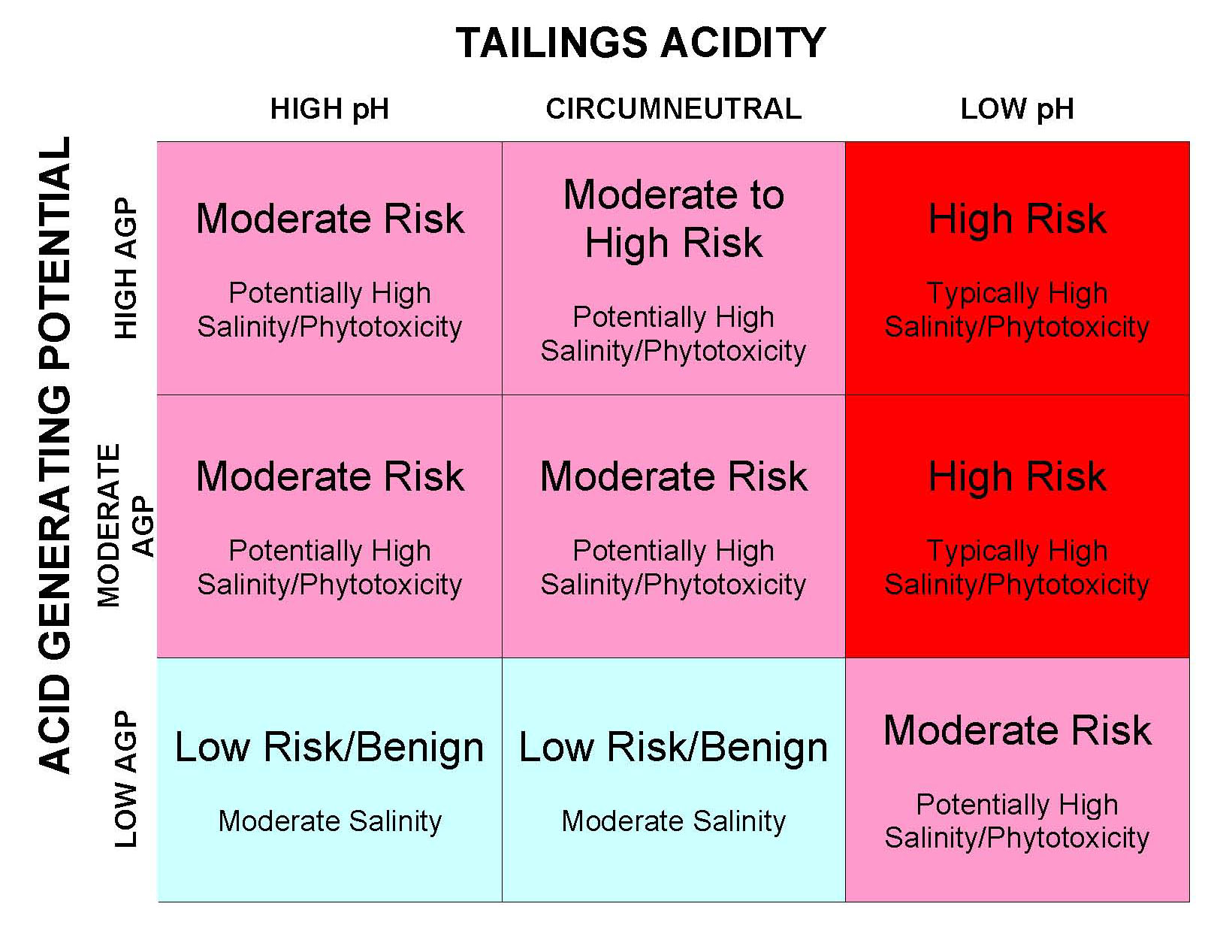
Matrix Approach
Cover Depth

Slide 10
Vegetation on
Reclaimed Tailings

Slide 11
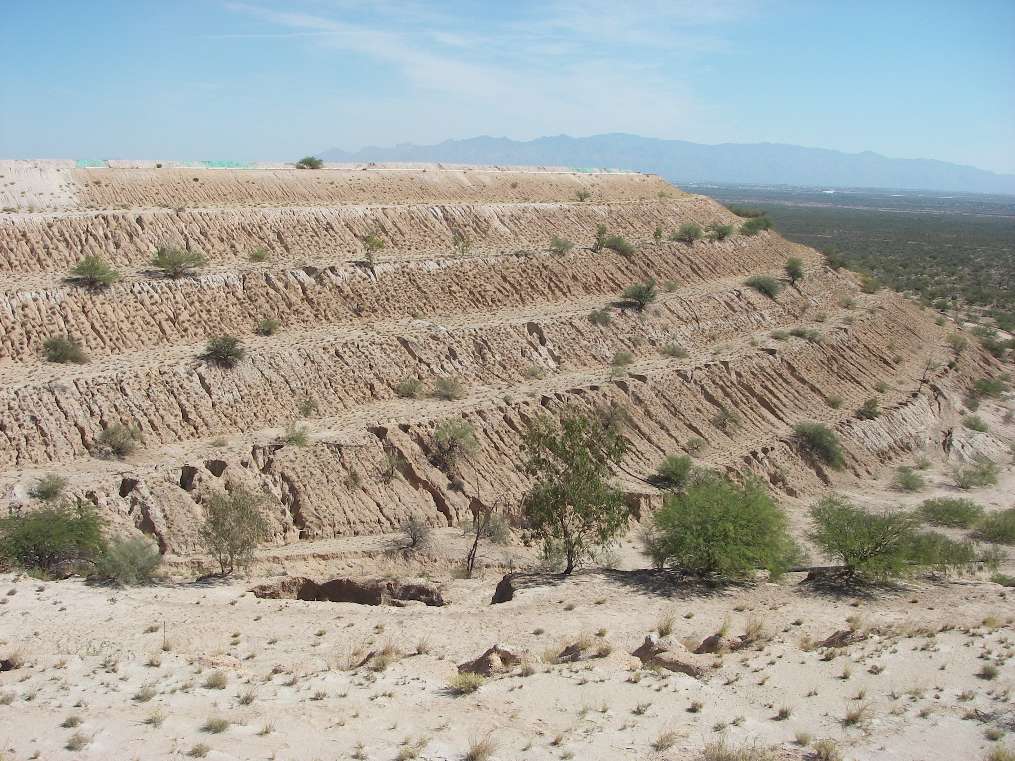
ASARCO Mission Tailings
Notes:
ROCK ARMOR PRESENTATION (JASON) AFTERNOON

Slide 12
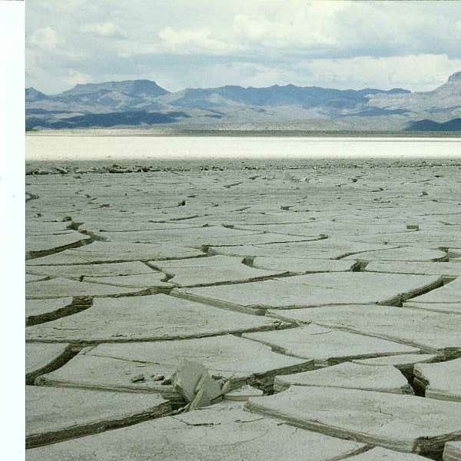

Slide 13
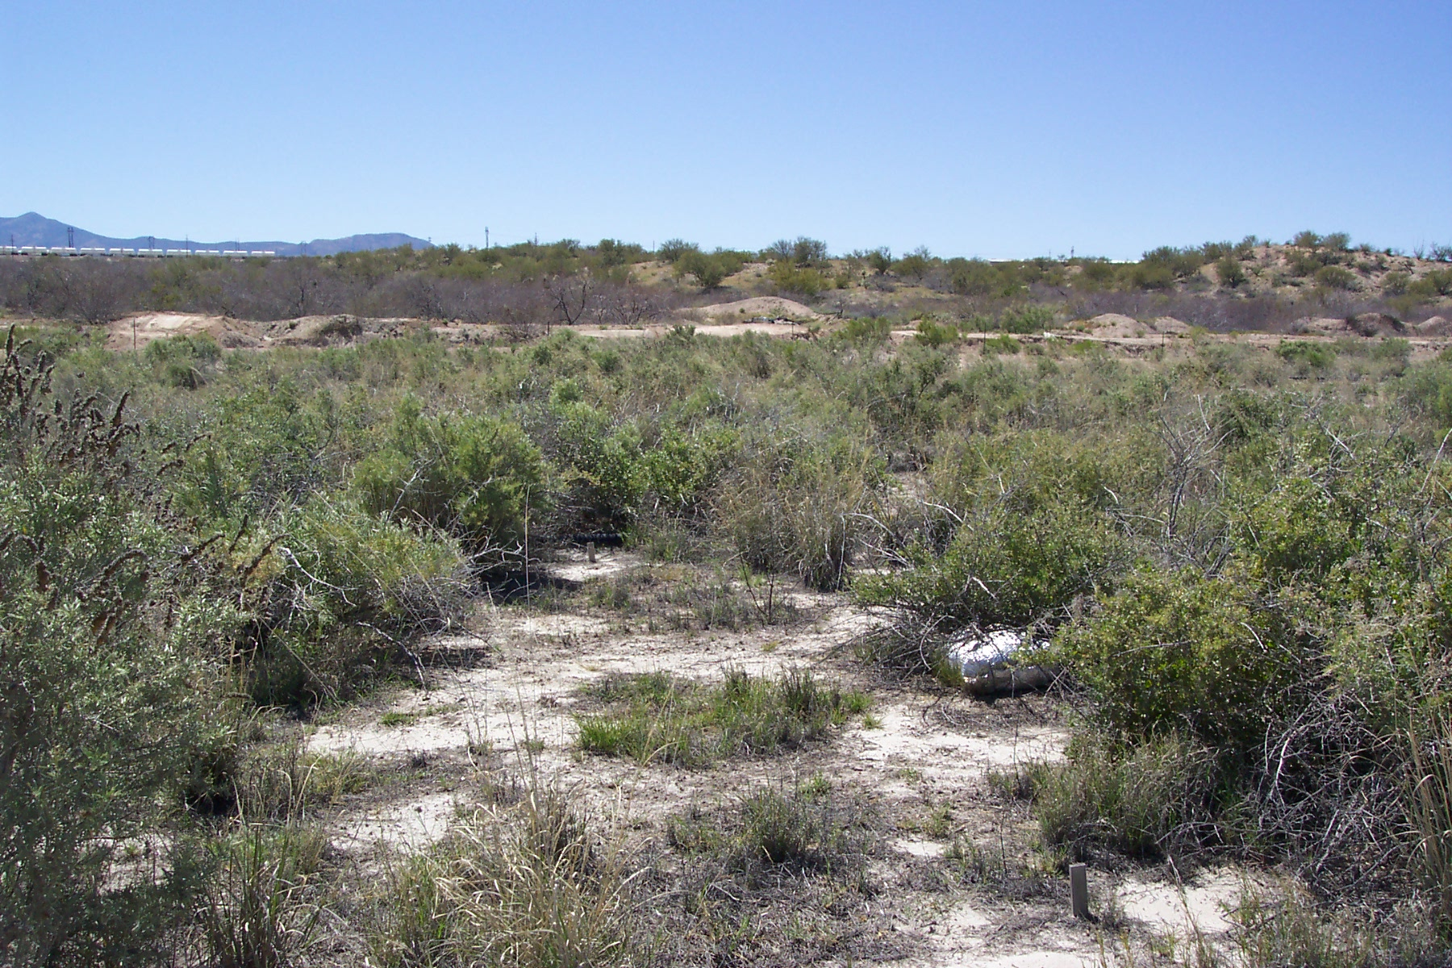
San Manuel
Circum-neutral
Mixed zone/ Slimes Tailings
Reclaimed in 1999
Vegetation in 2005
No cover. Biosolid/green waste amended

Slide 14
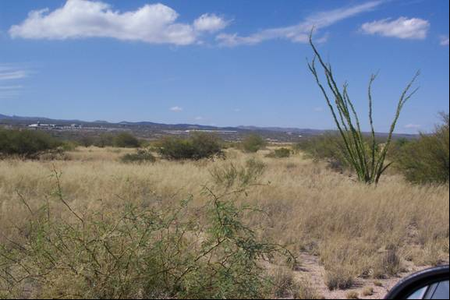
San Manuel
Circum-neutral Tailings, Beach/Mixed
Reclaimed in 1999
Vegetation in 2005
30-cm cover, reseeding/mulching,
hand planting

Slide 15
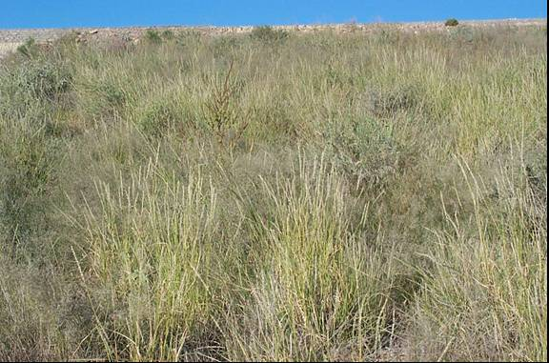
Morenci
Acid tailings, Side-slope
Reclaimed in 1998
Vegetation in 2007
30-cm cover, reseeded,
21 ton/acre biosolids,

Slide 16
30 cm Cover vs. 60 cm Cover

Slide 17
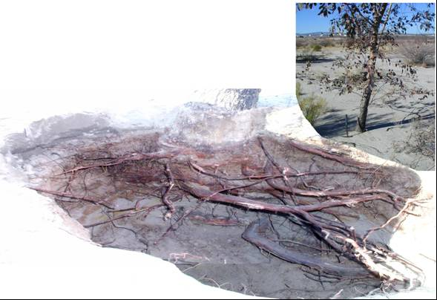
Rooting Characteristics

Slide 18
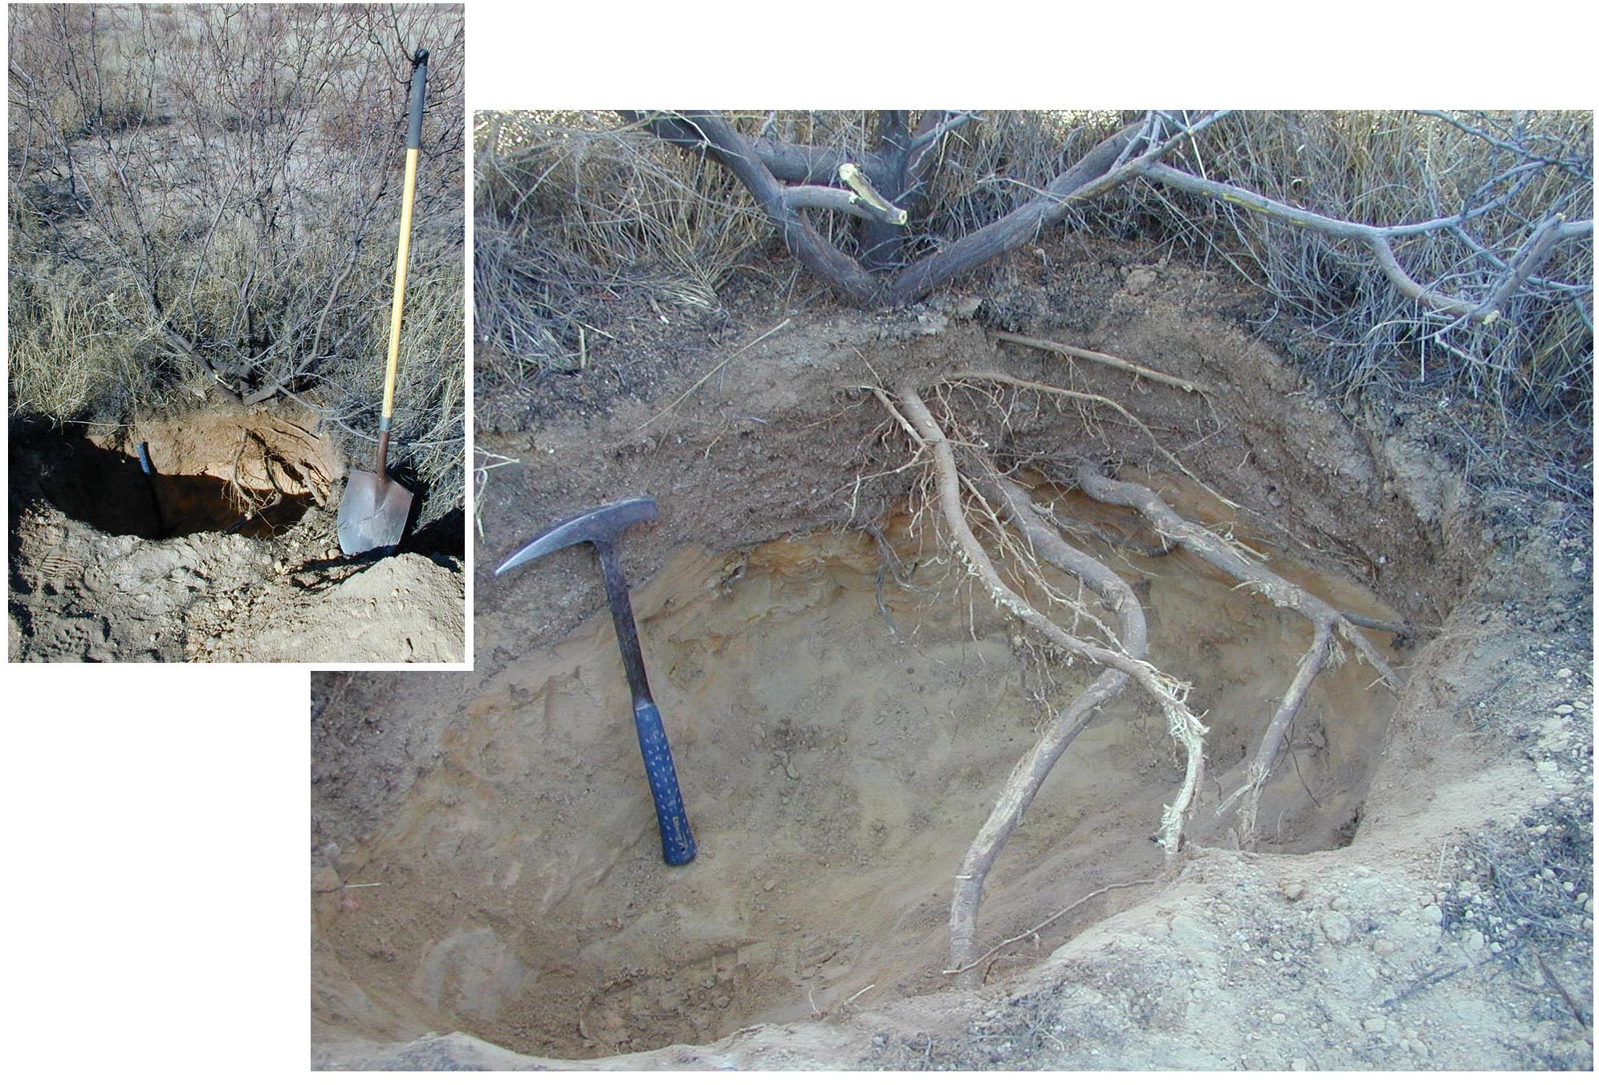

Slide 19
Vegetation Considerations
Rooting characteristics:
  Actively root into circum-neutral tailings
  Minor rooting into moderately acid tailings, primarily limited to cover and upper one foot of tailings
  Form dense root mat above cover/acid tailings contact
  Affected by tailings permeability
Vegetative success generally greater in mixed zone than in beach areas and slime areas
Vegetation characteristics varies with location (e.g. slimes vs. sands)

Slide 20
Vegetation Considerations (cont’d)
Effect of cover depth
  Nominal differences in vegetative covers > 30 cm thick
  BUT native species perform better on thicker covers
Effect of organic amendments:
  Can successfully reclaim raw tailings with a biosolids/green waste (compost) mix
  Results in significantly greater mean vegetation cover; however, less species diversity
  In some cases, observed effects sustained for over 10 years
Side slopes may require rock armoring; only seeded cover material may not adequately stabilize slopes

Slide 21
Low-pH and Saline Solution Migration into Monolayer Covers?

Slide 22
Trench Sample Design
(cm)
0
45
75

Slide 23
pH Profiles
Typically
Phytoxic

Slide 24
EC Profiles

Slide 25
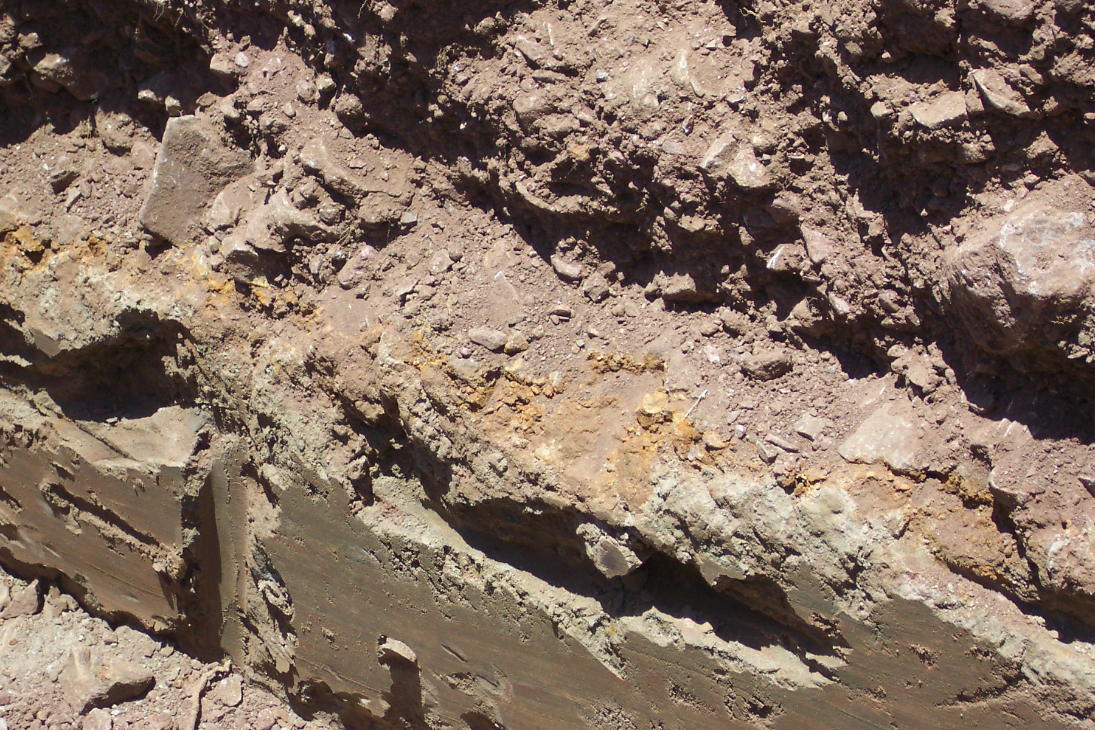
Tailing/Cover Contact

Slide 26
Acid and Salinity Migration Considerations
In a semi-arid environment salinity and acid migration observed in Southwest US environment to be limited to ≈ 15 cm above contact
Phytotoxic levels of pH and salinity in cover material generally absent ≈ 5 cm above contact
Increased migration above contact with decreased cover thickness (30 vs. 60 cm)
Acidity and salinity migration may be limited due to:
  Unsaturated hydraulic conductivities and upward flux rates greatly diminish with distance above the contact
  High calcium carbonate contents in the cover material can neutralize low-pH solution

Slide 27
Infiltration/Net Percolation

Slide 28
Calculated 1D Net Percolation Flux
Sensor Nest/Plot Location | Total Downward Flux (cm) | Annual Flux (cm/yr) | Annual Flux Rate (cm/s) | Estimated Flux as Percent of Precipitation
30 cm cover, low vegetation
Average (3 to 2 nests) | 3.23 | 0.37 | 1.16E-08 | 1.29%
Standard Deviation | 1.61 | 0.26 | 8.14E-09 | 1.04%
30 cm cover, high vegetation
Average (3 to 2 nests) | 0.84 | 0.12 | 3.80E-09 | 0.34%
Standard Deviation | 6.52 | 0.07 | 2.24E-09 | 0.30%
60 cm cover, low vegetation
Average (3 to 1 nest) | 4.20 | 0.55 | 1.74E-08 | 1.68%
Standard Deviation | 7.37 | 0.55 | 1.76E-08 | 1.35%
Average 60 cm cover, high vegetation
Average (3 to 2 nests) | 3.84 | 0.48 | 1.53E-08 | 1.53%
Standard Deviation | 3.10 | 0.29 | 9.13E-09 | 1.24%
Bare Tailings
Average (3 nests) | 0.17 | 0.02 | 6.56E-10 | 0.09%
Standard Deviation | 0.28 | 0.03 | 1.11E-09 | 0.16%
Shallower (30 cm) cover/ Lower permeability tailings
Deeper (60 cm) cover/ Higher permeability tailings
Low permeability bare tailings: > runoff, less infiltration

Slide 29
Predicted Effect of Increasing Cover Thickness
Tailing sideslope
Tailing beach
Tailing slimes

Slide 30
Net Percolation Considerations
Lower permeability tailings reduce net percolation
Increasing cover thickness can have less influence on net percolation than tailings characteristics
Shallow covers or direct reclaimed tailings can have less net percolation than deeper covers
Tailings are an integral part of store and release cover systems and their influence should be considered during cover design

Slide 31
Conclusions
Circumneutral tailings can be revegetated with organic amendments (if available); net percolation may actually decrease because of low permeability material at surface
Low permeability tailings serve to slow down infiltration and retain water in cover; can have greater effect on net percolation than cover depth
Revegetation seed mixes should consider differences between sand and slimes area; deeper covers are better for native seed mixes
Cover system modeling should acknowledge ET depth into tailings
Upward acidity and salinity migration into monolayer covers may be limited

Slide 32
THANK YOU! monisha@gsanalysis.com
More information at http://www.gsanalysis.com/minepub.html

