Slide 1
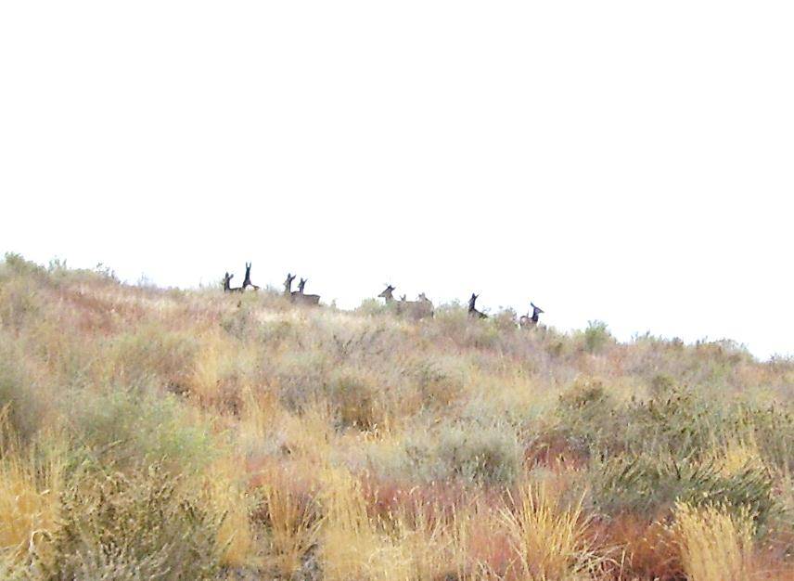
Ten-Year Performance Evaluation of the Evapotranspiration Cover
at Barrick Goldstrike Mine’s AA Leach Pad
Mike Milczarek, Jason Keller, Margaret Buchanan, Bob Rice, Mike Yao, Gary Goodrich, Johnny Zhan
Thanks to Dale Hammermeister and Joe Vinson

Slide 2
Background
Goldstrike Mine located in north-central Nevada
  Average precipitation = 11.7 in/yr (29.7 cm/yr): 1990-2011
  Primarily snow, December through May
AA Leach Pad
  HDPE lined gold heap leaching facility
  Operated from 1987 to 1999
  224 acres and 55 million tons of ROM leached ore
Estimates of natural groundwater recharge rates
  Function of elevation and precipitation
  Maxey-Eakin (1949) approximation – 3% to 5% of precipitation
Evapotranspiration (ET) cover designed and placed in 2000-2001

Slide 3
Barrick Gold Closure Objectives

Slide 4
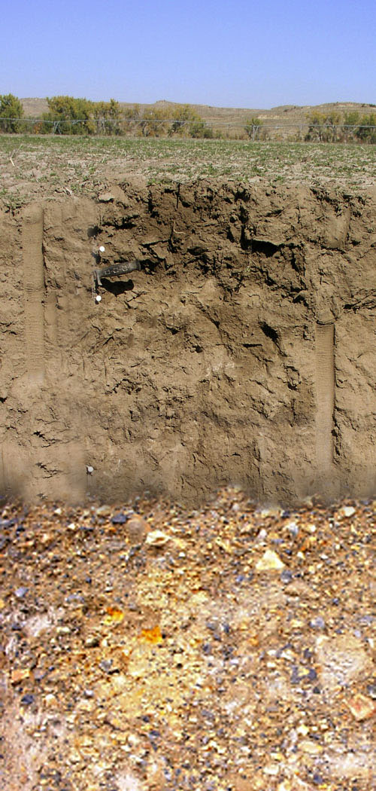
Designing an ET Cover
ET Cover – Seasonal storage and release of soil water
Fall
Soil is initially dry due to previous growing season

Slide 5
Designing an ET Cover
ET Cover – Seasonal storage and release of soil water
2. Winter
Rain and snowmelt gradually infiltrates, increasing soil water

Slide 6
Designing an ET Cover
ET Cover – Seasonal storage and release of soil water
3. Spring
Net percolation is most likely in this season (April-June) after a wet winter

Slide 7
Designing an ET Cover
ET Cover – Seasonal storage and release of soil water
4. Late Spring & Early Summer
Temperature warms, and evapo-transpiration increases

Slide 8
Designing an ET Cover
ET Cover – Seasonal storage and release of soil water
5. Late Summer
Continued transpiration by vegetation removes stored soil water from root zone

Slide 9
Designing an ET Cover
- Downward/upward flux rates are controlled by soil hydraulic properties and pressure potential gradients
Zero flux plane defines depth at which downward flux is occurring
Design Factors
- Cover should contain ample water-holding capacity (loams ideal)
An abrupt textural contrast from loams/silts to gravel/ sands may create capillary break
ZERO FLUX PLANE

Slide 10
AA Pad Closure
ET Cover Design Parameters
  Minimize net percolation from meteoric water
  Promote vegetation growth
Borrow material: fine grained topsoil or valley fill deposits (Carlin silt)
  Unsaturated flow modeling predicted nominal changes in flux above a 4 foot ET cover
Four foot ET cover (3 ft to 5.5 ft), placed in 2000-2001

Slide 11
AA Pad Cover Performance Monitoring
Soil cover monitoring stations (14)
  Soil water dynamics (water content, soil water pressure potential)
  In-situ and laboratory hydraulic property characterization
  Various monitoring locations to access solar aspect, slope location, proximity to runoff channels, cover material type
    East transect – Carlin Silt, east aspect
    West transect – Topsoil, north aspect
    South transects - Carlin Silt, south aspect
  Station installation 2001 (East and West) and 2005 (South)
Estimate net percolation:
  Use 1D Darcy approximation using pressure potential data and hydraulic properties from bottom two sensor locations

Slide 12
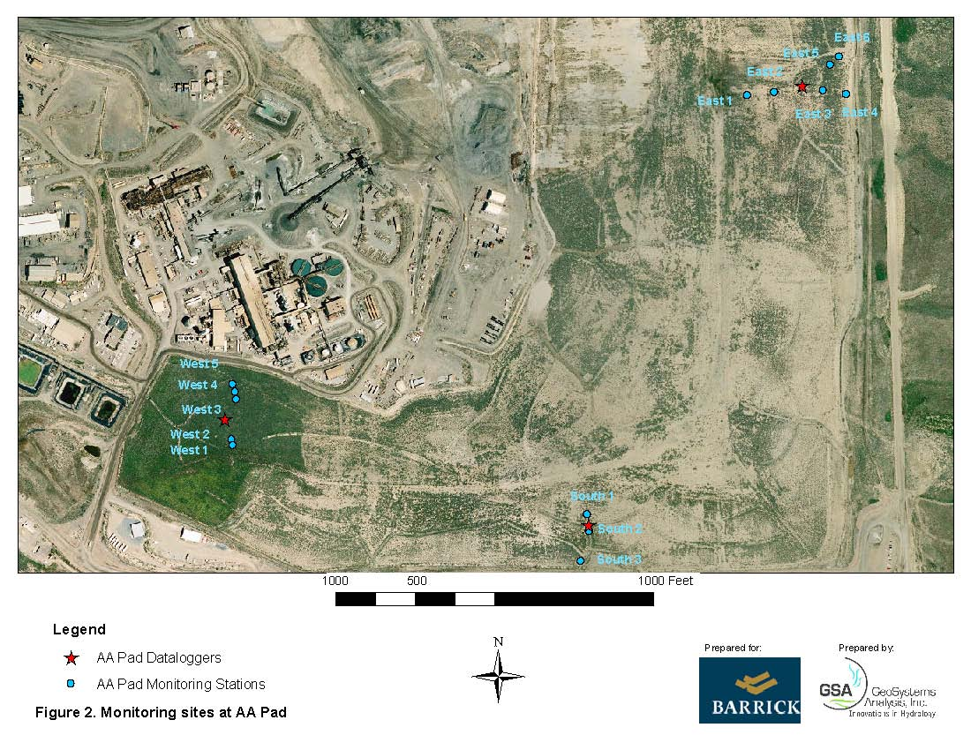

Slide 13
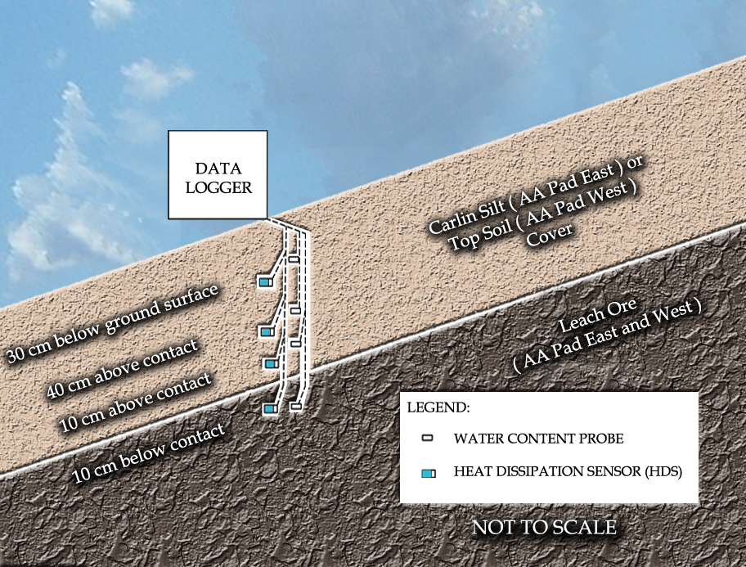
Notes:
Change to 3(H):1(V) slope angle

Slide 14
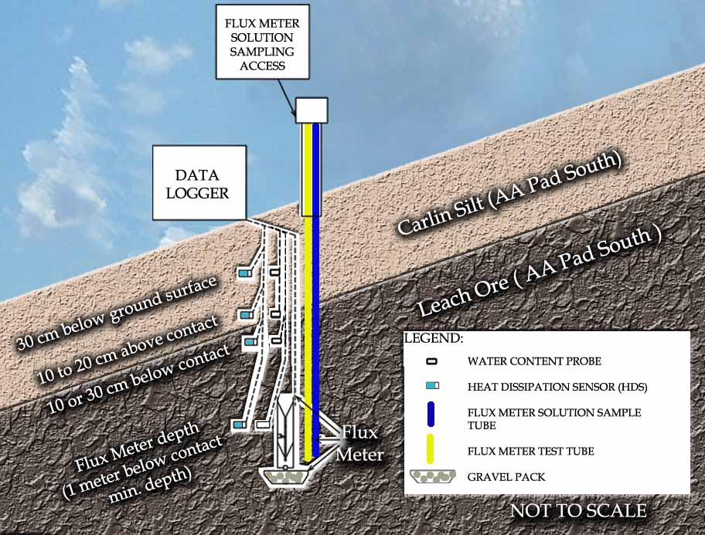
Notes:
Remove “commingled Carlin, Petroleum” etc. Replace with “Carlin Silt (AA Pad South)?. Change angle to 3(H):1(V)

Slide 15
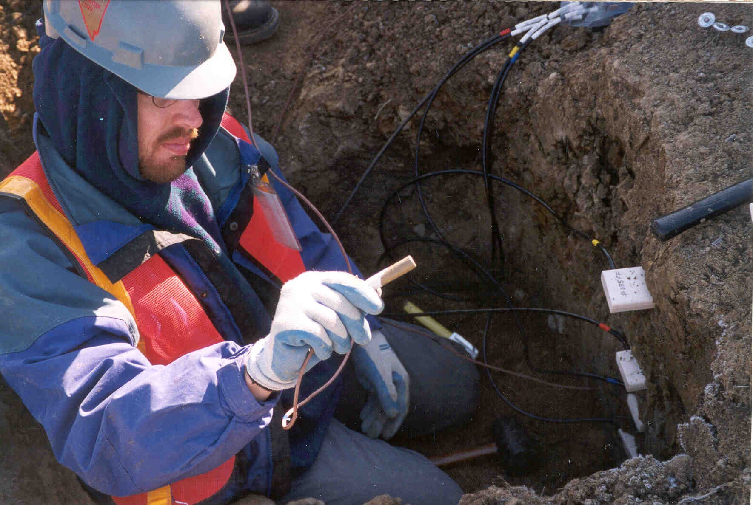
Sensor Installation

Slide 16
Data Summary

Slide 18
Vegetation Data

Slide 19
Vegetation after 10 years
Ground Cover Type | Transect
 | East | South | West
Total Plant | 26% | 36% | 89%
Perennial | 24% | 31% | 88%
Shrub and Forb | 17% | 21% | 87%

Slide 20
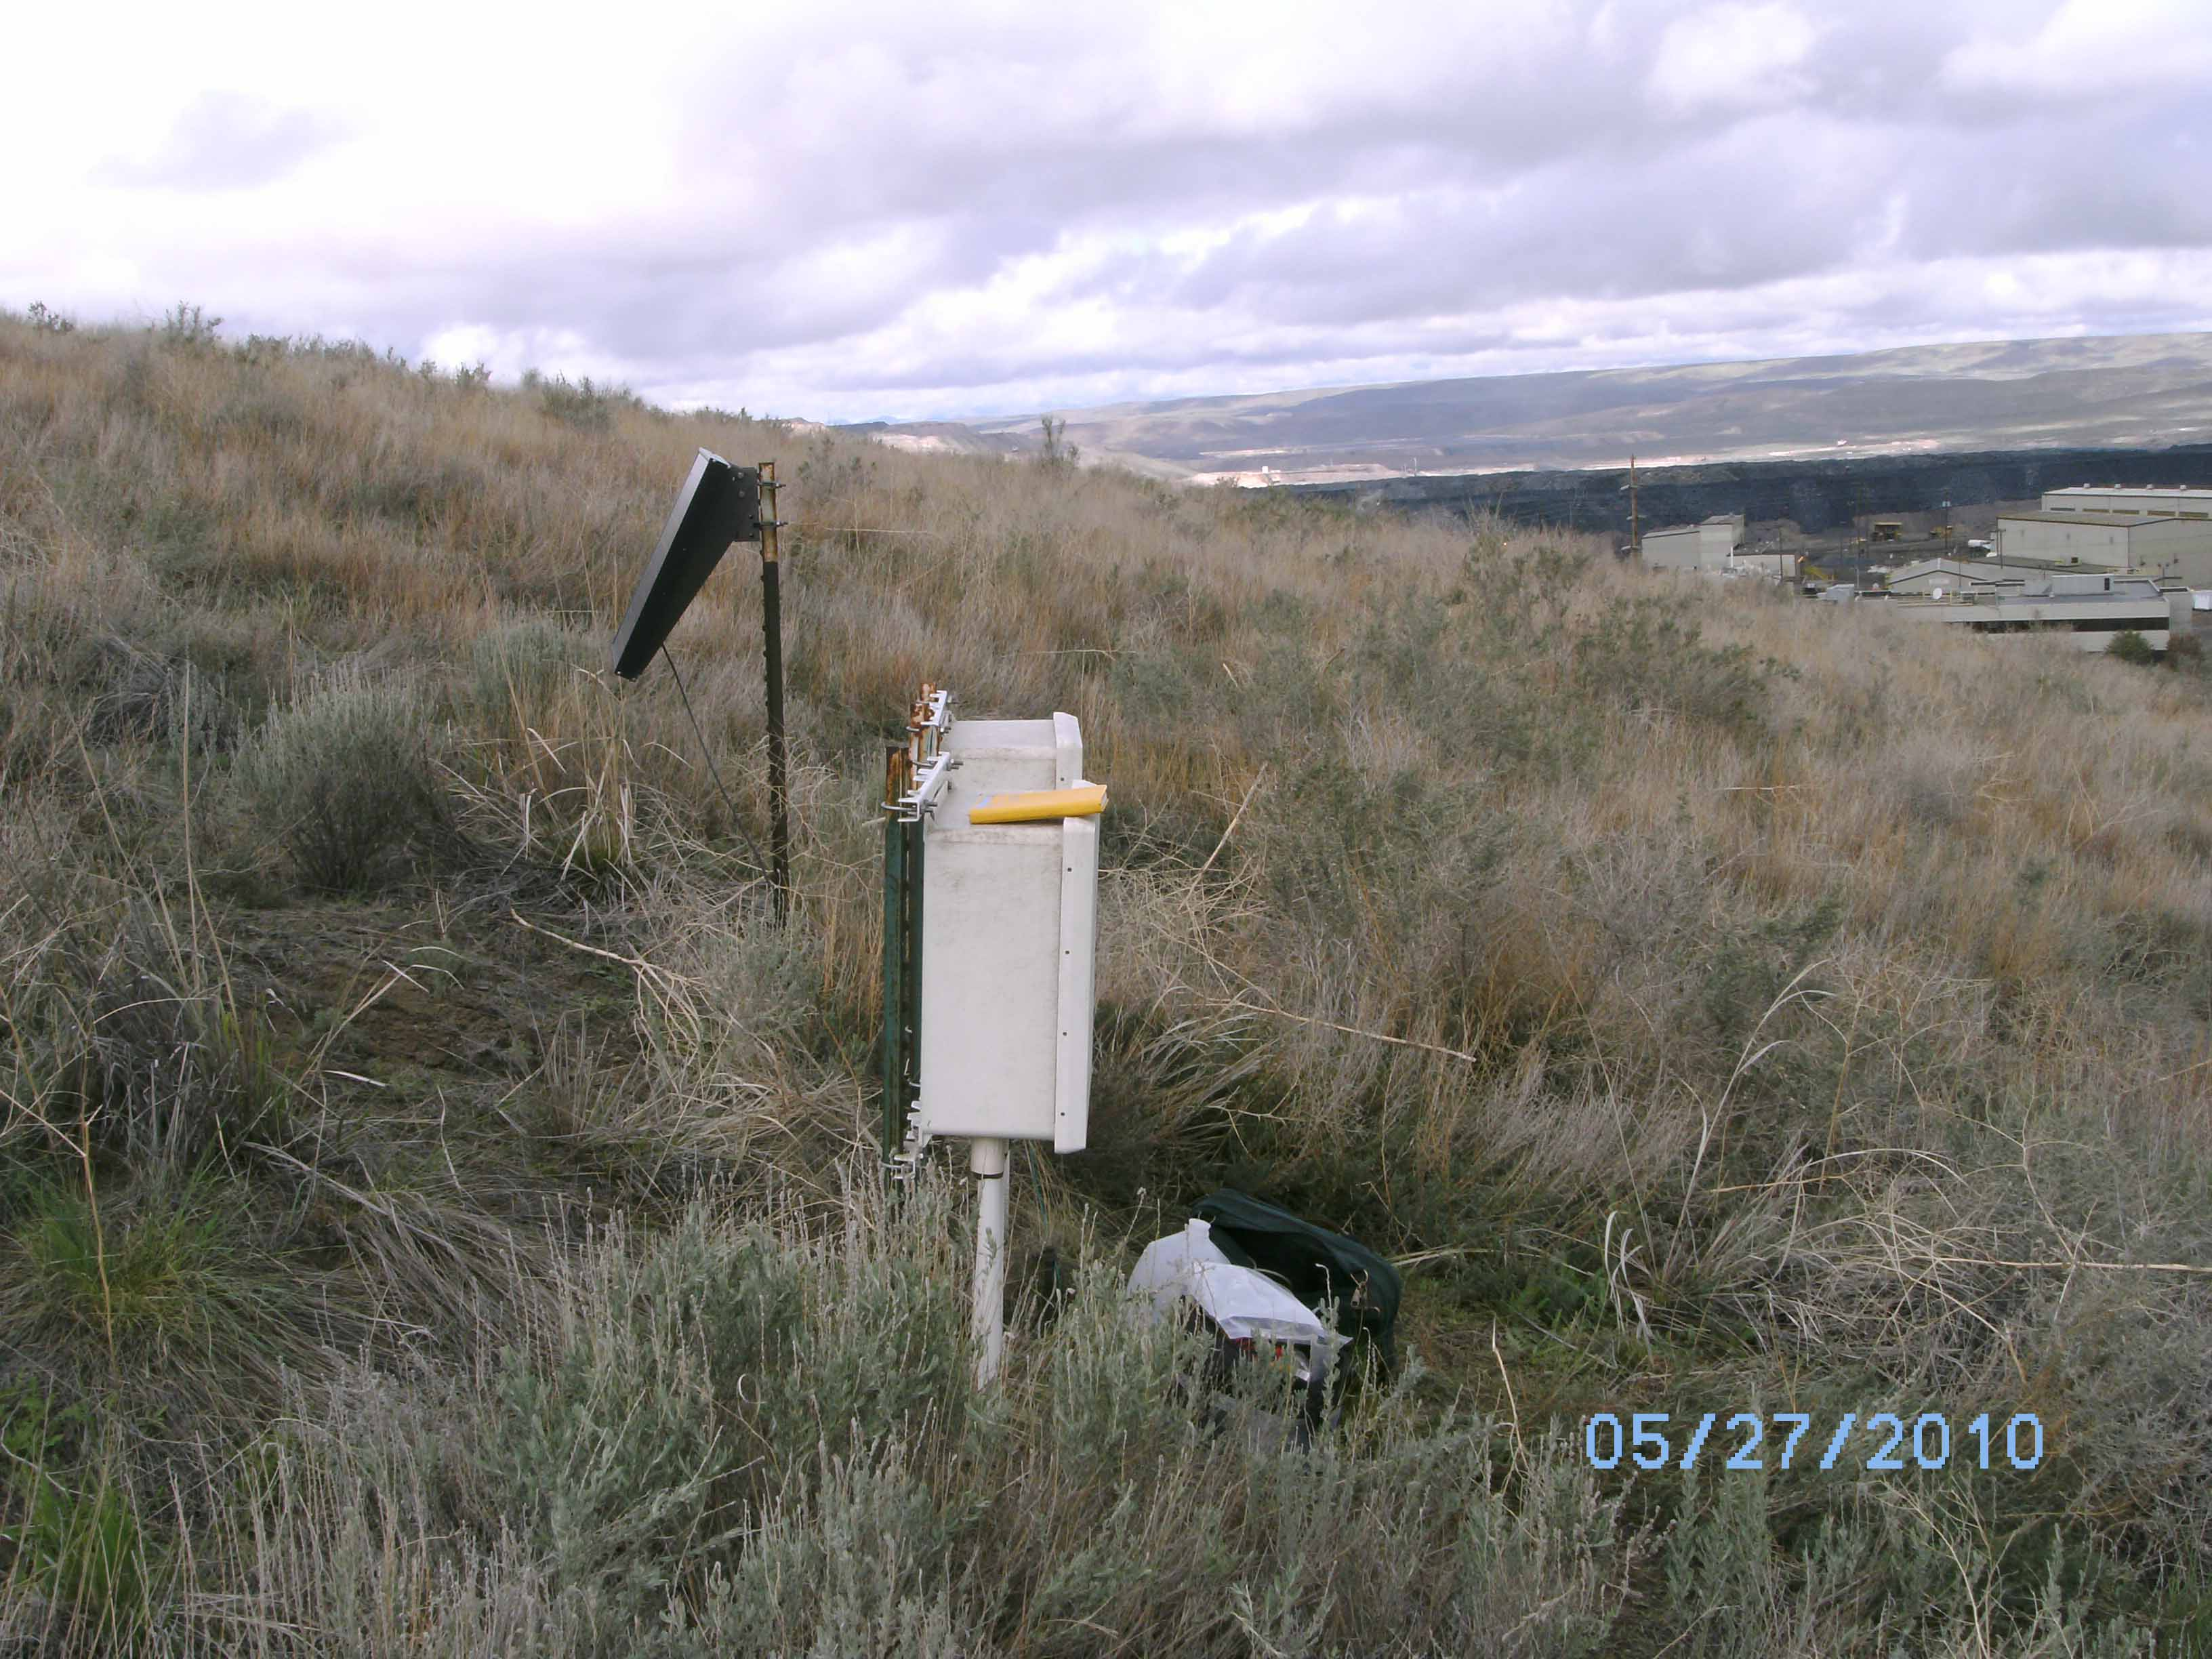
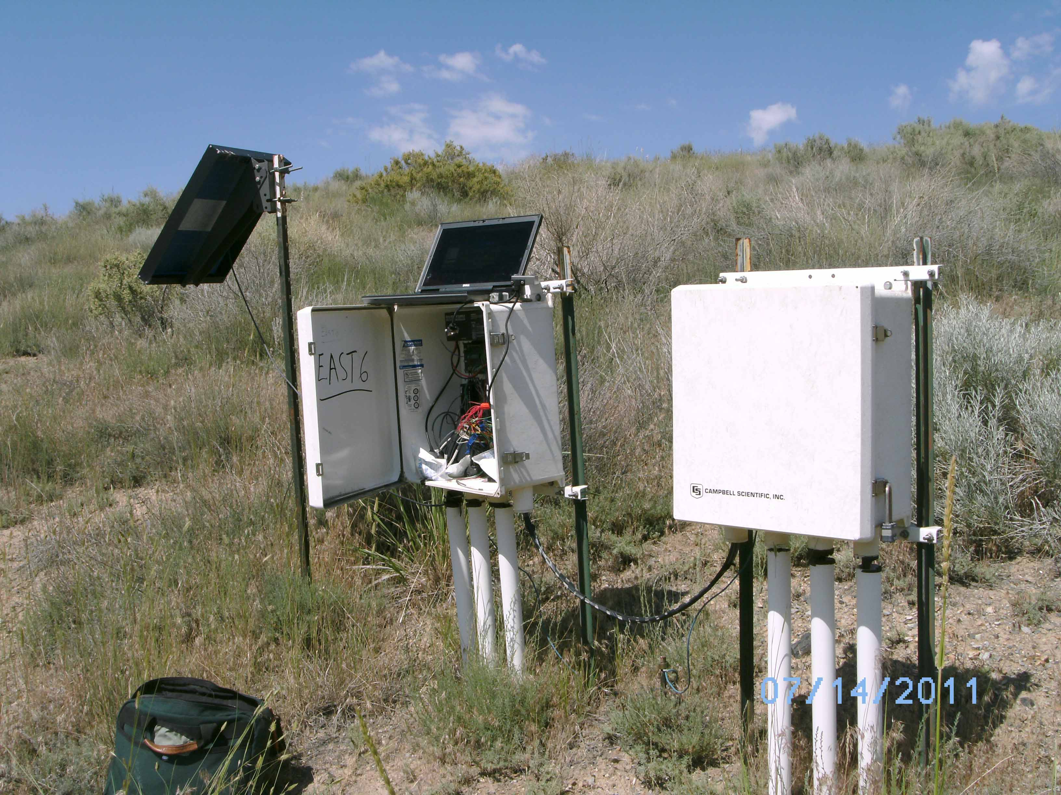
West Transect
East Transect

Slide 21
Water Content Data

Slide 22
East Transect Water Storage

Slide 23
West Transect Water Storage

Slide 24
Field Water Holding Capacity

Slide 25
Pressure Potential Data

Slide 26
West 2 Matric Potential

Slide 27
East 4 Matric Potential
Increasing dryness

Slide 28
Estimated Net Percolation Fluxes

Slide 29
Estimated Cumulative Flux East Transect

Slide 30
Estimated Cumulative Flux Channels

Slide 31
Estimated Cumulative Flux West Transect

Slide 32
Estimated Cumulative Flux South Transect

Slide 33
Estimated Cumulative Flux South WFMs

Slide 34
Summary of Monitoring Data
Average precipitation during monitoring period (2001-2011) was 13.6 in/yr (34.5 cm/yr)
  2004-2005 wettest year in 35 years (Elko, NV)
Estimated net percolation (from pressure potential monitoring data) as percent of annual precipitation:
  0.7% for topsoil and 1.5% for Carlin
  3.7% for Carlin channels
  Area weighted average ≈ 0.85%
Significantly higher estimated net percolation in channels, some evidence of downslope water accumulation
Average and dry years - little to no deep percolation
Observed ET and rooting from greater than 5 feet

Slide 35
AA Pad drain-down

Slide 36
Conclusions
ET cover has sufficient water storage, variable
Majority of net percolation is episodic, channels are foci
Estimated net percolation is well below regional estimates of recharge
  Topsoil shows best performance, Carlin adequate
  Variable soil and vegetation characteristics, rooting is not limited to cover material
Generally good agreement between monitoring data and draindown data
Multiple years of monitoring necessary

Slide 37
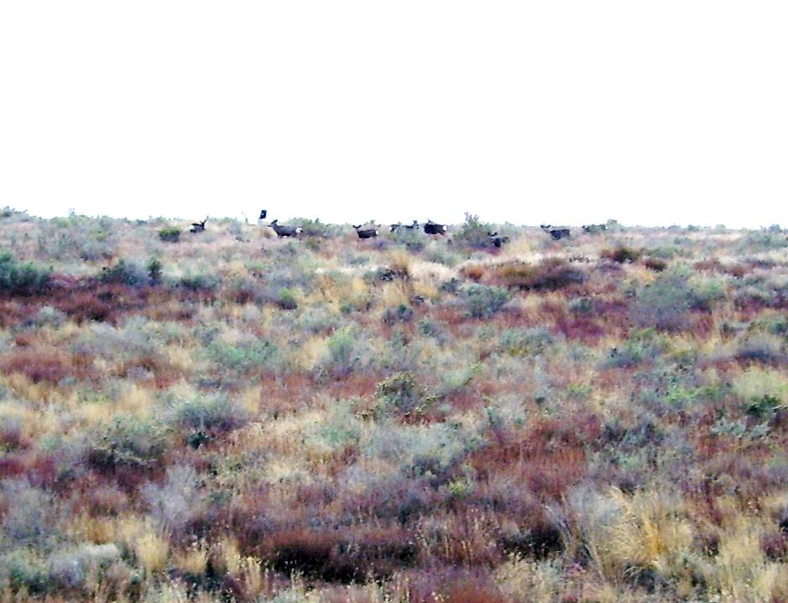
THANK YOU
More information at: http://www.gsanalysis.com/minepub.html

Slide 38
Maxey-Eakin Estimated Recharge (White River Valley, NV, 1949)
Interpolated
Recharge Estimate Intervals

Slide 39
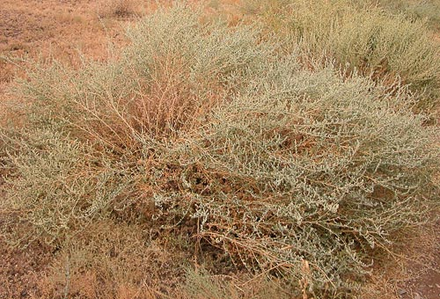
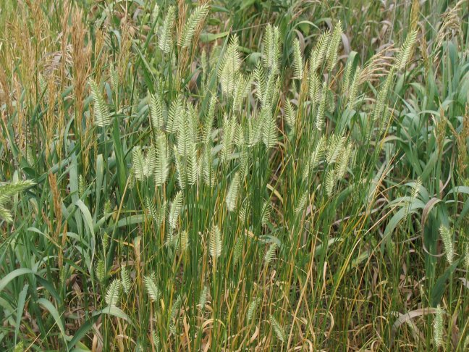
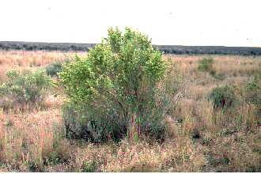
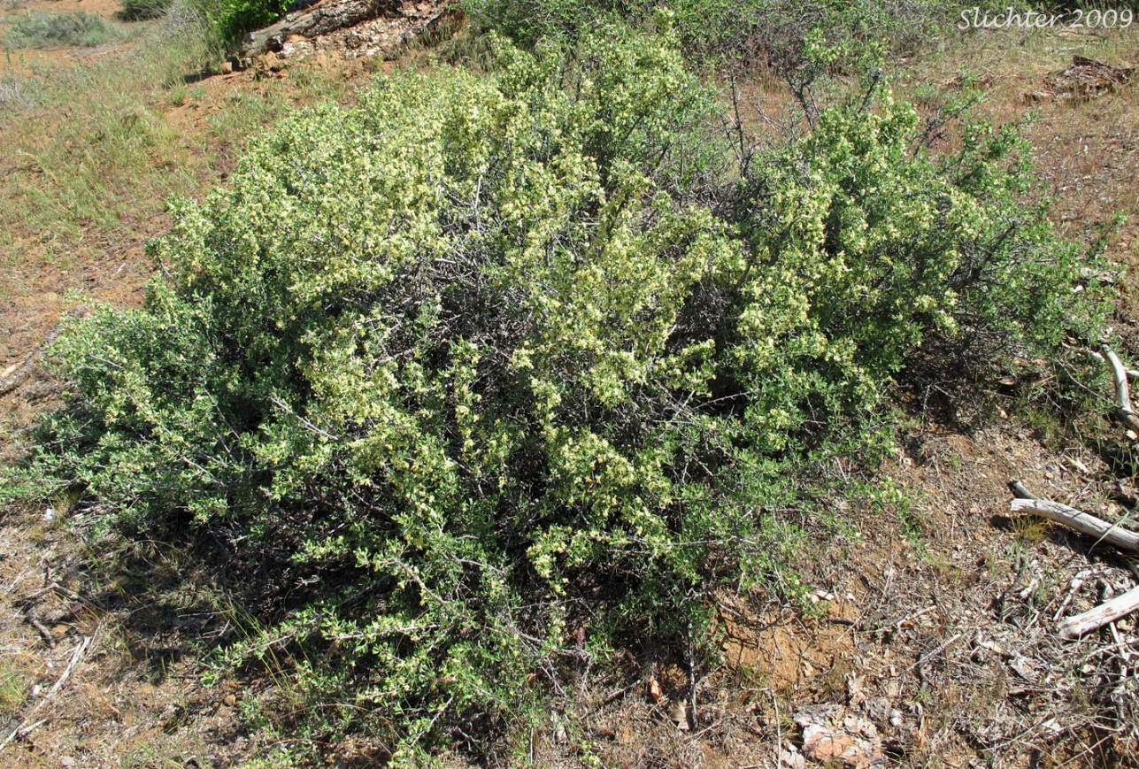
Vegetation after 10 years
Kochia prostrata
Agropyron (Wheatgrasses)
Elymus cinereus (Great Basin Wildrye)
Poa (Bluegrasses)
Bromus tectorum(Cheatgrass)
Kochia prostrata
Ground Cover Type | Transect
 | East | South | West
Total Plant | 26% | 36% | 89%
Perennial | 24% | 31% | 88%
Shrub and Forb | 17% | 21% | 87%
Atriplex Canescens (4-wing saltbush)
Purshia Tridenta (Bitterbush)

Slide 40
Estimated Net Percolation (Pressure Potential data)

