Slide 1
Predicting and Managing Waste Impacts through a Holistic and Life-of-mine
Geomet Application
Karin Olson Hoal, JKTech Pty Ltd, Brisbane Australia and
Colorado School of Mines
John Jackson, JKTech Pty Ltd, Brisbane Australia
David Mulligan and Mansour Edraki, Centre for Mined Land Rehabilitation, Sustainable Minerals Institute, University of Queensland, Australia
U.S. EPA Hardrock Mining Conference:
Advancing Solutions for a New Legacy
April 4 2012

Slide 2


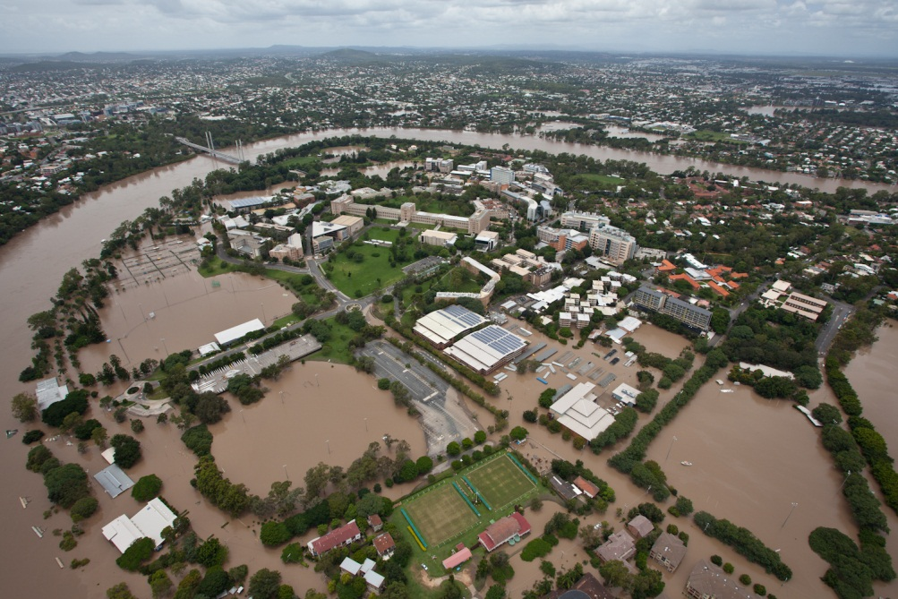
University of Queensland

Slide 3
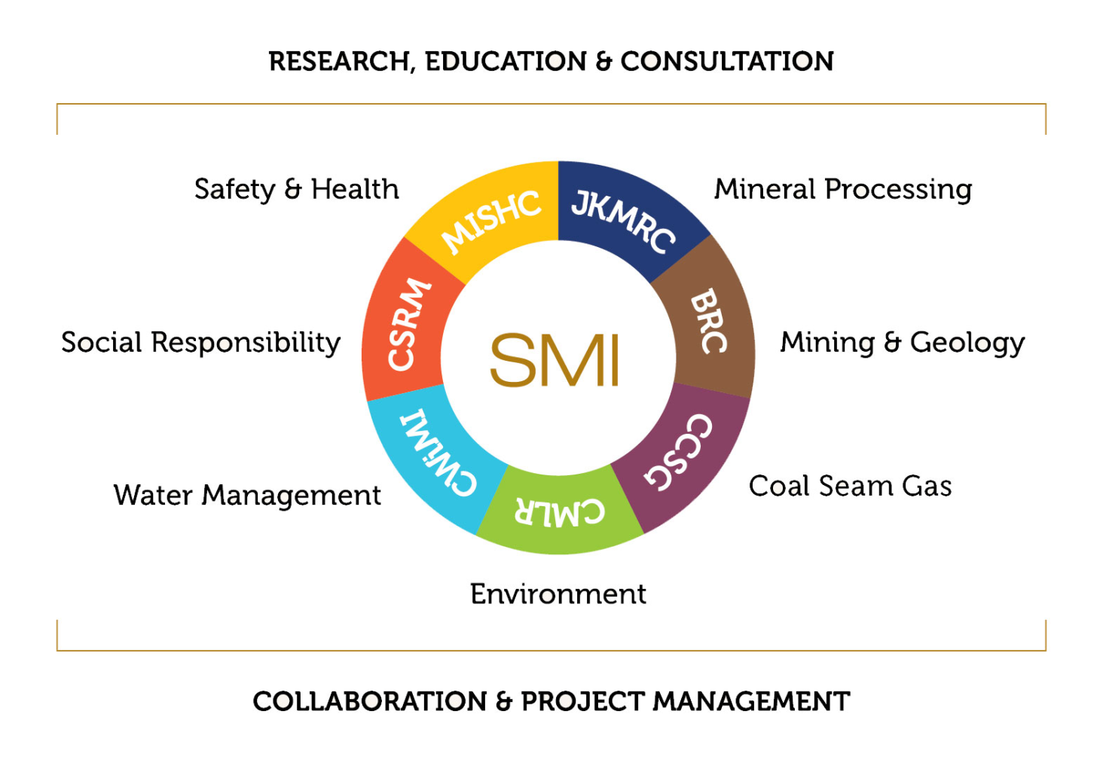

Sustainable Minerals Institute

Slide 4
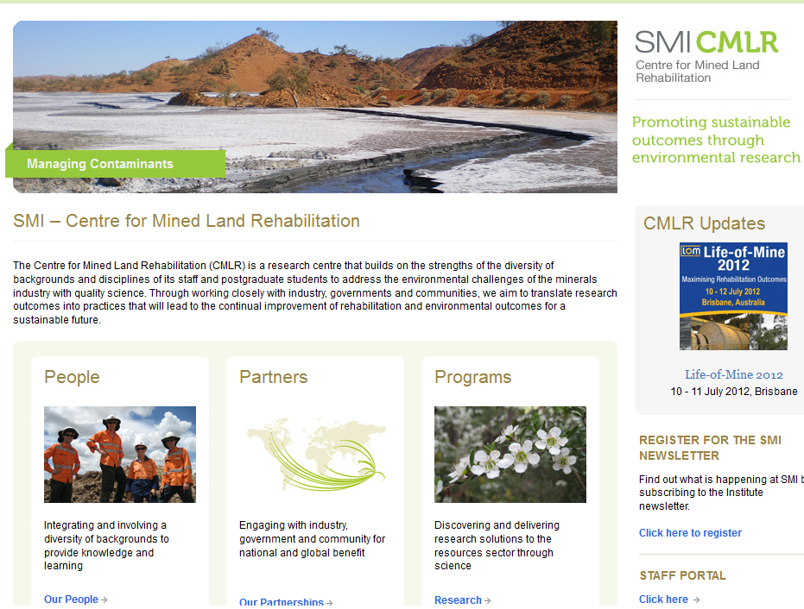

Slide 5

JKTech Pty Ltd
Brisbane Perth Johannesburg Denver Santiago

Slide 6
Mining: Challenges
Lower grade deposits
Increasingly inaccessible deposits
Higher operating costs
Higher energy costs
Critical water issues
Perceptions

Slide 7
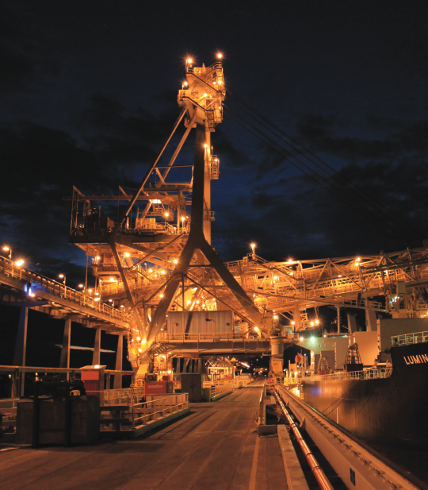
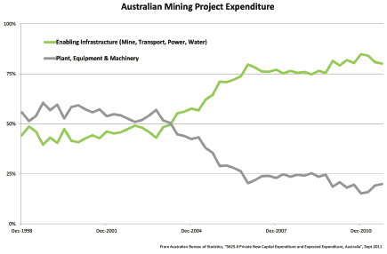
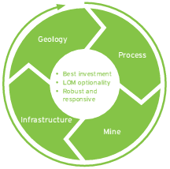
JKAurecon: The link to infrastructure
Mining: Drivers

Slide 8
Energy
6-7% Australia’s energy on comminution
Mining houses target of 10-20% reduction
BCS, June 2007. Mining industry energy bandwidth study. US Department of energy
(The following slides are Taken from JKMRC/JKTech/CRCORE 2010 presentation)
Notes:
Geomet – planning – characterisation impacts on energy eg

Slide 9

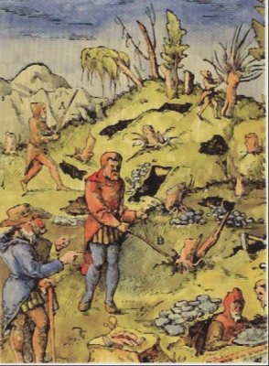
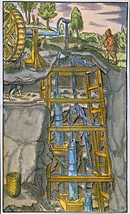
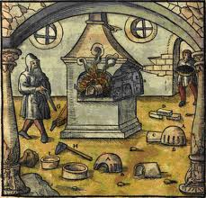
Mining: Perceptions
On the Nature of Metals (De re metallica) 1556, by Georg Bauer (Georgius Agricola)
Lawrence Gipe, “Rosemont Copper Girl:, 2011
Notes:
However, much of society sees the mining industry as an archaic, unnecessary and risky industry (this is particularly true in the US where I come from). It is true that as you look at Agricola you appreciate that not a lot has changed in 500 years: we dig, process, melt in much the same way. But we know the technological advancements have been significant.
Compare this image with the alternate message: that mining is a new-age industry that is risk adverse and value adding for society. This marketing approach has been working in Arizona, for example.

Slide 10
Perceptions
2010 World Economic Forum Report Mining & Metals Scenarios to 2030:
“…not anticipate any technological breakthroughs that would transform key aspects of the industry such as operations, metals and mineral use or energy technologies” for 30 years..
Notes:
Nevertheless, the message is not coming through. This World Economic Forum report on mining scenarios for 30 years explicitly assumes there will not be any significant technological breakthroughs in the industry.

Slide 11
Life-of-mine geomet application
$ value
Closure
Reclamation
Geological model
Value
Locked in variable ore relationships
Team-based approach
Integrate data sets
Operating cost reduction
Risk mitigation
through life of project
Drilling
Core logging
Operations
QA/QC
Characterisation
data sets
Piloting
Geochemistry
Assay
Mine plan and
design
Mineralogy
Metallurgical
tests
Materials
Attributes

Slide 12
New approaches
Reconcile extraction with sustainable practice
Operational state-of-the-art approaches to integrated extraction beneficiation and mineral processing
Effective prediction
Environmental and economic impacts

Slide 13
Predict …. Plan …. Manage
PREDICT performance
Recognize variability and geological drivers
Model relationships among attributes
Interpolate throughout mineral deposit
PLAN proactively
Integrate into mine plan and scheduling
Reduce uncertainty
Improve performance
MANAGE impacts
Understand and control environmental consequences
Reduce overall project risk
Recognize financial value through NPV and IRR options

Slide 14












Understanding the variability in the deposit:
Identifying the drivers of mining and processing responses
Front end
Intrinsic Rock Properties
Defining Physical Control

Slide 15
Proxies
Geology, Assays,Equotip, Sonic, NIR
Indices
RBTEx, GeMCi
Attributes
SPI, DWT, RBT

Slide 16
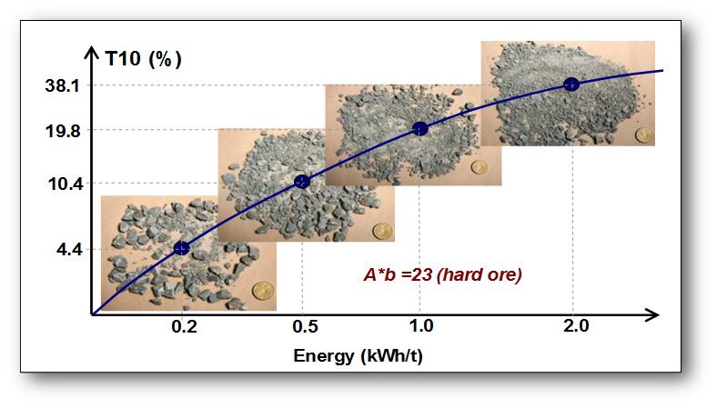
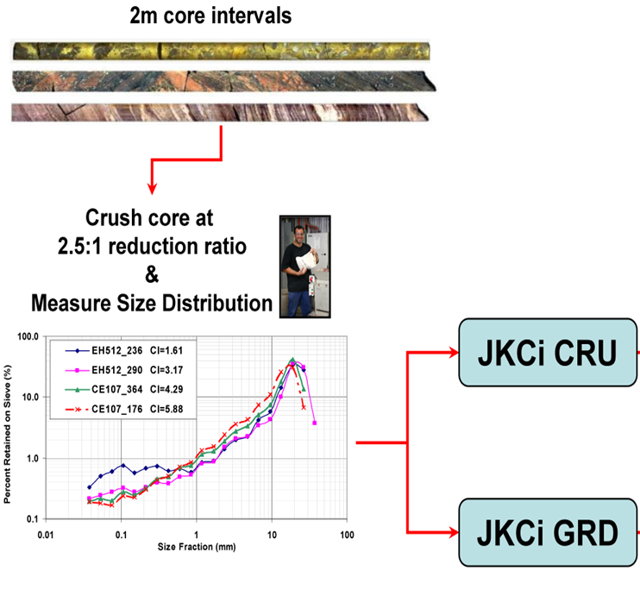
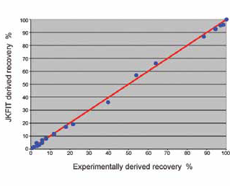

Met tests for variability vs composites
Rotary Breakage Tester
GeM Ci test
JKFI and MSI

Slide 17
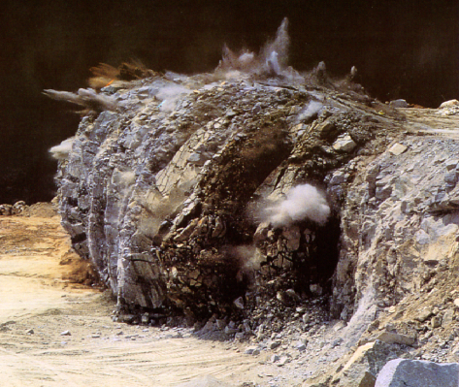

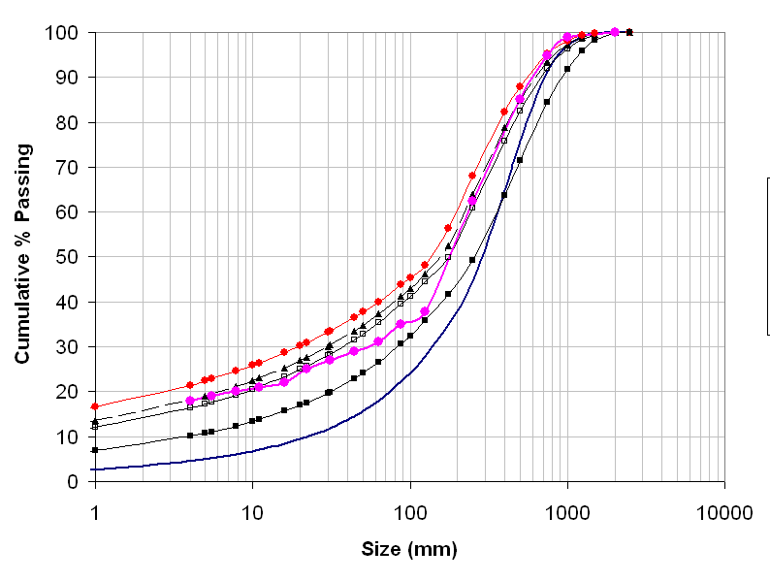
Blasting variability for mill
Blasting scenarios
SAG Mill
HPGR

Slide 18
Comminution variability by lithology
SAG Plant
HPGR Plant

Slide 19
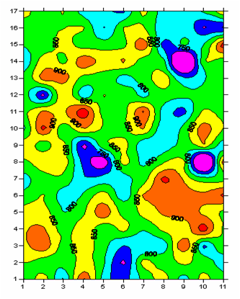

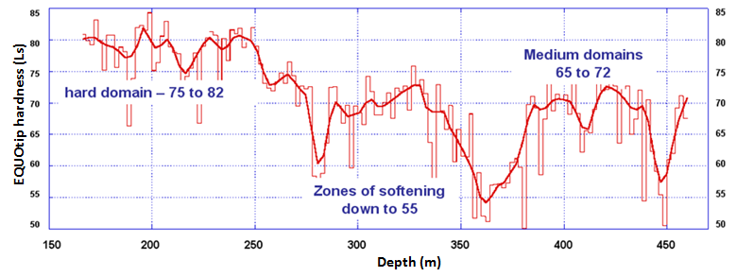
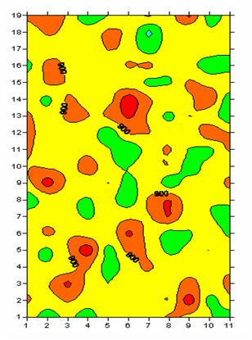
Spatial understanding
eg Equotip
1cm x 1cm grid
(From AMIRA P843)

Slide 20

Spatial 3D domains
Grade
Distribution of lithology and facies
Distribution of weathering and alteration
Mineralogy
Structural – geotech
Spatial distribution of met variables
Sampling and analytical precision

Slide 21
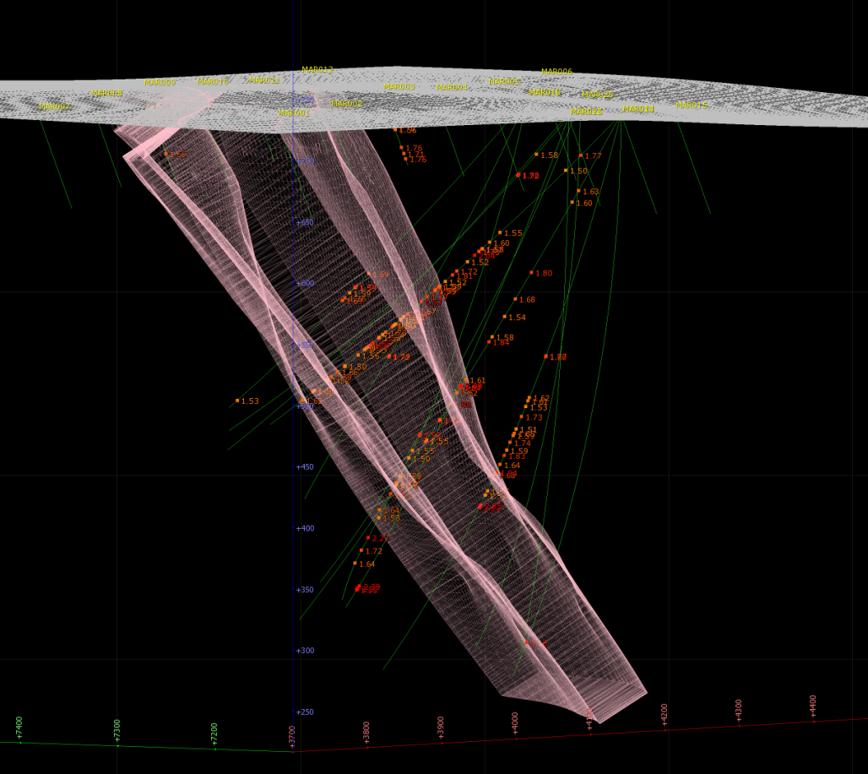
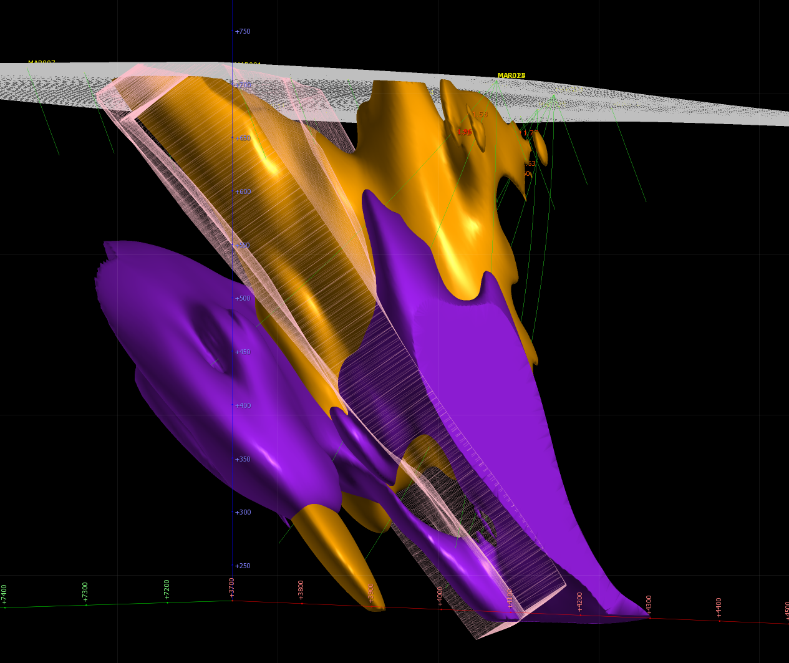
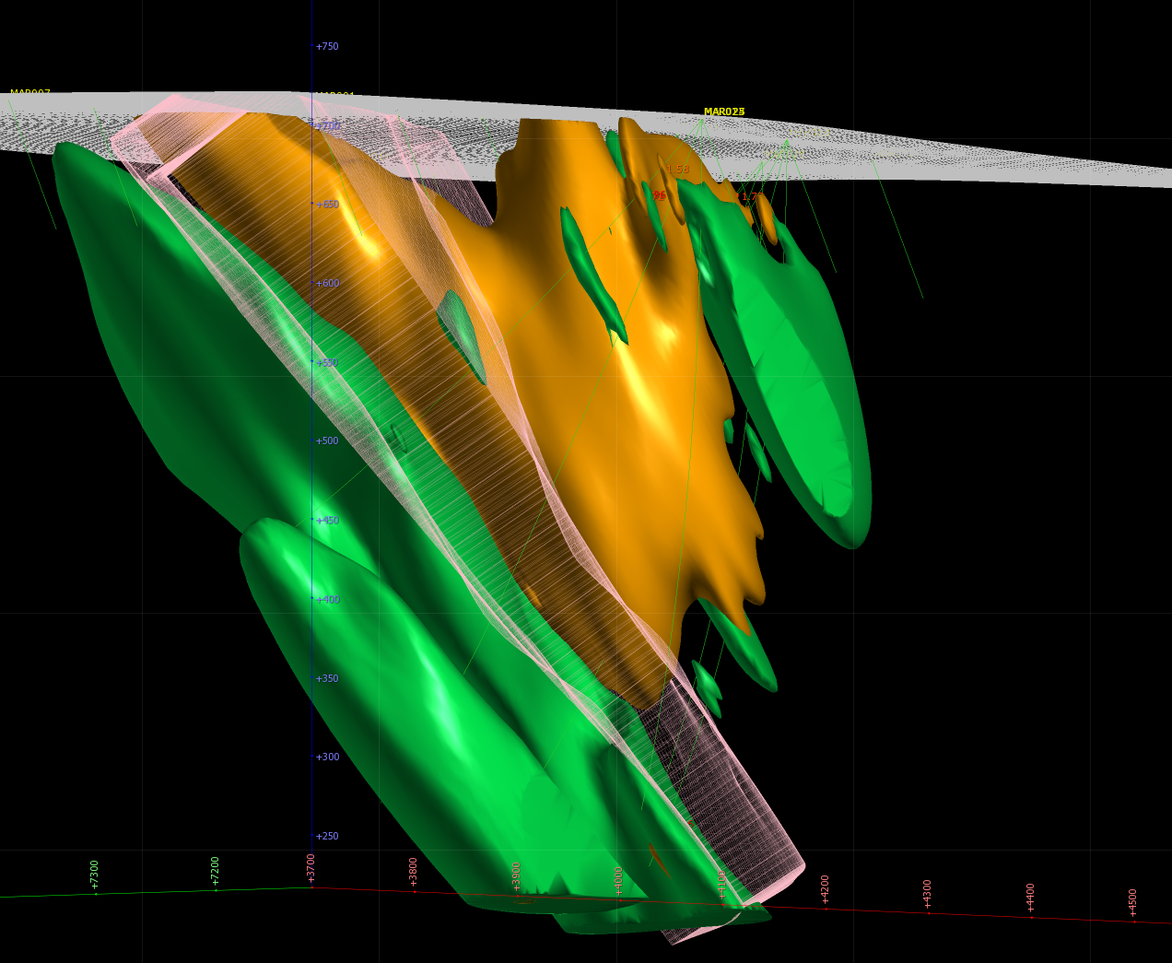
Gain spatial understanding of geological controls
Au assay
Au >40% locked in py
clay

Slide 22
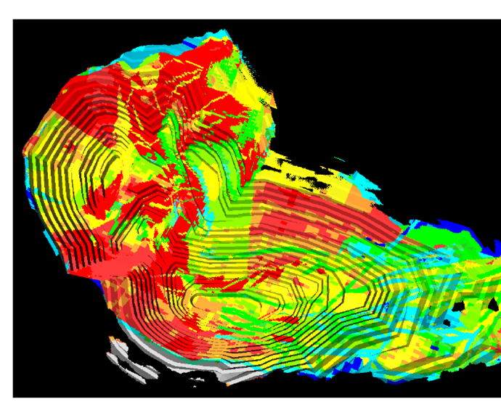
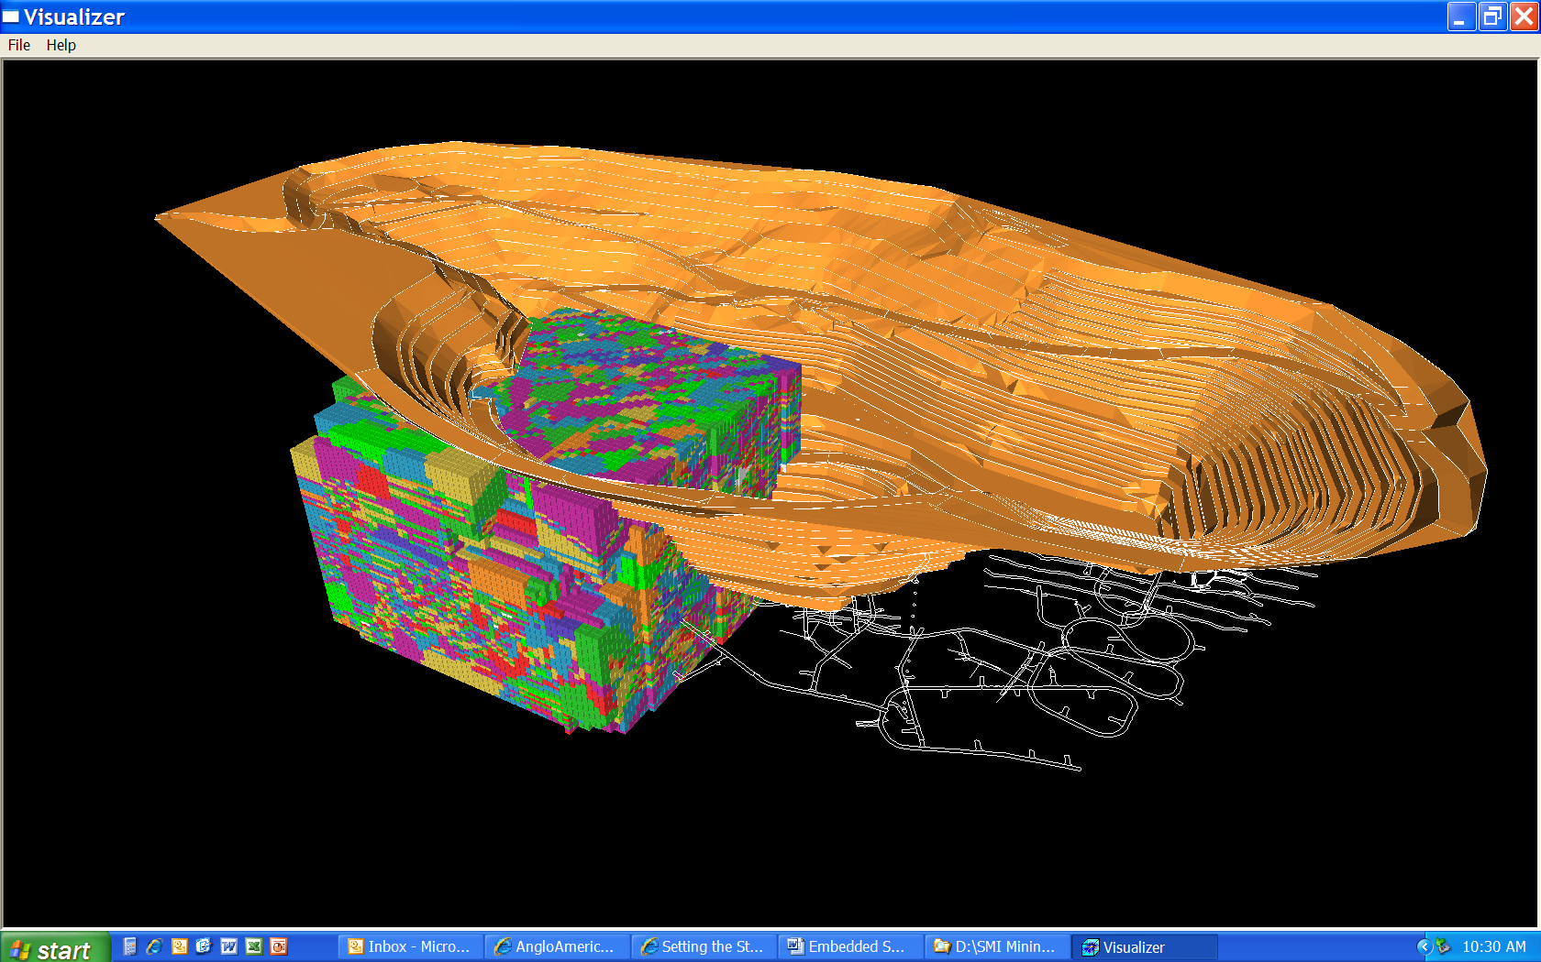
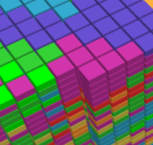
Planning: Attributes into Block Model
Each Model Cell to Contain
Intrinsic Rock Properties
Performance Attributes
Performance Parameters

Slide 23
Predict …. Plan …. Manage
PREDICT process performance
Recognize variability and geological drivers
Model relationships among attributes
Interpolate throughout mineral deposit
PLAN proactively
Integrate into mine plan and scheduling
Reduce uncertainty
Improve performance
MANAGE impacts
Understand and control environmental consequences
Reduce overall project risk
Recognize financial value through NPV and IRR options

Slide 24
Back end:
Variability and environmental impact
Acid rock drainage:
  Predict acid potential and neutralization potential
  mineralogy: total sulfides, carbonates, silicates
Metal deportment (eg Cd, Sb, As, etc)
  Predict where metals are concentrated and liberated
  mineralogy: sulfide species

Slide 25
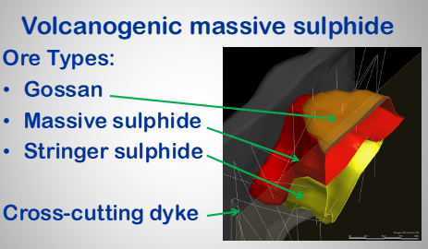
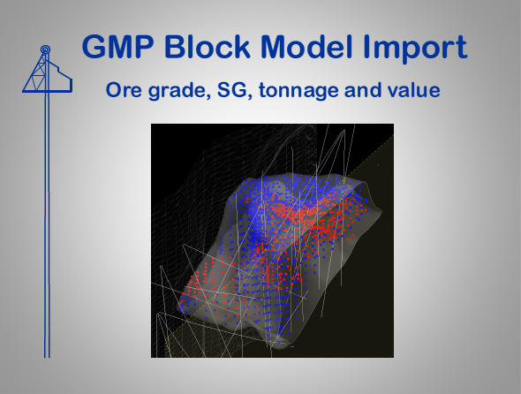
Modelling geology and grade
Ore grade
SG
Tonnage
Value
Knight et al., 2011

Slide 26
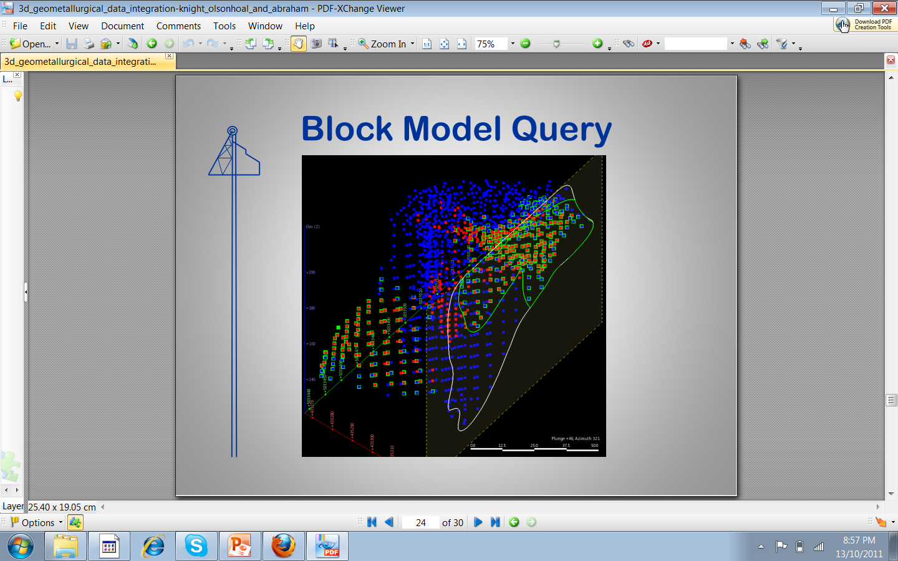
Resource-calculated ore with problematic Cd, As, Sb contents
Knight et al.
Is it still “ore”?

Slide 27

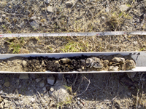
Stable Landforms and Sustainable Substrates
Effective store-release cover design for containment of waste
Remediation of problematic soil conditions, Yarraman mine
Options and strategies for tailings revegetation
Organic matter in mine rehabilitation and the carbon balance

Slide 28

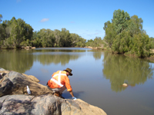
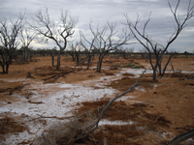
Water and contaminants in the landscape
Geochemistry of mine water in monsoonal climates
Lead pathways study
Acid mine drainage and geochemistry, Croydon Mine
Rehabilitation of oilfield brine impacts in an arid environment

Slide 29

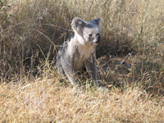

Ecosystem Structure and Function
Restoration of brigalow plant communities on degraded landscapes
Potential impacts of subsidence on the Newness Plateau, Centennial Coal
Long-term monitoring and research strategies at North Stradbroke Island
Sustainability of koala populations in mining environments

Slide 30
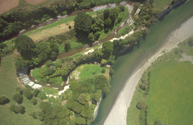
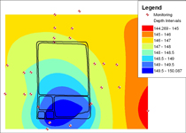
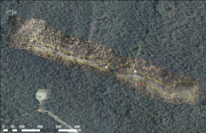
Monitoring and Mapping Technologies
SPOTing long-term changes in vegetation over short-term variability
Surface conditions of swamps subject to subsidence with high-resolution imagery
Mapping and validation of strategic cropping land
Spatial and temporal modelling for vegetation monitoring uncertainty

Slide 31
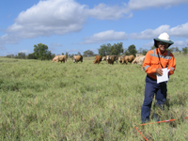

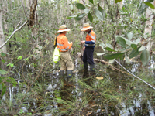
Mine closure and end-use planning
Closure strategy for tailings storage facilities
Risk assessment tools for post-mined line
Pre-operational rehabilitation research
Early ore body characterisation for the prediction of acid and metalliferous drainage

Slide 32
Mine closure and end-use planning
Closure strategy for tailings storage facilities
Risk assessment tools for post-mined line
Pre-operational rehabilitation research
Early ore body characterisation for the prediction of acid and metalliferous drainage

Slide 33
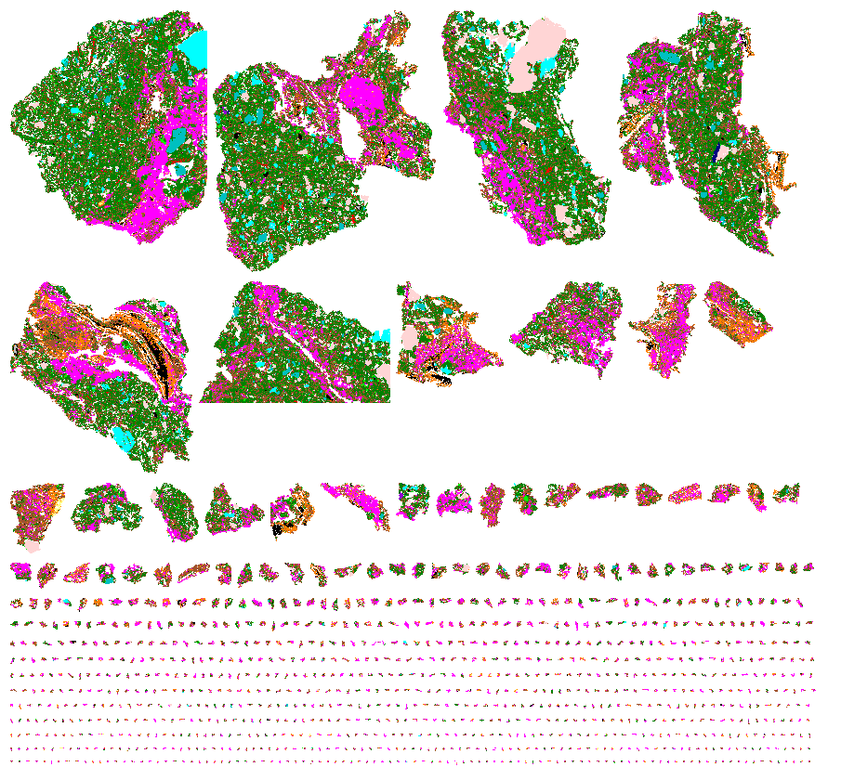
Same approach as for processing:
  Understand the mineralogical and geological relationships
  Locking, exposure to fluids, element deportment, bio-availability
Notes:
33

Slide 34
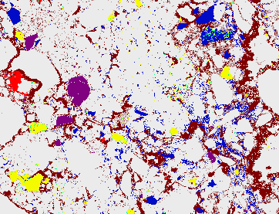
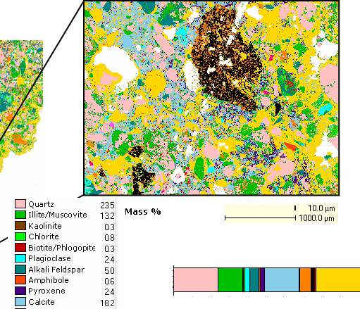
Mineral variability

Slide 35
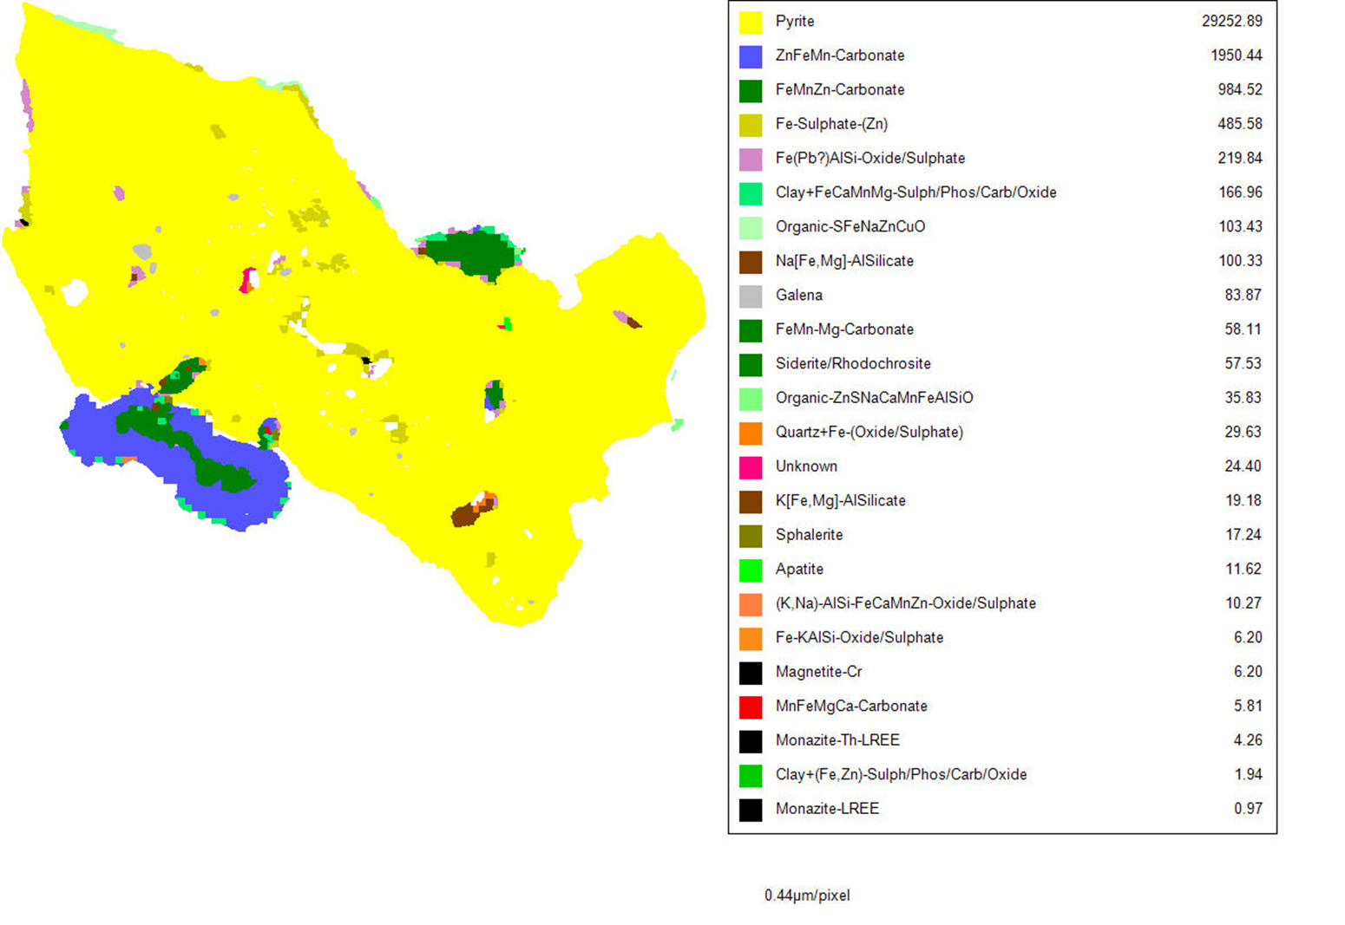
Prediction via mineral characterization

Slide 36
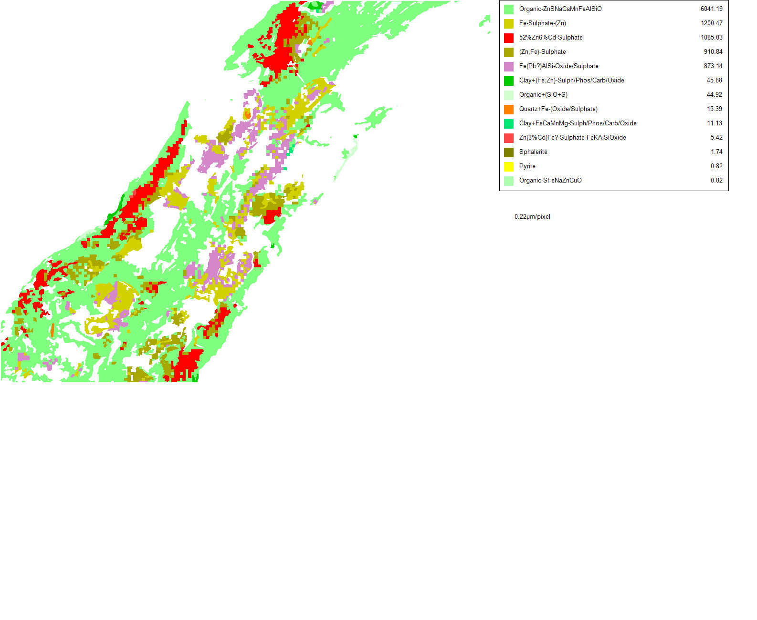

Slide 37
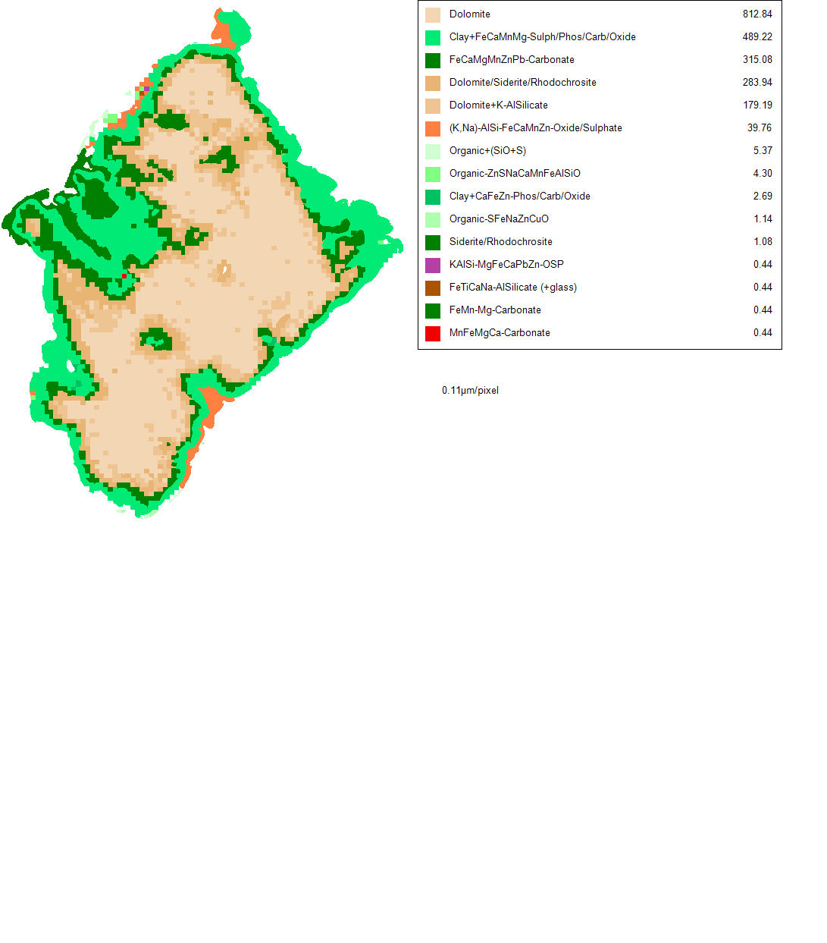
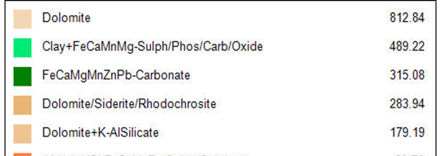
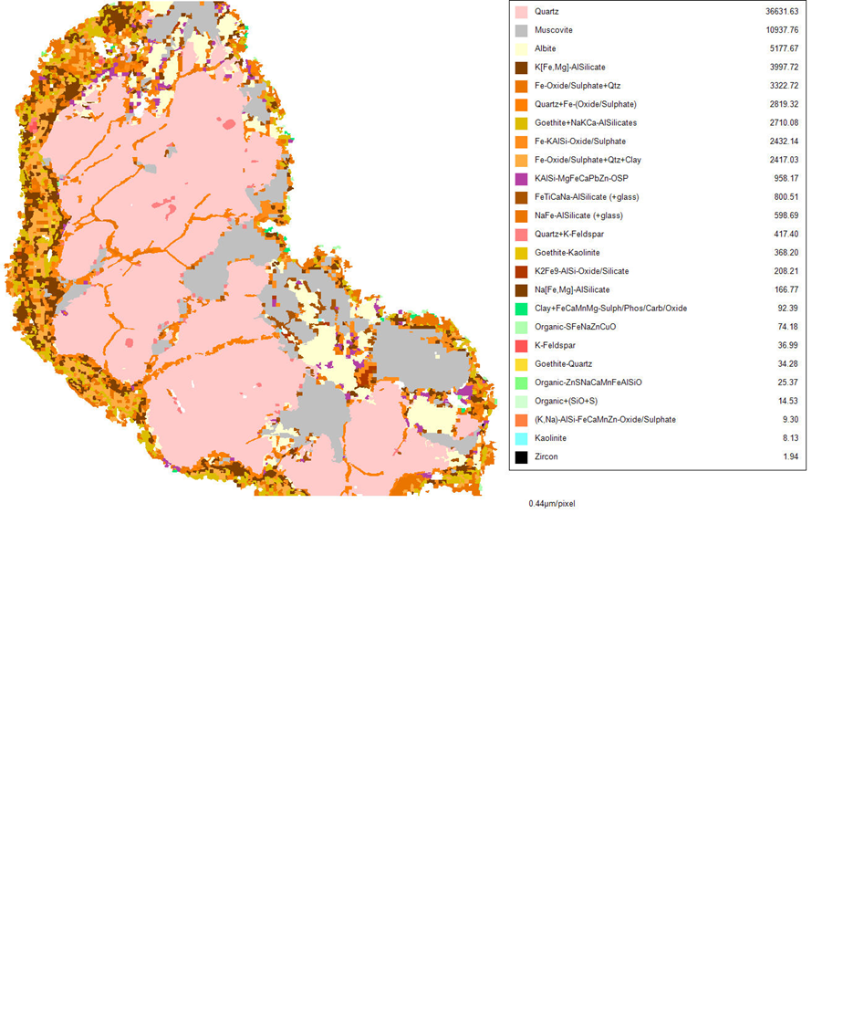
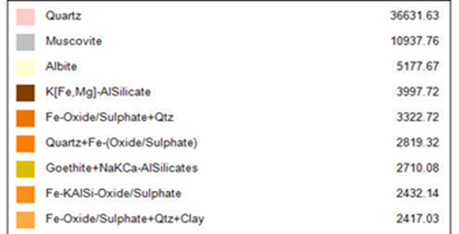

Slide 38
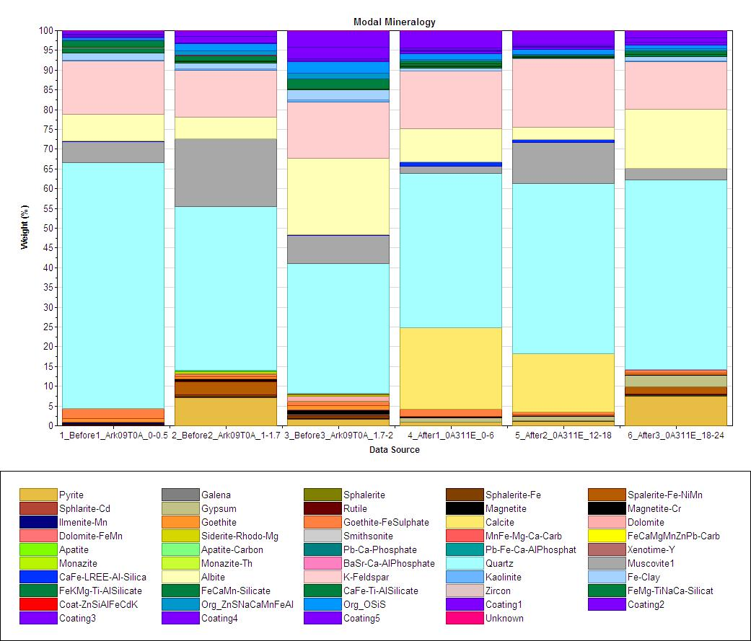
Before remediation ll After remediation

Slide 39

Application
Brownfields
Greenfields
SEE
SEE Lite
Sustainability & Extraction
Efficiency
LOM/Long Term
Planning
LOM/Long Term
Planning
Short Term Planning
Scheduling

Slide 40

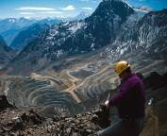
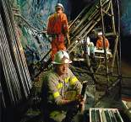
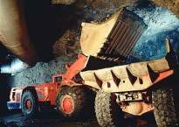
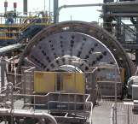
SEE: Sustainable extraction efficiency
Historical Mine to Mill Results
  cross-discipline (blast to S/AG Mill) intervention
  increases mill throughput in the short term
Geology-Mine-Plant Integration
  fully integrated predictive optimisation process
  considers key eco-efficiency attributes
  enables long-term improvements
- Metal tonnes - Cost ($/tonne) - Total Energy (kWh/tonne)
- Water (Ml/tonne) - Carbon Emissions (CO₂/tonne)

Slide 41
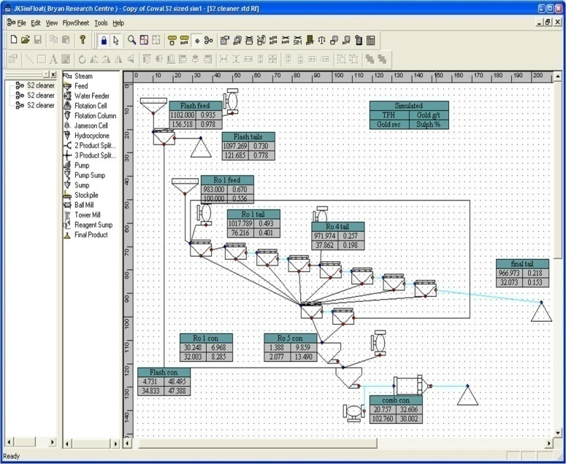






Putting it together
GeoMet Model

Slide 42
Energy impact
Flexible Circuits
kWh/t
% recovery
Notes:
Total with embodied = incl energy to make grinding media
Win win
Requires planning and flexibility

Slide 43

More effective project management

Slide 44


Impacting the cash flow
Uneconomic ore impacting cash flow
This illustrates the difference in cash flow predicted from a fully attributed GeM mine planning model versus the mines traditional ore reserve model. The variation is up to $50m per annum. This information leads to informed rescheduling to maximise value and minimise risk.

Slide 45
Predict …. Plan …. Manage
PREDICT process performance
Recognize variability and geological drivers
Model relationships among attributes
Interpolate throughout mineral deposit
PLAN proactively
Integrate into mine plan and scheduling
Reduce uncertainty
Improve performance
MANAGE impacts
Understand and control environmental consequences
Reduce overall project risk
Recognize financial value through NPV and IRR options

Slide 46
Life-of-mine geomet application
$ value
Closure
Reclamation
Geological model
Value
Locked in variable ore relationships
Team-based approach
Integrate data sets
Operating cost reduction
Risk mitigation
through life of project
Drilling
Core logging
Operations
QA/QC
Characterisation
data sets
Piloting
Geochemistry
Assay
Mine plan and
design
Mineralogy
Metallurgical
tests
Materials
Attributes

Slide 47


